Slide 1
What’s a system?
SAD 2019 - Lecture 2
Dave Stikkolorum
Michel Chaudron
Most images are derived from https://openclipart.org/

Slide 2
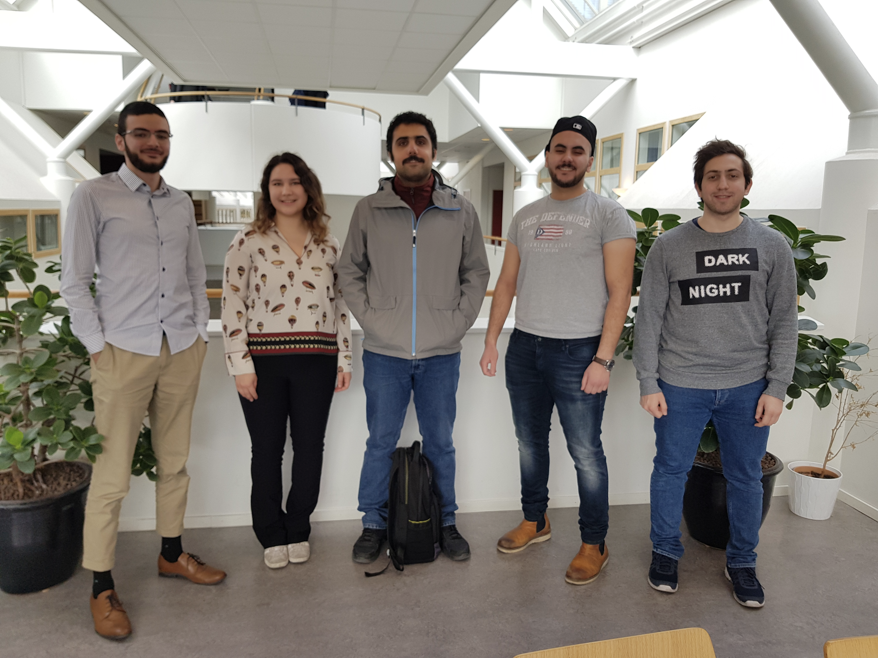
Presenting the TAs
Rashad, Ameera, Omid, Majd, Yazan

Slide 3
Global Learning Goals L2
Understand how we look at systems.
Understand a system is build with building blocks that have a responsibility
Introduction of objects and object orientation

Slide 4
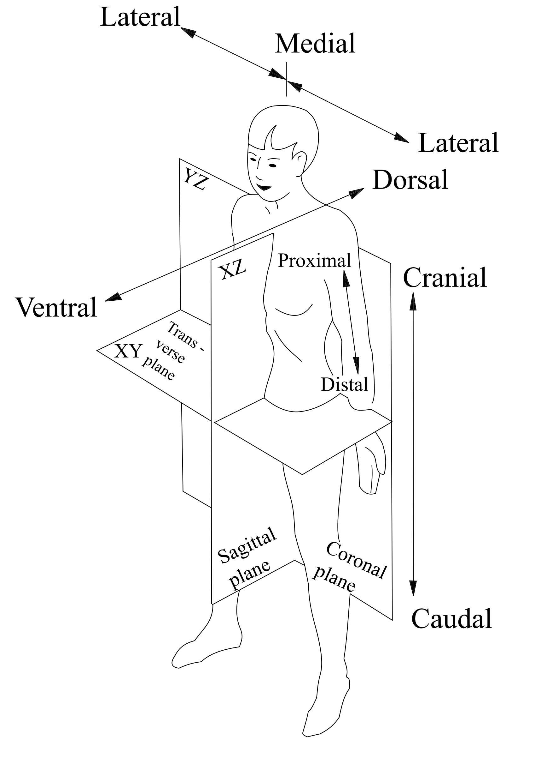
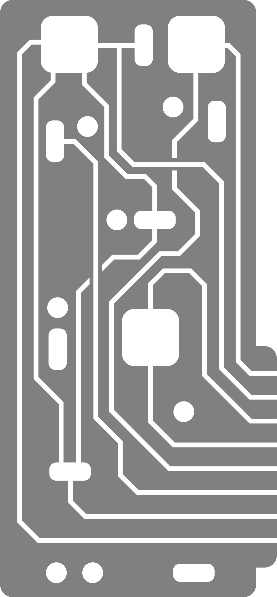
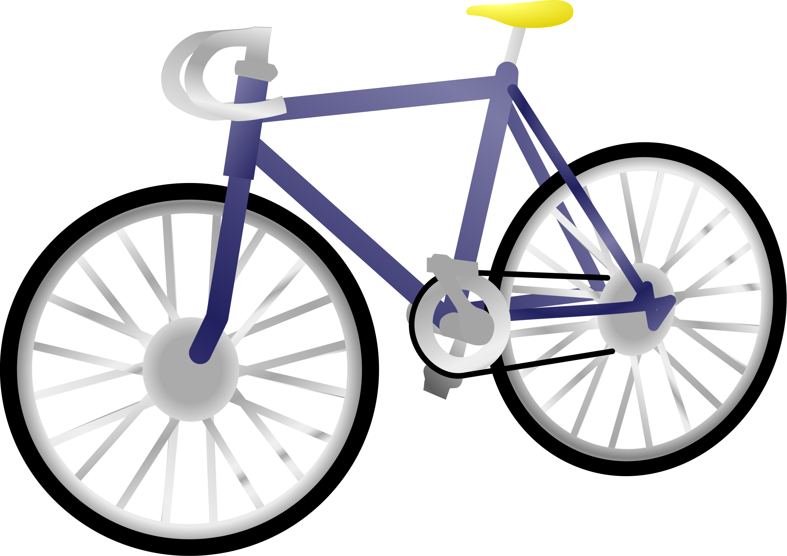
Which one do you think is a system?
[discuss for two minutes with you neighbour]
Notes:
Students discuss this question for two minutes.

Slide 5
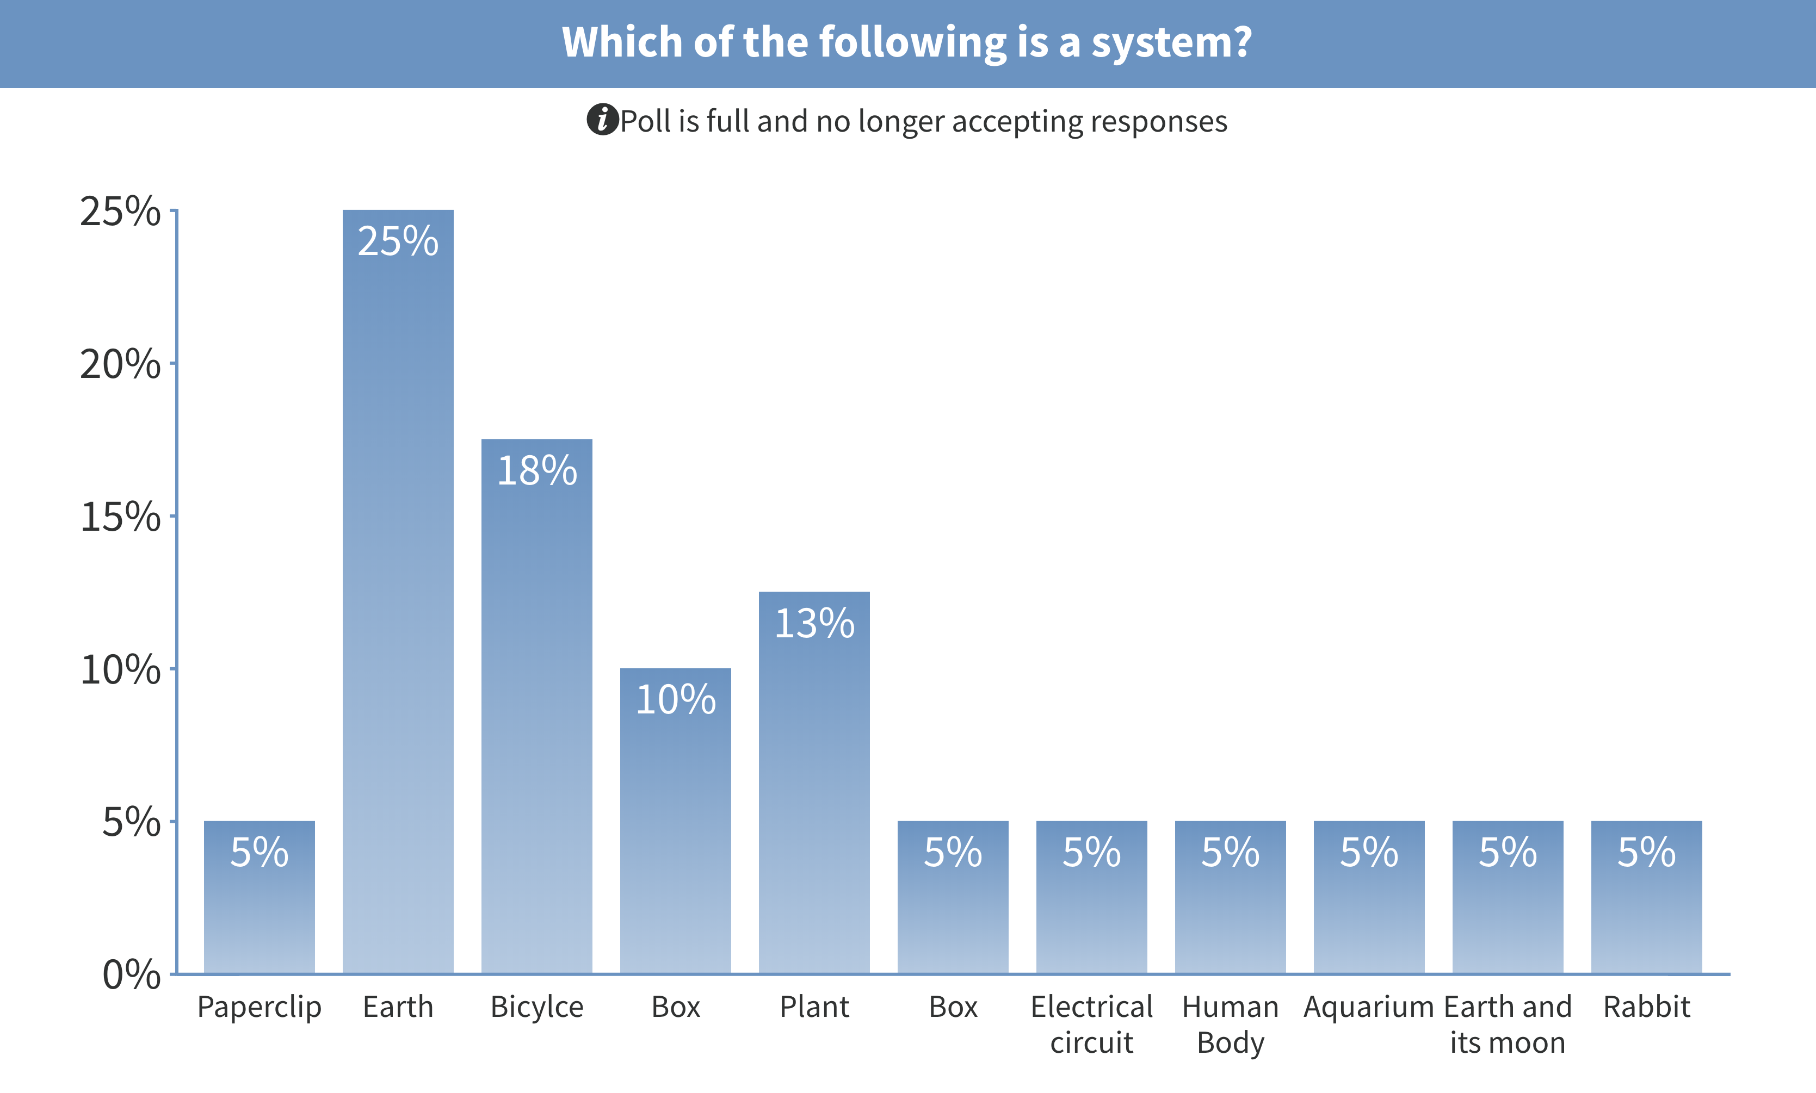
This image does not represent the students’
responses well because of technical issues

Slide 7
System
definition :
combination of interacting elements
organized to achieve one or more stated purposes [1]
Alt 1: interacting combination of elements to accomplish a defined objective [1]
Alt 2: set of interrelated or interacting elements [1]
Notes:
Note 1 to entry: A system is sometimes considered as a product or as the services it provides. In practice, the interpretation of its meaning is frequently clarified by the use of an associative noun, e.g., aircraft system. Alternatively, the word 'system' can be replaced by a context‐dependent synonym, e.g., aircraft, though this obscures the system perspective. A complete system includes all of the associated equipment, facilities, material, computer programs, firmware, technical documentation, services, and personnel required for operations and support to the degree necessary for self‐sufficient use in its intended environment.

Slide 8
System
system
Notes:
Note 1 to entry: A system is sometimes considered as a product or as the services it provides. In practice, the interpretation of its meaning is frequently clarified by the use of an associative noun, e.g., aircraft system. Alternatively, the word 'system' can be replaced by a context‐dependent synonym, e.g., aircraft, though this obscures the system perspective. A complete system includes all of the associated equipment, facilities, material, computer programs, firmware, technical documentation, services, and personnel required for operations and support to the degree necessary for self‐sufficient use in its intended environment.

Slide 9
System
(open) system
environment
Notes:
Note 1 to entry: A system is sometimes considered as a product or as the services it provides. In practice, the interpretation of its meaning is frequently clarified by the use of an associative noun, e.g., aircraft system. Alternatively, the word 'system' can be replaced by a context‐dependent synonym, e.g., aircraft, though this obscures the system perspective. A complete system includes all of the associated equipment, facilities, material, computer programs, firmware, technical documentation, services, and personnel required for operations and support to the degree necessary for self‐sufficient use in its intended environment.

Slide 10
Software System
system
software system
Program B
software
system
Program A
A software system is a kind of system
Program C
UML notation, explained later
Device I
Device II
Is a program also a system?

Slide 11
Software
Software (e.g. a program) is composed by parts

Slide 12
Modularity
This is a software design principle
definition:
“Degree to which a system or computer program is composed of discrete components such that a change to one component has minimal impact on other components” [1]
Notes:
Modular design, or "modularity in design", is a design approach that subdivides a system into parts, that can be independently created and then assembled into a system, and ideally reused in other systems.

Slide 13
Responsibilities
“A responsibility is an obligation to perform a task or know information” [2]

Slide 14
Responsibilities - System level
Booking System
System
Program
Booking Frontend
Part
Booking Logic
What’s the responsibility?
DataBase

Slide 15
Responsibilities - Program level
Booking Frontend
What’s the responsibility?
System
Program
Booking Gui
Calender
Part
…...
Printing

Slide 16
Responsibilities - Part level
What’s the responsibility?
Booking Gui
System
Form
Window
Program
Part
…...
…..

Slide 17
Responsibility driven design
A software application (program) consists of interacting objects (building blocks)
Objects have a responsibility or have a subresponsibility (a complex responsibility is divided over multiple objects)
Application
Object (to be discussed further)
Part

Slide 18
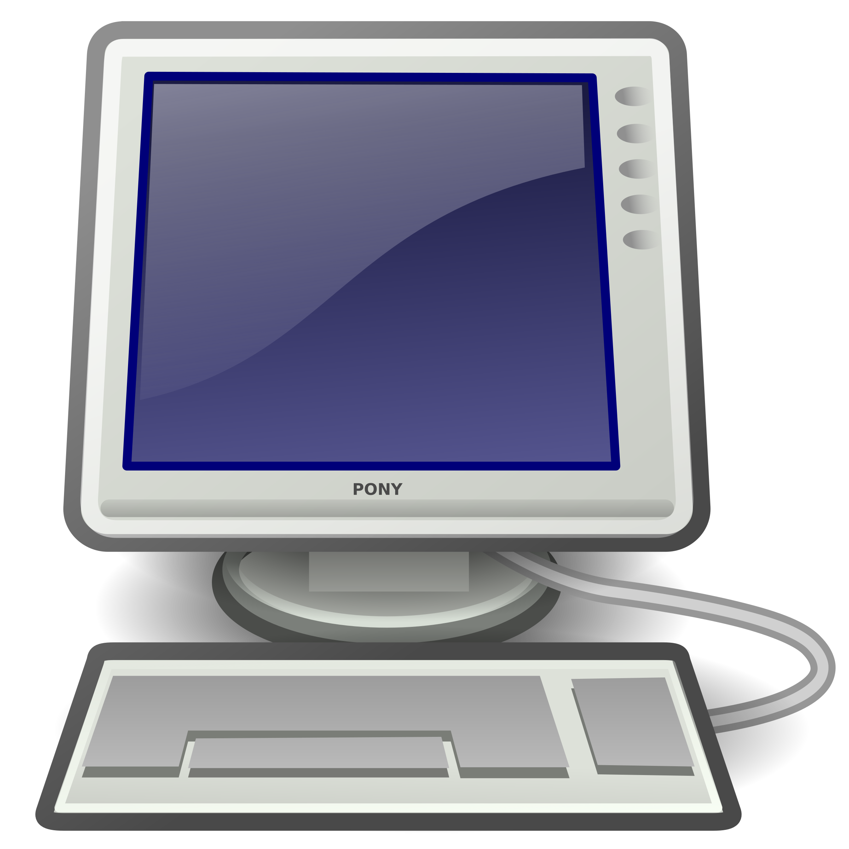
Object-orientation
Object-orientation looks at the world in terms of objects.
The world is seen as a composition of interacting objects.
Notes:
How far we have to dive into OO at this moment?

Slide 19
What’s an object?
[Bennet: chapter 4]
L1: Lecturer
Dave, 25, can teach
name = “Dave”
age = 25
teach()
C1: Computer
processor = “Quad-core”
Memory = “16GB”
Quad-core, 16GB, can render video’s
renderVideo()
Objects in UML notation

Slide 20
Object-orientation
Object-orientation can be used in the several stages of the SDLC*.
Planning
SAD Course MAIN Focus
Analysis
Express the problem with objects derived from parts of the real world
Design
Design the solution with relevant objects from the problem domain and objects from the solution domain
Implementation
Use an object-oriented technique such as object-oriented programming (OOP) with Java to implement the solution
*there are a lot of different views on development phases
Notes:
How far we have to dive into OO at this moment?

Slide 21
Object-orientation
Problem domain: identify objects (parts of the problem). Objects carry a responsibility. Objects have properties and behaviour.
Example: a car, a Tesla, moves from one city to another (responsibility: transport)
Solution domain: organise the (software) in objects. Objects carry a responsibility. Objects contain data (properties) and logic (behaviour).
Example: a form collects name and address and sends it to a database.
C1: Car
brand = “Tesla”
move()
F1: PersonForm
name = “Dave”
address = “Secret”
submit()
Notes:
How far we have to dive into OO at this moment?

Slide 22
Object Responsibilities - Roles
(software) objects can have various roles [2]:
Controller: decision maker, directs the action of other objects Coordinator: delegates tasks based on events Information Holder: knows and provides information Interfacer: transformer of informations, places request to others Service Provider: offers computing services Structurer: maintains relationships between objects

Slide 23
Object-orientation - Key Concepts
Classes (blueprint of an object) and objects
Encapsulation: combining data and logic into 1 object
Information hiding: hides implementation details for other parts of the program
Methods: implementation of objects behaviour (e.g. drive(), teach())
Messages: information that is sent to trigger an object’s method
Inheritance: base new classes on, more general, other classes
Polymorphism: different objects act on a message because of a shared abstraction (dynamic binding)

Slide 24
Object-orientation - Key Goals
Object-oriented analysis and design should deliver a higher quality software in terms of:
Maintainability
Extensibility
Expandability
Reuse

Slide 25
Object-orientation - Analysis and Design
Problem Domain
Application
??
Object-oriented analysis and design is the process of 1) identifying the problem, 2) identify possible solutions and define requirements, 3) design with an object perspective 4) implement with an object perspective

Slide 26
Practical Assignments
Pairs
6 (every other week)
Pass 5 out of 6
1 submission + 1 resubmission per assignment within 2 weeks after the feedback
Top 5 will be published after 4 weeks
Course grade = Exam grade when practical is passed

Slide 27
References
ISO/IEC/IEEE International Standard - Systems and software engineering--Vocabulary," in ISO/IEC/IEEE 24765:2017(E) , vol., no., pp.1-541, Aug. 28 2017
Wirfs-Brock, Rebecca; McKean, Alan (November 2002). Object Design: Roles, Responsibilities, and Collaborations.
Object-Oriented Systems Analysis and Design Using Uml, Bennet et al. (4th edition)

