Slide 1
Software Analysis & Design SAD 184
Spring 2018 edition
Prof. Dr. Michel R.V. Chaudron
Dave Stikkolorum

Slide 2
Outline
Introductions
Logistics of the course
Learning Objective
Modeling and Abstraction
Summary

Slide 3
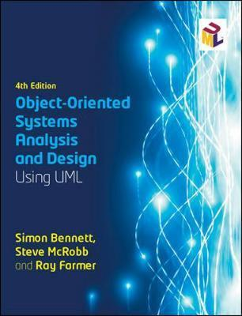
Mandatory Reading
Title:
Object-Oriented Systems Analysis and Design Using UML 4th Revised Edition
Authors:
Simon Bennett & Ray Farmer
Research papers:
Characterizing Classes, IEEE Software, by Rebecca Wirf-Brocks
More to be announced

Slide 4
Schedule - part 1
week | 13 |  |  | 14 |  |  | 15 |  |  | 16
day | tue | thu | fri | tues | thu | fri | tue | thu | fri | tue
 | 26 march | 28 march | 29 march | 2 april | 4 april | 5 april | 9 april | 11 april | 12 april | 16 april
 | Michel |  |  |  | Michel | practical (MC) | Michel | Michel |  | (MC traveling)
 |  | Dave | Dave |  |  |  |  |  |  | Dave
 | TA's |  | TA's |  |  | TA's | TA's |  | TA's | TA's
topic | 1 | 2 |  |  | 3 |  | 4 | 5 |  | 6
 |  |  |  |  |  |  |  |  |  | seq
 |  |  | Ass 1 |  |  | Ass 2 |  |  | Ass 3
 |  |  | Design Skill test
 |  |  | Pair-modeling
During supervision hours you can work in pairs on practical assignments
12.1 = Lecture
S = Supervision

Slide 5
Schedule - part 2
 |  | 19 |  |  | 20 |  |  | 21 |  |  | 22 | 23
thu | fri | tue | thu | fri | tues | thu | fr | tue | thu | fri | tue | fri
2 may | 3 may | 7 may | 9 may | 10 may | 14 may | 16 may | 17 may | 21 may | 23 may | 24 may | 28 may | 7 june
 |  | Michel | (ques-tion hour?) |  | Michel |  |  | Michel | Michel |  | No Michel (ICSE)
Dave | Dave |  | no Dave | no Dave |  | Dave | Dave |  |  |  |  | Dave
 | TA's | TA's |  | TA's | TA's |  | TA's | TA's
7 |  | 8 |  |  | 9 | 10 | 11
state machines |  | Design Princ 1 |  |  |  | Princ & Patt | workshop Agile UML |  | recap |  |  | exam
 | Ass 4 |  |  | Ass 5 |  |  | Ass 6

Slide 6
Lectures Outline – Part 1
Lecture | Topic
L1 | Introduction (course logistics, scoping, …) Design Process (Analysis & Design) Modeling in general
L2 | Systems/Responsibilities/Roles,Components, Objects & Object Orientation
L3 | The Problem Domain (Analysis): Context diagram, Stakeholders, Use Cases
L4 | Domain Modelling with Class Diagrams (Analysis / Finding Objects)
L5 | CRC cards
L6 | Collaborations / Internal and external interaction with sequence diagrams / State Machine Diagrams / Activity Diagrams

Slide 7
Lectures Outline – Part 2
Lecture | Topic
L7 | State machines & Activity Diagrams
L8 | Going from Domain to Technical Design (more depth/detail on UML notation), layering Component Diagram (part 1)
L9 | Going from Domain to Technical Design (more depth/detail on UML notation), layering Component Diagram (part 2)
L10 | Agile development with UML Agile Software Development Workshop (part 1)
L11 | Recap Design Principles and Design Patterns

Slide 8
Rules
NB Signing up for written hall examinations is mandatory. If you haven’t signed up, you will not be able allowed to take the exam and will have to wait until the next re-sit examination period.
GU students; You find information about how to and when to sign up on the CSE’s pages on the GU Student Portal.
https://studentportal.gu.se/english/my-studies/cse/Examination/
Chalmers students; You find the information about how to and when to sign up on the Student Portal at Chalmers. https://student.portal.chalmers.se/en/chalmersstudies/Examinations/Pages/how-to-sign-up.aspx

Slide 9
Rules
No laptops or phones during lecture
Please pay attention to me
Do no distract your neighbours
Or yourself
Evidence: better learning experience when you write your notes.

Slide 10
Learning Objective of this lecture
Understand:
Domain Analysis
Context diagrams
Stakeholders
Use Cases

Slide 11
What is System Analysis?
Identify main concepts in problem domain and their interrelations
Includes:
Eliciting and understanding requirements
Scoping of system context
Defining main concepts

Slide 12
Domain Analysis
Domain analysis is the process of
identifying,
collecting,
organizing,
analysing, and
representing
a domain model

Slide 13
Domain Analysis - Booch
“Domain Analysis is the formation of a vocabulary of the problem domain”
D.A. has elements of discovery of key concept
D.A. has elements of organizing/grouping

Slide 14
Typical things to look for in Domain Analyis
Things:
books, libraries, garage, … (concrete) order, payment, reservation, … (abstract)
Actors:
Persons, but also roles, organisations, …
Patient, doctor, driver, author, seller, sensor,
Properties of things/actors:
colour, location, name, amount, volume, currency, …
Relations between things:
is a, part of

Slide 15
Typical things to look for in Domain Analyis
Actions/Events & relations between them:
repair, pay, order, failure, turn, eat, move, … (atomic)
causal relations between actions:
passed deadline causes fine
Processes = relations between actions/events
(business) processes, information flows, control flows, …

Slide 16
Domain Analysis Case
University course-administration system
Concept:
Course
Lecturer
Student
Book
Exam
Schedule

Slide 17
Domain Analysis Case
University course-administration system
Student
Book
Course
Lecturer
Exercise
Exam
Lecture
Schedule

Slide 18
Domain Analysis Case
University course-administration system
registers
Student
has
has
Book
Course
Lecturer
has
mentions
is_part_of
is_part_of
is_part_of
Exercise
Exam
Lecture
Schedule

Slide 19
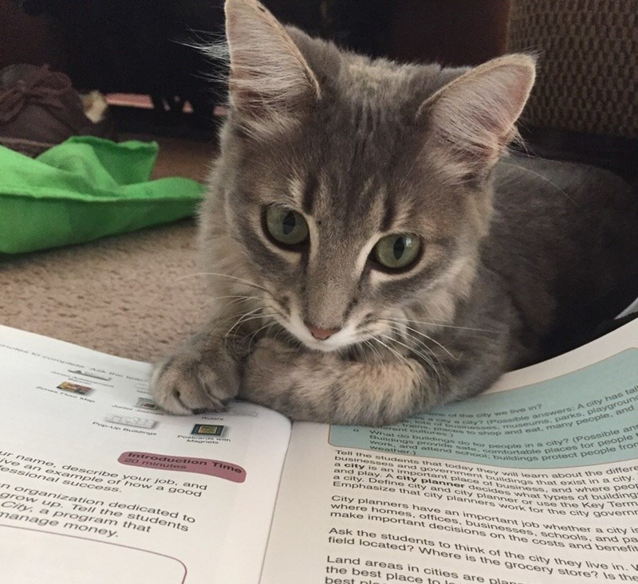
Domain Analysis Case
University course-administration system:
How about:
group?
grade?
students address? age? pet cat?

Slide 20
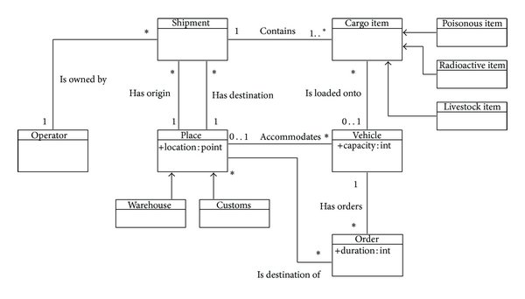
Domain Model Example

Slide 21
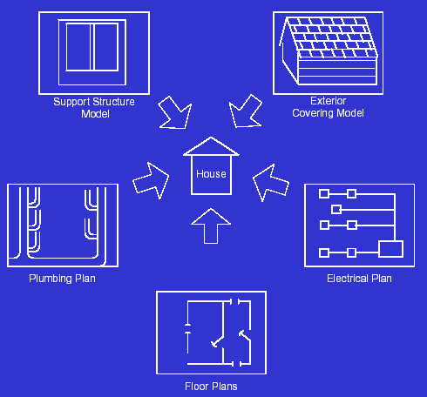
Software systems have multiple views

Slide 22
Example 4+1 Views model
Structure view: class/component-diagram
Development view
file ownership
Config. Mngnt view
versioning policies
…
A
B
Use cases
C
D
Behaviour view:
Sequence diagram
Deployment view:
physical model + mapping
A
B
C
D
A
C
D
B
TCP/IP over Ethernet
BC/WC e2e-response times, freq.
bandwidth, availability

Slide 23
1 Model = union of multiple views each view has one or more diagrams
System Model
Structural View
Class-diagrams
A
B
A
E
C
D
G
F
BehaviourView
Sequence diagrams
A
B
C
D
E
F
G
A
Use Case View
Deployment View
Development View

Slide 24
Domain Analysis Case
Also behaviour exists in domain – as illustration ….
Student
Course
Lecture
Exercise
Exam
enroll
attend
makes
attend
writes
Other modeling languages can be used for describing the behaviour(e.g. activity diagrams)

Slide 25
What makes a good analysis?

Slide 26
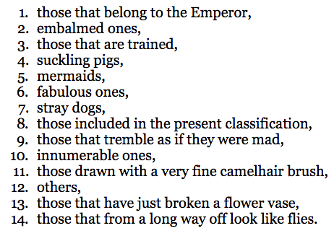
From: Jorge Luis Borges "El idioma analitico de John Wilkins"
“A certain Chinese encyclopaedia," likely fictitious, but attributed to Franz Kuhn, called the
Celestial Emporium of Benevolent Knowledge
said to divide animals into “

Slide 27
What makes a good analysis?
Correct Scope
Complete
Consistent
Systematic
Typically performed by an expert in the domain.
Domain analysist in finance/banking are not automatically good domain analysis in automotive.

Slide 28
Exercise
Create a domain model for the following case description:
It is Tuesday-afternoon and Sarah walks into the office of the SuperFly Travel Company on a Avenyn in Gothenburg. She opens the door and draws a ticket. Sara is 24 years also and would like to visit her grandmother Ana who is 77 years old and lives in Rotterdam. Sara is interested in booking a flight from Gothenburg to Amsterdam. When driving by road, the distance from Gothenburg to Amsterdam is about 1096 kilometers. From Amsterdam she will take the train to Rotterdam. Sara is known amongst her friends for being very flexible. However, she has a preference for pink airplanes.

Slide 29
Acquiring Domain Knowledge
Requirements Engineering
- documentation
- interviews
- observation of existing system/processes
- prototyping
- storyboarding
- ….

Slide 30
Model vs Diagram
Model
Systematic use of well-defined concepts and notation for representation (intent is to define)
Notation has consistent semantics (meaning)
Amenable to (automated) manipulation - such as simulation, analysis – based on meaning of model
Diagram
Choice of notation to support communication of content (intent is to communicate)
Notation may be informal, without consistent meaning
It is not just the appearance that distinguishes models and diagrams; more importantly: systematic use of semantics

Slide 31
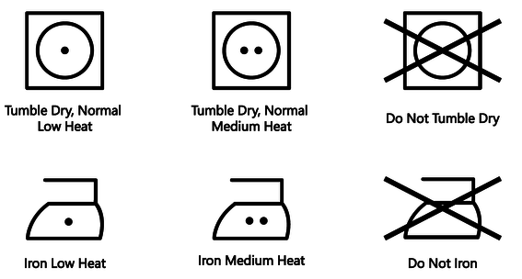
Model vs Diagram
In software modeling, we use icons that have a standardized meaning
Example of (non-UML) software symbols:
software

Slide 32
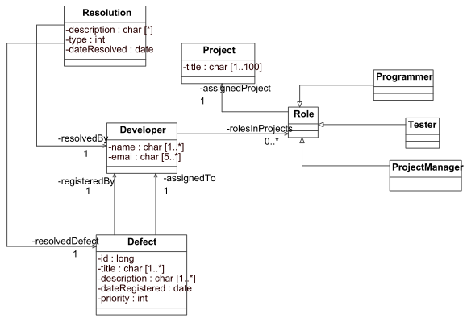
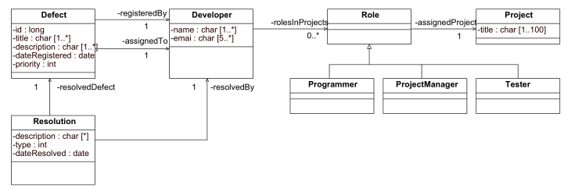
Model vs Diagram
A diagram is a graphical representation of a (part of a) model
Below are 2 different diagrams, depicting the same model
The diagrams on the right, has much nicer layout though!
A good layout helps in understanding and indicates a well-organized mind

Slide 33
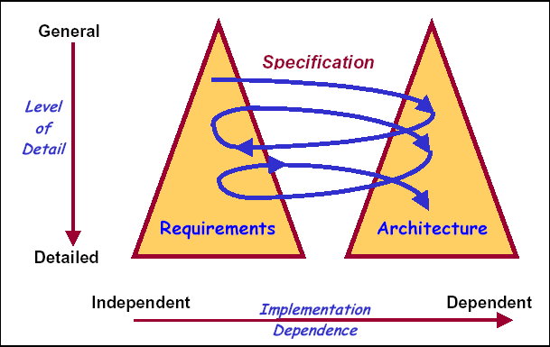
Twin Peaks Process
Separate but simultaneous development of
domain analysis (problem space) & solution space
WHAT:
problem
structuring
HOW:
solution
structuring
Progressing understanding of problem domain provides a basis for discovering further solution space and vice versa.
There is interaction between available solutions/technologies and the problem-domain
Notes:
For instance the structure of a hierarchy of requirements document follows the hierarchical structure of a system.
COTS influence what ultimate solution looks like.
Interaction allows to rapidly narrow down choices and accomodate COTS solutions.

Slide 34
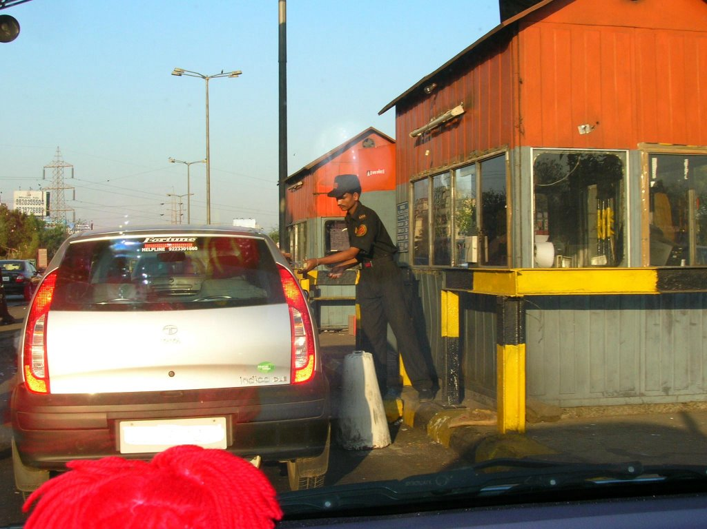
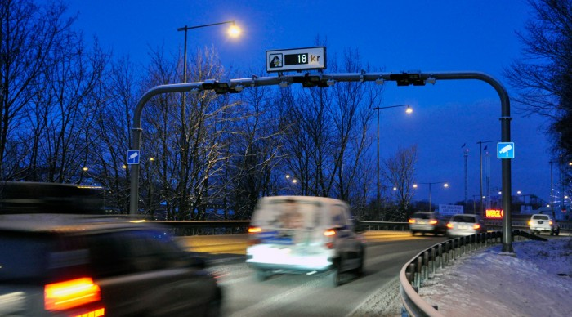
Road Toll Collection
What: collect toll-tax from vehicles that pass a certain point on the road
How (solution): manual or electronically.
Different high level solution decisions, affect the problem domain:
E.g.: license plate recognition, reliability, staffing, safety, …

Slide 35
Living ‘Documentation’
Panta Rei :
Everything Always Changes
Your domain will change, so you will need to update your domain analysis
And everything that depends on it….
This applies to all types of documentation.
Digital representations are easy to modify (and share)

Slide 36
(System) Context Diagram
A system context diagram (SCD) is a diagram that depicts the boundary between a system and its environment, showing the entities that interact with it.
Interacting entities can be different types of users or different types of interfacing systems

Slide 37
Context diagram
A context diagram depicts the system at the center, with no details of its interior structure.
label
label
External System 3
External System 1
System under Development
label
label
External System 2
actor / role
‘label’ describes the nature of the information that is exchanged

Slide 38
Context diagram
University course administration system
Government Student Financing System
registers
extracts
student
University Course Adm System
enter grades
enter grades
lecturer
Student administrators
‘label’ describes the nature of the information that is exchanged

Slide 39
Context diagram
Exercise: try for travel agency
Which are actors? Interfaces to External systems?
Travel Agency System
‘label’ describes the nature of the information that is exchanged

Slide 40
Context diagram
Exercise: try for travel agency
Flight Booking
pay
Hotel booking
customer
Travel Sales system
Payment system
book
Financial information
Travel-agent
Financial administrators
‘label’ describes the nature of the information that is exchanged

Slide 41
Another example
nice abstraction

Slide 43
Another example
This is becoming a bit complicated, I recommend to simplify by looking for abstraction

Slide 44
Why is a Sys Context Diagram useful?
It defines the scope of the system to be built
Which parts are included and which are not
The SCD indicates to which other systems interfaces need to be made
The SCD indicates to which types of users interact with the system
As such a SCD is made in the early stages of the development of a system and is typically part of a requirements document.

Slide 45
Stakeholders
‘‘4.16 Stakeholder: An interested party having a right, share or claim in the system or in its possession of qualities that meet their needs.’’
Draft Standard ISO/IEC 15288 (ISO/IEC 1999)
Customer:
solves problems at
User:
an acceptable cost in
easy to learn;
terms of money paid and
efficient to use;
resources used
helps get work done
Software
System
Development manager:
Developer:
sells more and
easy to design;
pleases customers
easy to maintain;
while costing less
easy to reuse its parts
to develop and maintain
Figure from: Lethbridge and Laganiere

Slide 46
Stakeholders

Slide 47
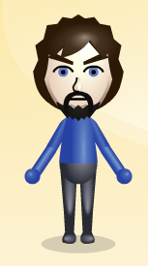
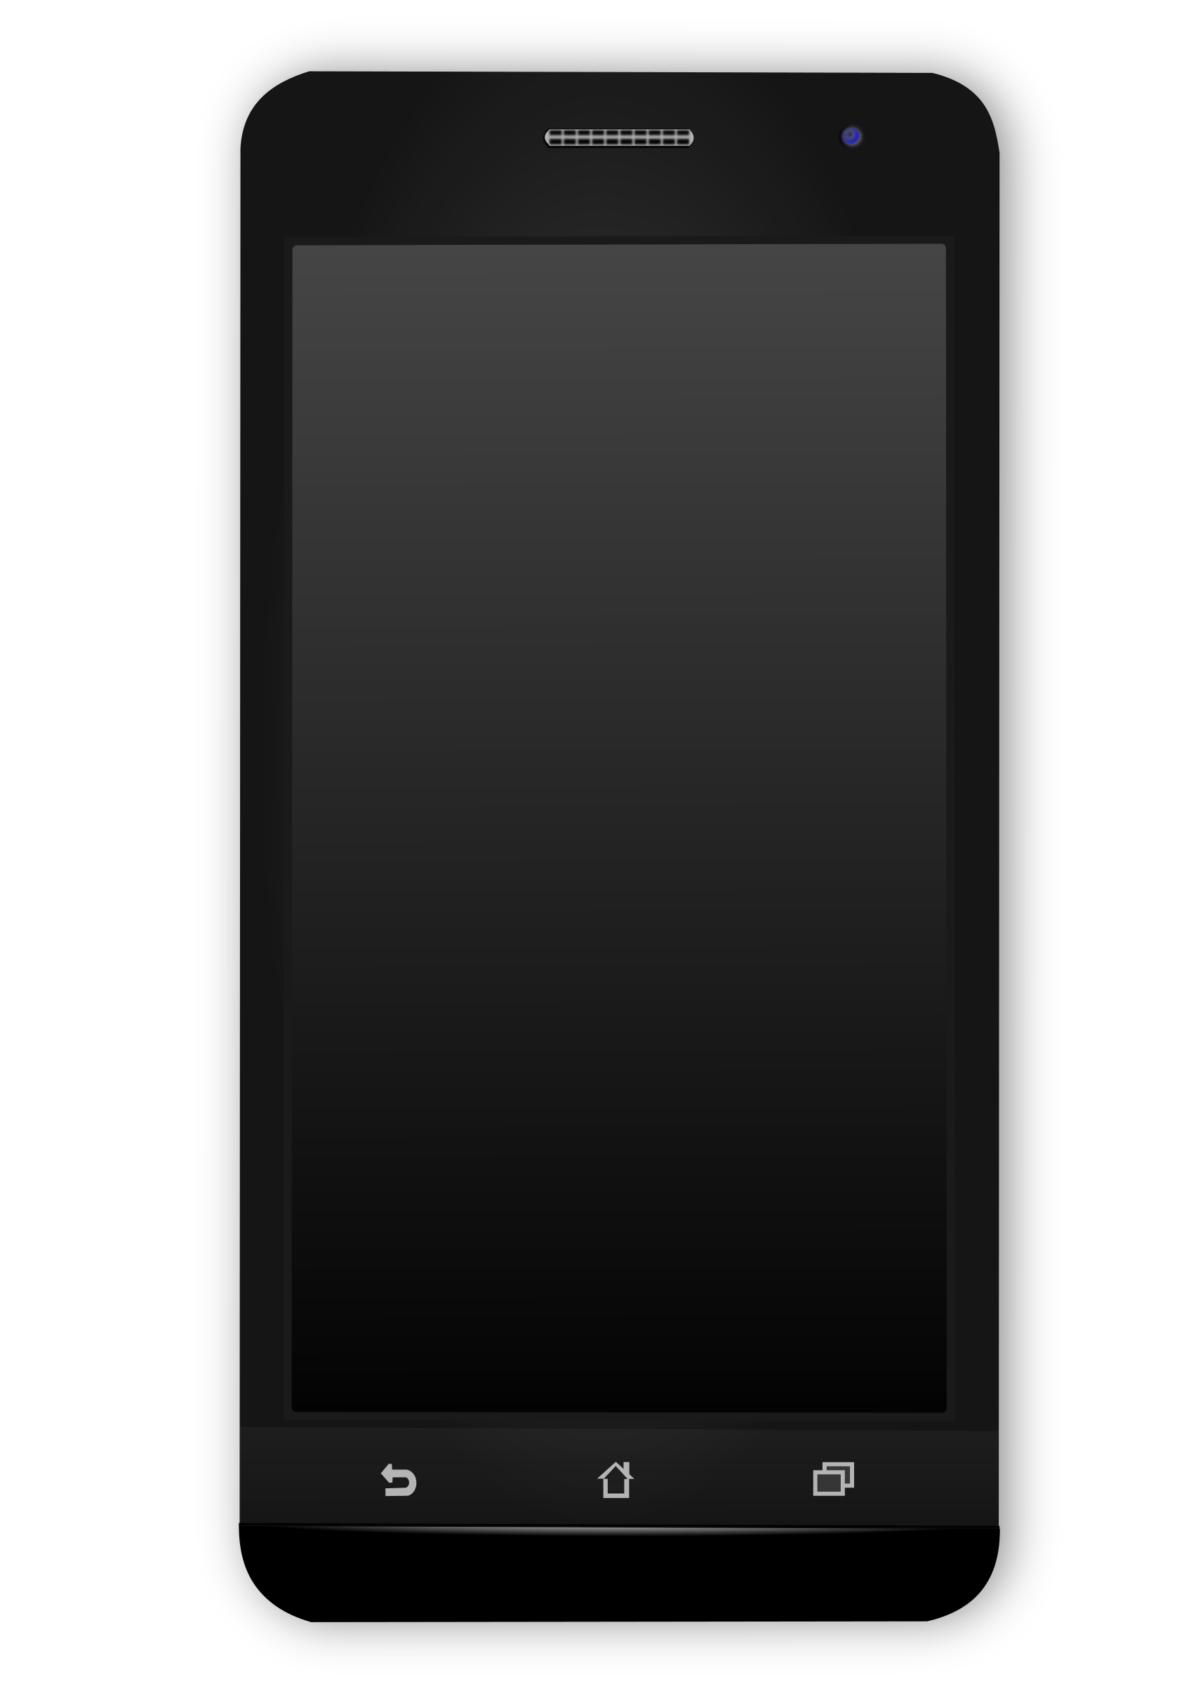
Requirements specification
Blood
Pressure
Running
Tracker
send

Slide 49
Use Case
Definition Use Case
Use Cases are descriptions of the functionality of the system from the perspective of the users.
Hence only using vocabulary/concepts from the ‘problem domain’
Use Case = Use Case Diagram + Use Case Story
A Use Case describes a user interacting with a system to achieve a goal [provide value to the actor].
The story focuses on interaction between user and system.

Slide 50
Use Case Diagrams
A use case diagram
Shows a set of tasks and actors and their relationships
Defines clear boundaries of a system
Identifies who or what interacts with the system
The System
Task 1
Use case 1
Use case 1
Actor 1
Actor 1
Actor 1
Actor 2
Task 2
Use case 2
Use case 2
Task 3
Use case 3
Use case 3
Actor 3
An actor can either be an individual or another system
Multiple actors can be involved in one use case

Slide 51
Notation of Use Case Diagrams
Communication
Use case (task)
association
Change a client
contact
Staff Contact
Actor
System or subsystem boundary (Subject)
Notes:
Fig. 6.5

Slide 52
Benefit of Use Case Diagrams
Simple diagram that can be understood by both business and technical
people.
This makes Use Case Diagrams important for communication between
people from the domain and IT-people.
Communication leads to joint understanding, clarification, identification of mistakes or missing requirements.

Slide 53
Naming Use Cases
A use case name should
Be unique, intuitive, and self-explanatory
Define clearly and unambiguously the observable result of value gained from the use case
Be from the perspective of the actor that triggers the use case
Describe the behavior that the use case supports
Start with a verb and use a simple verb-noun combination
Send Health Log
Measure distance

Slide 54
Use Case Diagrams: Extend relationship
used when one use case provides additional functionality that may be required in another use case
there may be multiple ways of extending a use case, which represent variations in the way that actors interact with the use case
extension points show when the extension occurs
a condition can be placed in a note joined to the dependency arrow (Note that it is not put in square brackets, unlike conditions in other diagrams.)

Slide 55
Extend relationship
Check campaign
budget
extension points
Summary print
«extend»
Condition {print option selected}
extension point: Summary print
Campaign Manager
Print campaign
summary
Notes:
Fig. 6.7

Slide 56
Include Relationship
Assign staff to work on a campaign
«include»
Find campaign
Campaign Manager
Notes:
Fig 6.8

Slide 57
Use Case Diagrams: Include relationship
used when one use case always includes the functionality of another use case
a use case may include more than one other
can be used to separate out a sequence of behaviour that is used in many use cases
should not be used to create a hierarchical functional decomposition of the system

Slide 58
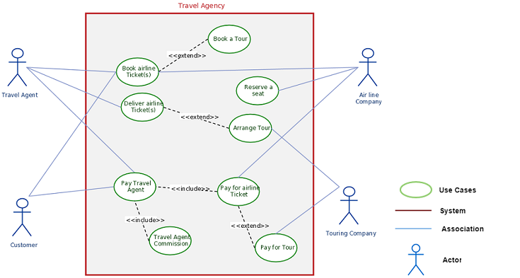
Examples of extends

Slide 59
Use Case Diagrams: Generalization
shows that one use case provides all the functionality of the more general use case and some additional functionality
shows that one actor can participate in all the associations with use cases that the more general actor can plus some additional use cases

Slide 60
Record completion
of an advert
Staff Contact
Change a client
contact
Assign individual staff to work on a campaign
Assign staff to work on a campaign
Campaign
Manager
Assign team of staff to work on a campaign
Notes:
Fig. 6.10

Slide 61
Use Case Diagrams
NO
temporal ordering
Car
Car
Start Car
Start Car
Use case 1
Use case 1
Driver
Driver
Actor 1
Actor 1
Actor 1
Actor 1
Drive Car
Drive Car
Use case 2
Use case 2
Park Car
Park Car
Use case 3
Use case 3

Slide 62
Use Case Diagrams
NO Functional Decomposition
Coffee Machine
Order Coffee
Use case 1
Driver
Actor 1
Actor 1
Fill with Coffee
Add Milk
Use case 2
Get Cup

Slide 63
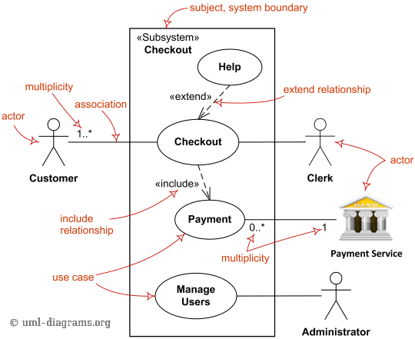
Extend relationship
Notes:
Fig. 6.7

Slide 64
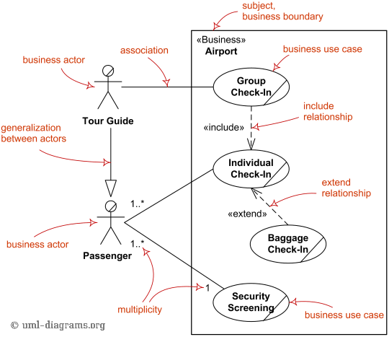
Example

Slide 65
Use Case Descriptions
Can be a simple paragraph
Assign staff to work on a campaign
The campaign manager wishes to record which staff are working on a particular campaign. This information is used to validate timesheets and to calculate staff year-end bonuses.

Slide 66
Use Case Descriptions
Can be a step-by-step breakdown of interaction between actor and system
Assign staff to work on a campaign
Actor Action System Response
1. The actor enters the client name. 2. Lists all campaigns for that client.
3. Selects the relevant campaign. 4. Displays a list of all staff members not already allocated to this campaign.
5. Highlights the staff members 6.Presents a message confirming
to be assigned to this campaign. that staff have been allocated.
Alternative Courses
Steps 1–3. The actor knows the campaign name and enters it directly.

Slide 67
Webshop Scenario: ‘Buy product’
Informal description:
Buy product online
1. Customer browses catalogue
2. System displays product details
3. Customer selects item to buy, goes to check-out
4. System displays shopping cart page
5. Customer fills in delivery information
6. System shows full pricing, including shipping
7. Customer fills in credit card details
8. System authorizes card, confirms sale on screen and sends email to customer
(Note that ‘Shopping cart’ and ‘email’ are real aspects of this use case, while the rest of the description is essential)

Slide 68
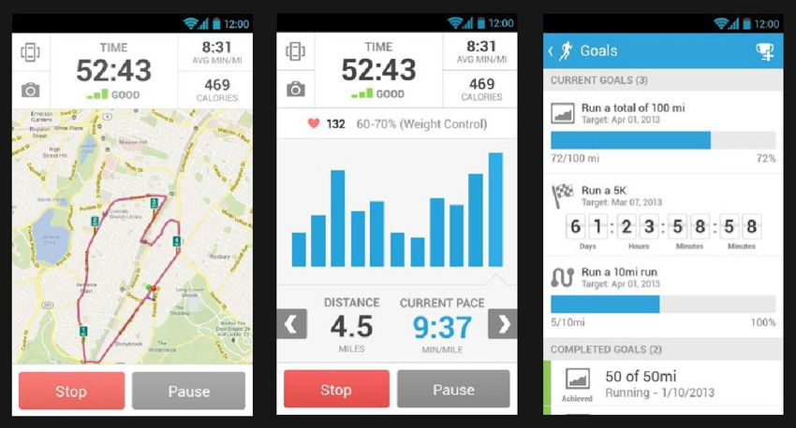
Phrasing of steps
Use the active voice
Say: “The Runner Runs home”
Say what triggers the step
Say: “The use case starts when the Runner chooses to burn fat”
Instead of: “The use case starts when the Runner decides to burn fat”
Say who is doing what (use the Actor name)
Say: “The Runner chooses …”
Instead of: "The user chooses …"
Say: “The System validates …”
Instead of: "The choice is validated …“
Do not make reference to the internal architecture / implementation.
Leave the user interface out of the use case (and focus on events).
Say: “the runner confirms the registration”
Instead of “the runner presses the OK button”

Slide 69
Avoiding UI Details
Good use cases are free from UI realization details.
Words to Avoid
Words to Use
Click Drag Form
Open Close Drop
Button Field
Drop-down Pop-up
Scroll Browse
Record Window
Prompts Chooses
Initiates Specifies
Submits Selects
Starts Displays Informs

Slide 70
Keeping Flows Concise
Define terms used in the project in a glossary, not in flows
Start early
Continue throughout the project
Glossary
Main Flow
…
5. Enter Runner Information
The system prompts the Runner to enter his/her Personal Details.
The Runner enters the Personal Details.
Glossary
Personal Details Information about the runner weight, age, and height. Info is used to compute BMI and to estimate the maximum heart rate.
Template: Glossary.doc

Slide 71
Optional Steps
Description also covers any alternative courses, and the triggers that initiate their execution:
Alternative course: Card fails to authorize
At step 8, system fails to authorize credit purchase.
Return to step 7, allow customer to re-enter credit card information, retry authorization.

Slide 72
Main scenario: ‘Book course place’
Book course place
1. Admin clerk retrieves scheduled course details
2. System displays number of places free
3. Admin clerk chooses ‘add delegate to a course’
4. System requests delegate details
5. Admin clerk enters delegate details
6. System stores details and confirms

Slide 73
Alternate course: no free places
1. Admin clerk retrieves scheduled course details
2a. System displays ‘no places free’
2a1. Admin clerk selects ‘search for dates with free places’
2a2. Systems displays dates with free places
2a3. Admin clerk selects date
(back to main course, step 4)

Slide 74
Alternate course: details missing
4. System requests delegate details
5a. Admin clerk enters details that are known
5a1. Systems displays ‘reservation is conditional on full details – OK?’
5a2. Admin clerk clicks OK
(back to main course, step 6)

Slide 75
Outline the flow of events
An outline captures use case steps in short sentences, organized sequentially
Use Case Name
Brief Description
Basic Flow
1. First step
2. Second step
3. Third step
Alternative Flows
Alternative flow 1
Alternative flow 2
Alternative flow 3
Subflow
1. Subflow 1
2. Subflow 2
3. Subflow 3
Structure the basic flow into steps
Number and name the steps
Identify
alternative
flows
Notes:
Developing a use-case sequence of actions is an iterative process. Start by developing an outline or draft, such as the one on this page. Later, add the descriptions. The outlines are not official documents, but merely a start toward developing a document.
The basic flow shows the major steps in accomplishing the goal of the use case.
The alternative flows show alternatives behavior (what may go wrong and optional behavior). At this point in the process, it is enough to identify the most significant alternatives without describing them in detail.
Structure the flow into steps with either bullets or numbers.
Review the basic concepts for developing a use-case outline.
See Student Notes.

Slide 76
Preconditions
A precondition is an assumption of the system’s state when the use case starts
A simple, clear logical statement (explained with predicate math notation -> LAD)
Should be verifiable
Should not refer to prior use cases
The measured distance should be zero when starting the use case
Example
Precondition: distance = 0
Measure Distance
Notes:
A precondition for a use case is a condition in the system that must be true before the use case can begin. For example, the list of course offerings must be available before a student can register for courses. Otherwise, the student could not select from the course list.
A precondition is not the event that starts the use case. For example, if a use case is written in such a way that logging on to the system is the first event in the use case, then logging on is not a precondition. But if a use case is written so that logging on must happen before the use case begins, then “The user has logged on to the system” would be a precondition.
Preconditions reduce the need for validation inside the use-case flows. In this example, you do not need to test whether the course offerings are available anywhere in the use-case flows of events, because, by definition, they must have been available or the use case could not execute.
Preconditions do not describe things outside of the system. For example, “The customer has a valid PIN” would be an invalid precondition. Validating the PIN is something that the system does in the use case.
Preconditions are optional. They are used only if they are needed for clarification.
Note: Preconditions can also be used at the beginning of an alternative flow or subflow. More commonly, they are used only on the basic flow. An example of using a precondition on an alternative flow is to describe security. If only certain actors can perform a given flow, you could attach a precondition to that flow to ensure that the user has the appropriate authentication to perform the flow.
There is no need to state the obvious pre or post conditions.

Slide 77
Post conditions
A postcondition describes the state of the system after the use-case
Use when the system state is a precondition to another use case, or when the possible use case outcomes are not obvious to use case readers
The measured distance should be the old value added with ( the average speed * measured time)
Example
Measure Distance
Postcondition:
distance’ = distance + avr_speed * delta_time
Notes:
A precondition for a use case is a condition in the system that must be true before the use case can begin. For example, the list of course offerings must be available before a student can register for courses. Otherwise, the student could not select from the course list.
A precondition is not the event that starts the use case. For example, if a use case is written in such a way that logging on to the system is the first event in the use case, then logging on is not a precondition. But if a use case is written so that logging on must happen before the use case begins, then “The user has logged on to the system” would be a precondition.
Preconditions reduce the need for validation inside the use-case flows. In this example, you do not need to test whether the course offerings are available anywhere in the use-case flows of events, because, by definition, they must have been available or the use case could not execute.
Preconditions do not describe things outside of the system. For example, “The customer has a valid PIN” would be an invalid precondition. Validating the PIN is something that the system does in the use case.
Preconditions are optional. They are used only if they are needed for clarification.
Note: Preconditions can also be used at the beginning of an alternative flow or subflow. More commonly, they are used only on the basic flow. An example of using a precondition on an alternative flow is to describe security. If only certain actors can perform a given flow, you could attach a precondition to that flow to ensure that the user has the appropriate authentication to perform the flow.
There is no need to state the obvious pre or post conditions.

Slide 78
Use Case Descriptions
Many projects use templates
name of use case
pre-conditions
post-conditions
purpose
description
alternative courses
errors

Slide 79
Q: What to look for when reviewing use cases?

Slide 80
Checklist
Is it is easy to understand what the system does by reviewing the use cases?
The use cases have unique, intuitive, and explanatory names?
Customers and users understand the names and descriptions of the use cases.
The brief description gives a true picture of the use case.
Each use case is involved with at least one actor.
No use cases have very similar behaviors or flows of events.
Have all use cases been identified?
Can every use case be traced back to a functional requirement.
All CRUD use cases (Create, Retrieve, Update, Delete) have been removed.
Have you found all of the actors?
Have you accounted for all roles in the system's environment?
Is each actor involved with at least one use case?
Do any actors play similar roles in relation to the system? If so, merge them into a single actor.

Slide 81
Summary
What is domain analysis?
What is context diagram?
What are Stakeholders
Use cases
What is the difference between a diagram and a model?

Slide 82
Basic Use Case Diagram Notation Overview
Use Case Name
The Subject (The System)
Use Case
System Name
Actor
Associations
Relations
<<include>>
Always
system border
<<extend>>
Optional

Slide 83
Use Case Diagrams
Use Cases describe WHAT users want to do with the system.

Slide 85
4+1 Views Representation of System Architecture
What can/does the system do ?
How is the system structured?
How to build / configure ?
Logical View
Development View
System Architect
End-user
Programmers
Configuration management
Functionality (Decomposition)
Use Case View
How does the system behave?
Where to install ?
What hw\nw is used?
Process View
Deployment View
System Architect
System engineering
System topology
Delivery, installation, maintenance
Performance, Scalability, Throughput
Concurrency, Communication,
Synchronization
How does the system perform ?

Slide 86
Example 4+1 model
Structure view: components, packages, interfaces
Development view
versioning policies
file ownership
…
A
B
Stakeholders &
Use cases view
C
D
Behaviour view:
MSC, state-diagrams
Deployment view:
physical model + mapping
A
B
C
D
A
C
D
B
TCP/IP over Ethernet
BC/WC e2e-response times, freq.
bandwidth, availability

