Slide 1
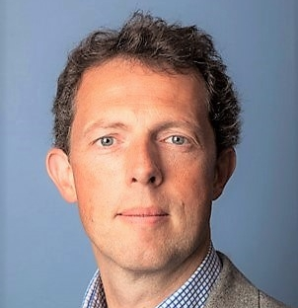

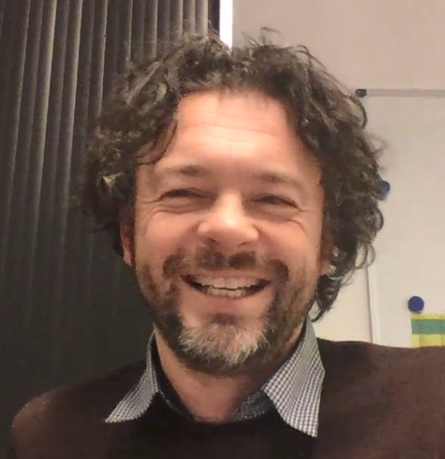
Software Analysis & Design SAD 184
Domain Analyis, Responsibility
[ Behaviour Modeling ]
Spring 2018 edition
Michel R.V. Chaudron & Dave Stikkolorum

Slide 2
Lectures Outline – Part 1
Lecture | Topic
L1 | Introduction (course logistics, scoping, …) Design Process (Analysis & Design) Modeling in general
L2 | Systems/Responsibilities/Roles,Components, Objects & Object Orientation
L3 | The Problem Domain (Analysis): Context diagram, Stakeholders, Use Cases
L4 | Domain Modelling with Class Diagrams (Analysis / Finding Objects)
L5 | CRC cards
L6 | Collaborations / Internal and external interaction with sequence diagrams / State Machine Diagrams / Activity Diagrams

Slide 3
Lectures Outline – Part 2
Lecture | Topic
L7 | State machines & Activity Diagrams
L8 | Going from Domain to Technical Design (more depth/detail on UML notation), layering Component Diagram (part 1)
L9 | Going from Domain to Technical Design (more depth/detail on UML notation), layering Component Diagram (part 2)
L10 | Agile development with UML Agile Software Development Workshop (part 1)
L11 | Recap Design Principles and Design Patterns

Slide 4
Schedule - part 1
week | 13 |  |  | 14 |  |  | 15 |  |  | 16
day | tue | thu | fri | tues | thu | fri | tue | thu | fri | tue
 | 26 march | 28 march | 29 march | 2 april | 4 april | 5 april | 9 april | 11 april | 12 april | 16 april
 | Michel |  |  |  | Michel | practical (MC) | Michel | Michel |  | (MC traveling)
 |  | Dave | Dave |  |  |  |  |  |  | Dave
 | TA's |  | TA's |  |  | TA's | TA's |  | TA's | TA's
topic | 1 | 2 |  |  | 3 |  | 4 | 5 |  | 6
 |  |  |  |  |  |  |  |  |  | seq
 |  |  | Ass 1 |  |  | Ass 2 |  |  | Ass 3
 |  |  | Design Skill test
 |  |  | Pair-modeling
During supervision hours you can work in pairs on practical assignments
12.1 = Lecture
S = Supervision

Slide 5
Schedule - part 2
 |  | 19 |  |  | 20 |  |  | 21 |  |  | 22 | 23
thu | fri | tue | thu | fri | tues | thu | fr | tue | thu | fri | tue | fri
2 may | 3 may | 7 may | 9 may | 10 may | 14 may | 16 may | 17 may | 21 may | 23 may | 24 may | 28 may | 7 june
 |  | Michel | (ques-tion hour?) |  | Michel |  |  | Michel | Michel |  | No Michel (ICSE)
Dave | Dave |  | no Dave | no Dave |  | Dave | Dave |  |  |  |  | Dave
 | TA's | TA's |  | TA's | TA's |  | TA's | TA's
7 |  | 8 |  |  | 9 | 10 | 11
state machines |  | Design Princ 1 |  |  |  | Princ & Patt | workshop Agile UML |  | recap |  |  | exam
 | Ass 4 |  |  | Ass 5 |  |  | Ass 6

Slide 6
Lectures (2018) Outline – Part 1
Lecture | Topic
L12.1 | Introduction (course logistics, scoping, …) Design Process (Analysis & Design) Modeling in general
L12.2 | Systems/Responsibilities/Roles,Components, Objects & Object Orientation
L13 | The Problem Domain (Analysis): Stakeholders, Use Cases, Context diagram
L15.1 | Domain Modelling with Class Diagrams (Analysis / Finding Objects)
L15.2 | CRC cards
L16.1 | Collaborations / Internal and external interaction with sequence diagrams / State Machine Diagrams / Activity Diagrams

Slide 7
Lectures (2018) Outline – Part 2
Lecture | Topic
L16.2 | to be determined
L17.1 | Going from Domain to Technical Design (more depth/detail on UML notation), layering Component Diagram (part 1)
L17.2 | Going from Domain to Technical Design (more depth/detail on UML notation), layering Component Diagram (part 2)
L18.1 | Agile development with UML Agile Software Development Workshop (part 1)
L18.2 | to be determined
L19.1 | Recap Design Principles and Design Patterns

Slide 8
Rules
NB Signing up for written hall examinations is mandatory. If you haven’t signed up, you will not be able allowed to take the exam and will have to wait until the next re-sit examination period.
GU students;
You find information about how to and when to sign up on the CSE’s pages on the GU Student Portal.
https://studentportal.gu.se/english/my-studies/cse/Examination/
Chalmers students;
You find the information about how to and when to sign up on the Student Portal at Chalmers.
https://student.portal.chalmers.se/en/chalmersstudies/Examinations/Pages/how-to-sign-up.aspx

Slide 9
Rules
No laptops or phones during lecture
  Please pay attention to me
  Do no distract your neighbours
  Or yourself
  Evidence: better learning experience when you write your notes.

Slide 10
Learning Objective of this lecture
Know:
  Understand what domain analysis is
  Understand what Sequence Diagrams are
  What are CRC cards and how they can be used in analysis and design
Do:
  Perform a domain analysis for a case described in natural language
  Create Sequence Diagrams

Slide 11
Outline
Recap Domain modeling
CRC cards
Sequence Diagrams

Slide 12
Use Cases

Slide 13
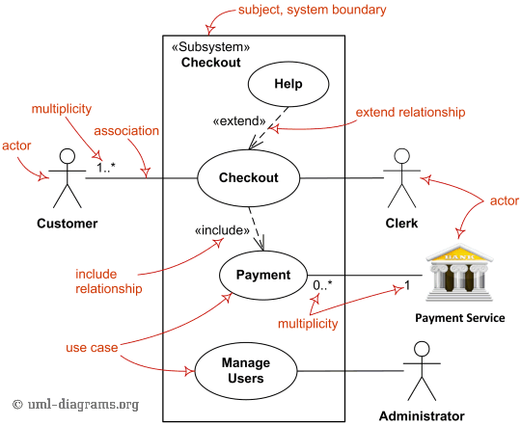
Use Cases
Notes:
Fig. 6.7

Slide 14
Domain Analysis – things to look for
Things:
books, libraries, garage, … (concrete)
order, payment, reservation, … (abstract)
Actors:
Persons, but also roles, organizations, …
Patient, doctor, driver, author, seller, sensor,
Properties of things/actors:
colour, location, name, amount, volume, currency, …
Relations between things:
is a, part of

Slide 15
Typical things to look for in Domain Analysis
Actions/Events & relations between them:
repair, pay, order, failure, turn, eat, move, … (atomic)
Domain Logic/Rules:
Causal relations between actions:
Passing a deadline causes a fine.
Processes = relations between actions/events
(business) processes, information flows, control flows, …

Slide 16
What makes a good analysis?
Correct Scope
Complete
Consistent
Systematic
Typically performed by an expert in the domain.
Domain analysist in finance/banking are not automatically good domain analysis in automotive.
<- Guidelines for your peer-review (homework)

Slide 17
Exercise
It is Tuesday-afternoon and Sarah walks into the office of the SuperFly Travel Company on Avenyn in Gothenburg. She opens the door and draws a ticket. Sara is 24 years also and would like to visit her grandmother Ana who is 77 years old and lives in Rotterdam. Sara is interested in booking a flight from Gothenburg to Amsterdam. When driving by road, the distance from Gothenburg to Amsterdam is about 1096 kilometers. From Amsterdam she will take the train to Rotterdam. Sara is known amongst her friends for being very flexible. However, she has a preference for pink airplanes.
Assignment: Create a domain model

Slide 18
Exercise
It is Tuesday-afternoon and Sarah walks into the office of the SuperFly Travel Company on Avenyn in Gothenburg.
company
has
office
has
customer
customer
is abstraction
of Sara
location
name
Notation:
‘thing’
properties
capabilities
Notes:
NB it is our interpretation/domain knowledge that tells us that Sara is a customer

Slide 19
“She opens the door and draws a ticket”
Maybe ‘ticket’?

Slide 20
“Sara is 24 years also and would like to visit her grandmother Ana who is 77 years old and lives in Rotterdam.”
Sara => Customers have a name (property) and age (property).
Grandmother and age and her location are not essential for travelling

Slide 21
“Sara is interested in booking a flight from Gothenburg to Amsterdam”
customer
has
booking
origin
destination

Slide 22

“Sara is interested in booking a flight from Gothenburg to Amsterdam”
customer
has
booking
has
trip
has
*
leg
origin
destination
Notation: * means 0 or more
(note: no plurals in ‘thing’ names)
transportation -type

Slide 23
“Sara is interested in booking a trip from Gothenburg to Rotterdam”, flying from Got to AMS and taking the train from AMS to Rotterdam.
trip
has
*
leg
instance
origin
leg 1
leg 2
destination
Gothenburg
Amsterdam
transportation -type
Amsterdam
Rotterdam
flight
train

Slide 24
“When driving by road, the distance from Gothenburg to Amsterdam is about 1096 kilometers.”
This is not so relevant (yet), maybe could be input to pricing.
This data can be derived from existing data => maybe no need to include in our system.

Slide 25
“Sara is known amongst her friends for being very flexible. However, she has a preference for pink airplanes.”
customer
name
preference
Notation:
‘thing’
properties
capabilities

Slide 26
Putting Everything Together
has
company
office
*
location
has
*
customer
has
booking
has
trip
*
name
birthday
preference
has
*
leg
origin
destination
transportation -type

Slide 27
So far so good
Anything missing from the analysis?
Dynamics/behaviour
Business logic

Slide 28
Finding Classes - Guidelines
Refine to a list of candidate classes.
Some guidelines are:
  Model physical objects — e.g. disks, printers
  Model conceptual entities — e.g. windows, files
  Choose one word for one concept — what does it mean within the system
  Be wary of adjectives — is it really a separate class?
  Be wary of missing or misleading subjects — rephrase in active voice
  Model categories of classes — delay modelling of inheritance
  Model interfaces to the system — e.g., user interface, program interfaces
  Model attribute values, not attributes — e.g., Point vs. Centre

Slide 29
Example: Requirements Specification of a Drawing Editor
The drawing editor is an interactive graphics editor. With it, users can create and edit drawings composed of lines, rectangles, ellipses and text.
Tools control the mode of operation of the editor. Exactly one tool is active at any given time.
Two kinds of tools exist: the selection tool and creation tools. When the selection tool is active, existing drawing elements can be selected with the cursor. One or more drawing elements can be selected and manipulated; if several drawing elements are selected, they can be manipulated as if they were a single element. Elements that have been selected in this way are referred to as the current selection. The current selection is indicated visually by displaying the control points for the element. Clicking on and dragging a control point modifies the element with which the control point is associated.
When a creation tool is active, the current selection is empty. The cursor changes in different ways according to the specific creation tool, and the user can create an element of the selected kind. After the element is created, the selection tool is made active and the newly created element becomes the current selection.
The text creation tool changes the shape of the cursor to that of an I-beam. The position of the first character of text is determined by where the user clicks the mouse
button. The creation tool is no longer active when the user clicks the mouse button outside the text element. The control points for a text element are the four corners of the region within which the text is formatted. Dragging the control points changes this region. The other creation tools allow the creation of lines, rectangles and ellipses. They change the shape of the cursor to that of a crosshair. The appropriate element starts to be created when the mouse button is pressed, and is completed when the mouse button is released. These two events create the start point and the stop point.
The line creation tool creates a line from the start point to the stop point. These are the control points of a line. Dragging a control point changes the end point.
The rectangle creation tool creates a rectangle such that these points are diagonally opposite corners. These points and the other corners are the control points. Dragging a control point changes the associated corner.
The ellipse creation tool creates an ellipse fitting within the rectangle defined by the two points described above. The major radius is one half the width of the rectangle, and the minor radius is one half the height of the rectangle. The control points are at the corners of the bounding rectangle. Dragging control points changes the associated corner.

Slide 30
Drawing Editor: noun phrases
The drawing editor is an interactive graphics editor. With it, users can create and edit drawings composed of lines, rectangles, ellipses and text.
Tools control the mode of operation of the editor. Exactly one tool is active at any given time.
Two kinds of tools exist: the selection tool and creation tools. When the selection tool is active, existing drawing elements can be selected with the cursor. One or more drawing elements can be selected and manipulated; if several drawing elements are selected, they can be manipulated as if they were a single element. Elements that have been selected in this way are referred to as the current selection. The current selection is indicated visually by displaying the control points for the element. Clicking on and dragging a control point modifies the element with which the control point is associated.
When a creation tool is active, the current selection is empty. The cursor changes in different ways according to the specific creation tool, and the user can create an element of the selected kind. After the element is created, the selection tool is made active and the newly created element becomes the current selection.
…

Slide 31
The text creation tool changes the shape of the cursor to that of an I-beam. The position of the first character of text is determined by where the user clicks the mouse button. The creation tool is no longer active when the user clicks the mouse button outside the text element. The control points for a text element are the four corners of the region within which the text is formatted. Dragging the control points changes this region. The other creation tools allow the creation of lines, rectangles and ellipses. They change the shape of the cursor to that of a crosshair. The appropriate element starts to be created when the mouse button is pressed, and is completed when the mouse button is released. These two events create the start point and the stop point.
The line creation tool creates a line from the start point to the stop point. These are the control points of a line. Dragging a control point changes the end point.
The rectangle creation tool creates a rectangle such that these points are diagonally opposite corners. These points and the other corners are the control points. Dragging a control point changes the associated corner.
The ellipse creation tool creates an ellipse fitting within the rectangle defined by the two points described above. The major radius is one half the width of the rectangle, and the minor radius is one half the height of the rectangle. The control points are at the corners of the bounding rectangle. Dragging control points changes the associated corner.

Slide 32
Class Selection Rationale
Model conceptual entities:
  ellipse, line, rectangle
  Drawing, Drawing Element
  Tool, Creation Tool, Ellipse Creation Tool, Line Creation Tool, Rectangle Creation Tool, Selection Tool, Text Creation Tool
  text, Character
  Current Selection
Model physical objects:
  mouse button [event or attribute]

Slide 33
Class Selection Rationale ...
Choose one word for one concept:
  Drawing Editor ⇒
  editor, interactive graphics editor
  Drawing Element ⇒ element
  Text Element ⇒ text
  Ellipse Element, Line Element, Rectangle Element
  ⇒ ellipse, line, rectangle

Slide 34
Class Selection Rationale ...
Be wary of adjectives:
  bounding rectangle, rectangle, region ⇒ Rectangle
    common meaning, but different from Rectangle Element
  Point ⇒ end point, start point, stop point
  Control Point
    more than just a coordinate
  corner ⇒
  associated corner, diagonally opposite corner
    no new behaviour

Slide 35
Class Selection Rationale ...
Be wary of sentences with missing or misleading subjects:
  “The current selection is indicated visually by displaying the control points for the element.”
    by what? Assume Drawing Editor ...
Model categories:
  Tool, Creation Tool
Model interfaces to the system: — no good candidates here ...
  user — don’t need to model user explicitly
  cursor — cursor motion handled by operating system

Slide 36
Class Selection Rationale ...
Model values of attributes, not attributes themselves:
  height of the rectangle, width of the rectangle
  major radius, minor radius
  position — of first text character; probably Point attribute
  mode of operation — attribute of Drawing Editor
  shape of the cursor, I-beam, crosshair — attributes of Cursor
  corner — attribute of Rectangle
  time — an implicit attribute of the system

Slide 37
Candidate Classes
Preliminary analysis yields the following candidates:
Character | Line Element
Control Point | Point
Creation Tool | Rectangle
Current Selection | Rectangle Creation Tool
Drawing | Rectangle Element
Drawing Editor | Selection Tool
Drawing Element | Text Creation Tool
Ellipse Creation Tool | Text Element
Ellipse Element | Tool
Line Creation Tool
Expect the list to evolve as design progresses.

Slide 38
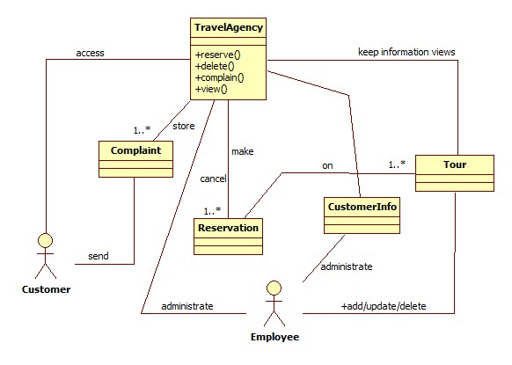
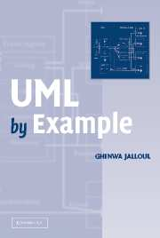
Example Domain Model: Travel Agency
The model captures a domain:
the important concepts
Important relations between concepts

Slide 39
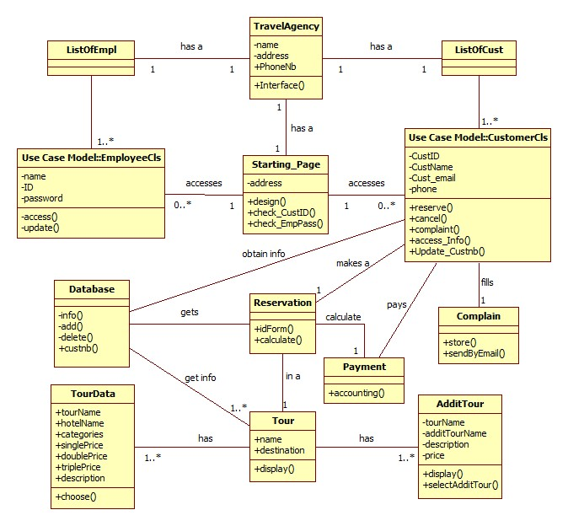
Example Design Model: Travel Agency
This model still has important concepts.
This model also has classes that are closer to the implementation:
- Database
- Interface
Classes themselves have more details

Slide 40
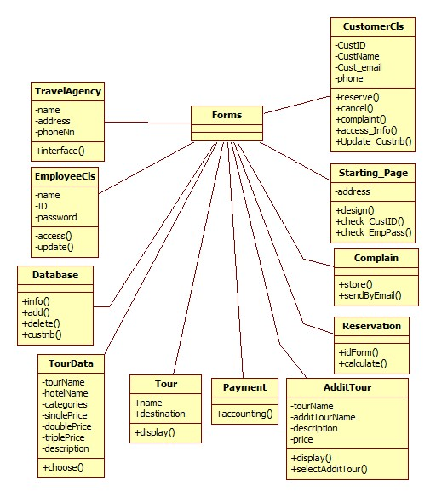
Reverse Engineered UML diagram
Lost conceptual links
between classes
Quite detailed
Often not useful for
understanding the design
(only for the implementation)

Slide 41
Responsibility
The state or fact of having a duty to deal with something or of having control over someone.
Synonyms: authority, control, power, leadership, management, influence; duty
2. The state or fact of being accountable or to blame for something.
Synonyms: blame, fault, guilt, culpability, blameworthiness,
liability
A moral obligation to behave correctly towards or in respect of.
"individuals have a responsibility to control their behaviour"

Slide 42
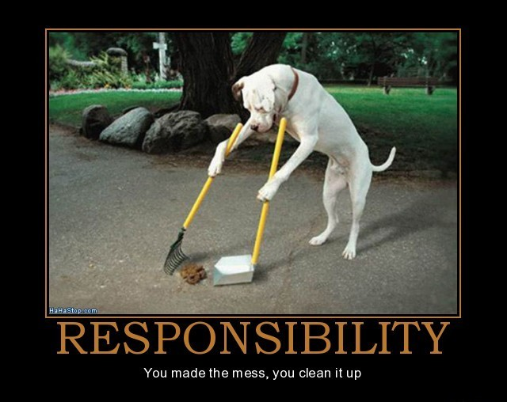
Responsibility
The opportunity or ability to act independently and take
decisions without authorization.
A thing which one is required to do as part of a job, role, or
legal obligation.
Synonyms: duty, task, function, job, role, place, charge, business, onus, burden, liability, accountability, answerability, province

Slide 43
Responsibility
To Know something
To Do something
  Act
  Control
  Decide

Slide 44
Challenge: Uncovering the hidden structure of designs
Rebecca WB: Software designs are
built from building blocks that have
stereotypical roles
Information holder
Service Provider
Interfacer
Structurer
Controller
Coordinator
Notes:
■Information holder: an object designed to know certain information and provide that
information to other objects.
■ Structurer: an object that maintains relationships between objects and information about
those relationships. Complex structurers might pool, collect, and maintain groups of
many objects; simpler structurers maintain relationships between a few objects. An example
of a generic structurer is a Java HashMap, which relates keys to values.
■ Service provider: an object that performs specific work and offers services to others
on demand.
■ Controller: an object designed to make decisions and control a complex task.
■ Coordinator: an object that doesn’t make many decisions but, in a rote or mechanical
way, delegates work to other objects. The Mediator pattern is one example.
■ Interfacer: an object that transforms information or requests between distinct parts of a
system. The edges of an application contain user-interfacer objects that interact with the
user and external interfacer objects, which communicate with external systems. Interfacers
also exist between subsystems. The Façade pattern is an example of a class designed
to simplify interactions and limit clients’ visibility of objects within a subsystem.

Slide 45
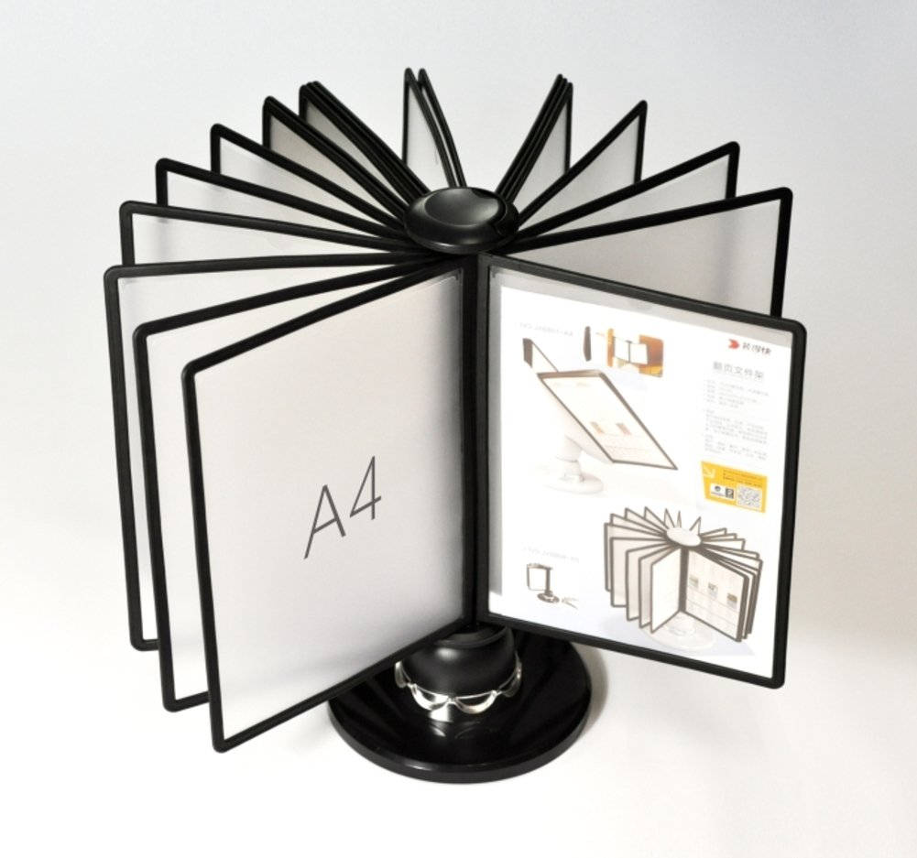
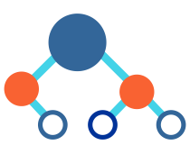

■Information holder: an object designed to know certain information and provide that information to other objects.
■ Structurer: an object that maintains relationships between objects and information about those relationships.
Complex structurers might pool, collect, and maintain groups of many objects; simpler structurers maintain relationships between a few objects. An example of a generic structurer is a Java HashMap, which relates keys to values.
■ Service provider: an object that performs specific work and offers services to others on demand.

Slide 46

■ Controller: an object designed to make decisions and control a complex task.
■ Coordinator: an object that doesn’t make many decisions but, in a rote or mechanical way, delegates work to other objects.
■ Interfacer: an object that transforms information or requests between distinct parts of a system. The edges of an application contain user-interfacer objects that interact with the user and external interfacer objects, which communicate with external systems. Interfacers
also exist between subsystems. The Façade pattern is an example of a class designed
to simplify interactions and limit clients’ visibility of objects within a subsystem.

Slide 47
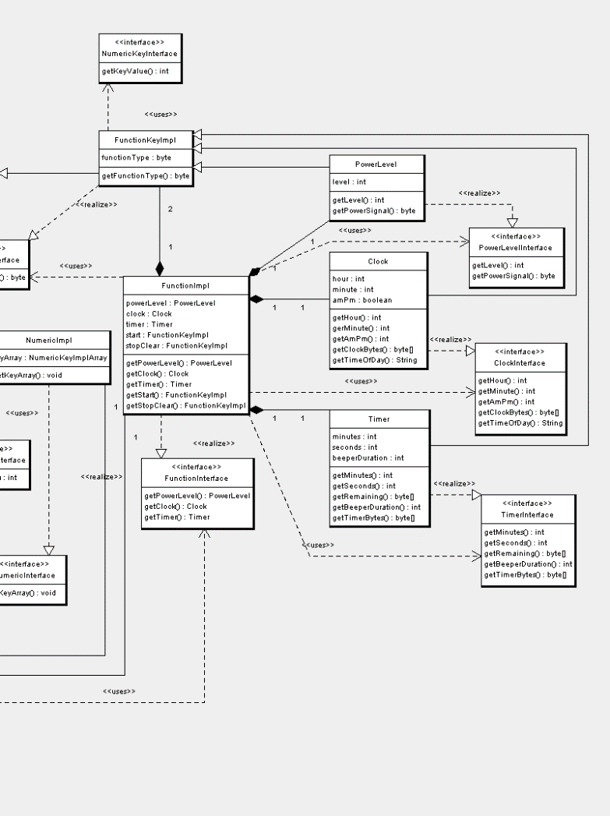
Role-patterns in Software Designs
Through labelling of roles, we find regularities in the graph-patterns
Controller
Service Provider
Service Provider
Service Provider

Slide 48
CRC Cards
CRC cards are a method for analyzing and designing (OO) system based on the notion of responsibility.
CRC cards help in:
- allocating/scoping responsibilities per class
- identify interactions between classes
CRC cards allow for ‘role-playing’, as a way of simulations/prototyping.

Slide 49
CRC Cards Template
Class Name:
Responsibilities
Collaborations
Responsibilities of a class are listed in this section.
Collaborations with other classes are listed here, together with a brief description of the purpose of the collaboration.

Slide 50
CRC Cards - Example
Class Name: BANK
Responsibilities
Collaborations
Store money (securely)
Dispense money
Transfer money
Receive money
Provide account info
Other banks’s
ATM’s
Shops
Credit card companies
Tax agency

Slide 51
CRC Cards - Example
Class Name: Doggie Hotel
Responsibilities
Collaborations
Store dog
Keep dog fit
Return Dog
Dog owner
Pet Supermarket
Stay ‘declarative’ (WHAT rather than HOW):
This CRC card does not say HOW it keeps the dog fit (We assume it will do feeding, walking, combing, …; but these are internal actions)

Slide 52
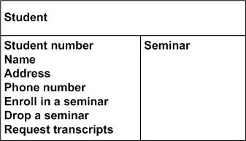
Example CRC card
University system
Not responsibilities!
Instead: know student-name & contact information
Not an actor;
Instead: Student-Admin

Slide 53
CRC Cards
Class Name:
Responsibilities
Collaborations
Responsibilities of a class are listed in this section.
Collaborations with other classes are listed here, together with a brief description of the purpose of the collaboration.
Responsibilities are candidates for turning into methods
Collaborations are candidates for interfaces / interactions with other classes

Slide 54
CRC Cards: FlowerShop Example
Class Name: Flower Shop
Responsibilities
Collaborations
Sell flowers
Deliver flowers
Customer
Flower-farmer
Class Name: Customer
Class Name: Flower Farmer
Responsibilities
Collaborations
Responsibilities
Collaborations
Buy flowers
…
Flower Shop
Sell flowers
…
Flower Shop

Slide 55
CRC Sessions
CRC cards are not a specification of a design.
They are a tool to explore possible designs.
  Prepare a CRC card for each candidate class
  Get a team of Developers to sit around a table and distribute the cards to the team
  The team walks through scenarios, playing the roles of the classes.
This exercise will uncover:
  unneeded classes and responsibilities
  missing classes and responsibilities

Slide 56
Responsibilities
What are responsibilities?
  a know responsibility:
    the knowledge an object maintains and provides
  a do responsibility:
  the actions it can perform
Responsibilities represent the public services an object may provide to clients (but not the way in which those services may be implemented)
  specify what an object does, not how it does it
  don’t describe the interface yet, only conceptual responsibilities

Slide 57
Identifying Responsibilities
Study the requirements specification:
  highlight verbs and determine which represent responsibilities
  perform a walk-though of the system
    explore as many scenarios as possible
    identify actions resulting from input to the system
Study the candidate classes:
  class names ⇒ roles ⇒ responsibilities
  recorded purposes on class cards ⇒ responsibilities
Notes:
each class exists because of an implied responsibility

Slide 58
Collaborations
What are collaborations?
collaborations are requests to other classes needed to fulfill responsibilities
collaborations reveal control and information flow and, ultimately, subsystems
collaborations can uncover missing responsibilities
analysis of communication patterns can reveal
ill-assigned responsibilities

Slide 59
Finding Collaborations
For each responsibility:
  Can the class fulfill the responsibility by itself?
  If not, what does it need, and from what other class can it obtain what it needs?
For each class:
  What does this class know?
  What other classes need its information or results?
  Check for collaborations.
  Classes that do not interact with others should be discarded.
  (Check carefully!)

Slide 60
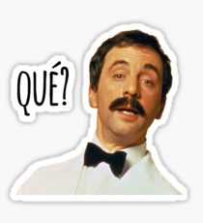
Exercise
Restaurant ‘Fusion Conclusion’
Restaurant offers meals to customers. The restaurant has 20 tables and 5 waiters. The restaurant has a menu from which customers can choose what to order. The menu changes once per month. Every menu contains dishes from around the world: pizza, kebab, pancakes, sushi. The menu also offers drinks from around the world: wine, beer, juice, and soda-drinks. In the restaurant, tables are numbered. Waiters serve a fixed set of tables each day. Waiters take the order of the customers at the table. They bring the orders to the kitchen and to the bar. In the kitchen, the cook and his staff prepare the meals. Staff at the bar prepare the drinks.
The waiters serve the orders to the customers.
If customers order in rounds (e.g. starter, main, dessert), then the waiters remove the plates from the previous round before serving the next round.
The customers pay for the meals before they leave.

Slide 61
Work together in groups of 4 people
Each person in the group plays one role:
  Customer
  Waiter
  Cook
  Bar-staff
Feel free to improve more roles:
  Delivery service
  Reservation desk

Slide 62
Identify 3 use cases
For each use case,
  identify responsibilities and collaborations
  (write them on your card)
  Play through the scenarios: each person identifies what is her/his responsibility/task and which interactions she/he has with other roles.

Slide 63
Summary
What are CRC cards and how can they be used in software development – esp analysis and design
Context
Diagram
Use Cases
Domain analysis
Stake-holders
UC
Diagram
UC
Text
Domain Model
Design Model
Domain Classes

Slide 64
Challenge: Uncovering the hidden structure of designs
Rebecca WB: Software designs are
built from building blocks that have
stereotypical roles
Information holder
Service Provider
Interfacer
Structurer
Controller
Coordinator
Notes:
■Information holder: an object designed to know certain information and provide that
information to other objects.
■ Structurer: an object that maintains relationships between objects and information about
those relationships. Complex structurers might pool, collect, and maintain groups of
many objects; simpler structurers maintain relationships between a few objects. An example
of a generic structurer is a Java HashMap, which relates keys to values.
■ Service provider: an object that performs specific work and offers services to others
on demand.
■ Controller: an object designed to make decisions and control a complex task.
■ Coordinator: an object that doesn’t make many decisions but, in a rote or mechanical
way, delegates work to other objects. The Mediator pattern is one example.
■ Interfacer: an object that transforms information or requests between distinct parts of a
system. The edges of an application contain user-interfacer objects that interact with the
user and external interfacer objects, which communicate with external systems. Interfacers
also exist between subsystems. The Façade pattern is an example of a class designed
to simplify interactions and limit clients’ visibility of objects within a subsystem.

Slide 65
Role-patterns in Software Designs
Through labelling of roles, we find regularities in the graph-patterns
Controller
Service Provider
Service Provider
Service Provider

Slide 66
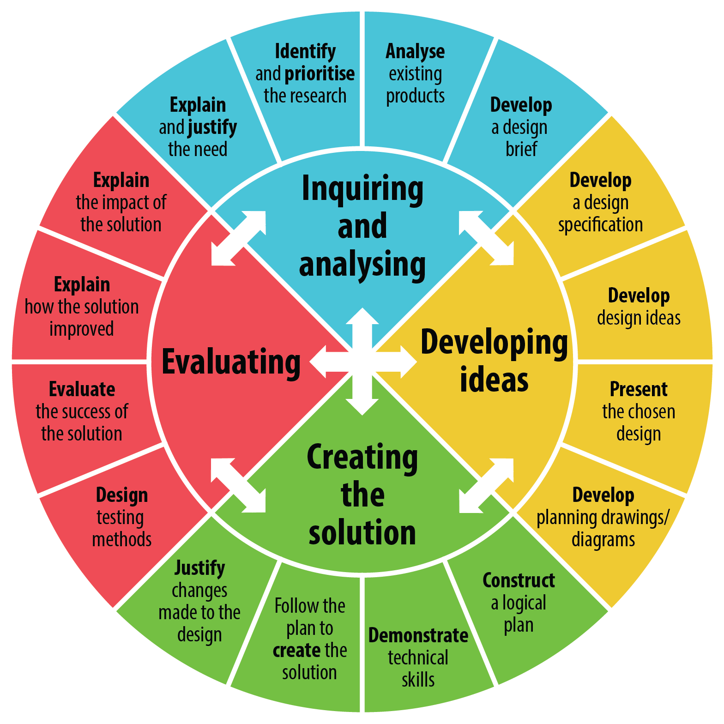
Software Designing

Slide 67
4+1 Views Representation of System Architecture
What can/does the system do ?
How is the system structured?
How to build / configure ?
Logical View
Development View
System Architect
End-user
Programmers
Configuration management
Functionality (Decomposition)
Use Case View
How does the system behave?
Where to install ?
What hw\nw is used?
Process View
Deployment View
System Architect
System engineering
System topology
Delivery, installation, maintenance
Performance, Scalability, Throughput
Concurrency, Communication,
Synchronization
How does the system perform ?

Slide 68
Example 4+1 model
Structure view: components, packages, interfaces
Development view
versioning policies
file ownership
…
A
B
Stakeholders &
Use cases view
C
D
Behaviour view:
MSC, state-diagrams
Deployment view:
physical model + mapping
A
B
C
D
A
C
D
B
TCP/IP over Ethernet
BC/WC e2e-response times, freq.
bandwidth, availability

