Slide 1
Class Diagrams
Sequence Diagrams
Activity Diagrams
Truong Ho-Quang
truongh@chalmers.se
Gothenburg, 12th of April 2018

Slide 2

Truong Ho-Quang
Research interest:
  Software Modeling and Design
  Best practices of software modeling in open source
  Software Visualisation
B.Sc. Thesis?
  http://wiki.portal.chalmers.se/cse/pmwiki.php/SE/ThesisProjects

Slide 3
Outline
Documenting Software Designs
Activity Diagram
Class Diagram
Sequence Diagram
By Felix Bachmann et al.
Documenting Software Architectures: Views and Beyond, 2nd Edition, Addison-Wesley Professional, 2010
By Bennett, McRobb and Farmer
Object Oriented Systems Analysis and Design Using UML, 2nd Edition, McGraw Hill, 2002
Notes:
This lecture is divided in two parts:
Software Architecture Documentation, and
UML, however we will only consider some type of diagrams not all of them.
We will learn Activity, Class and Sequence diagrams.
I will talk about software architecture documentation in the beginning, and then have a break, and then show you how to use UML.
Is it Okay?

Slide 4
Software Architecture/Design
Notes:
A software architecture is a set of decisions about the organization of a software system which presents information about the structure of the system and its behavior. How the elements of the architecture are related to each other and how they behave right.
A software architecture is a blueprints for software construction and evolution.
The software architect creates…

Slide 5
Documenting
Software Architecture / Design
“If it is not written down, it does not exist”
─ Philippe Kruchten
Notes:
Creating an architecture is not enough, documenting it in a proper way is essential to make people know it, find it, understand it, use it, extend it or modify it. Specially when in cases when there is a software architect in a company how works for a period of time, and then he/she left the company, so his or her architecture should speak for him or her, in the sense that the architecture should be well documented and described for future extension, modification, maintenance, etc.
Usually in practice, the architecture is communicated to some stakeholders in order to let them do their job. For example a software architect has to communicate or describe his or her decisions and designs to developers in a proper way, otherwise, developers and testers will have difficulty and maybe do an extra effort in doing their jobs.
So documentation is essential to describe the design decisions and rationale of the architects.

Slide 6



Audiences for
Software Documentation
Software Design Documentation has three main uses:
  As means of education: introducing the system to developers.
  As means for communication among stakeholders.
  As basis for system analysis and construction.
Notes:
The architecture documentation has 3 main uses:
Introduce the architecture to other stakeholders e.g. developers, customers, testers, etc. people could be also new people or new team members.
The design decisions are usually communicated between stakeholders in a form of documentation.
Architects tell implementers what to implement and develop. The architecture might be too complex and documentations serve as means to communicate how complex details should be implemented and not overlooked.
Documentations must also contain information to evaluate different attributes such as performance, security, usability and user interaction.

Slide 7
Notations for
Architecture Documentation
Notations?
  Views or models that represent an architecture
There are three main categories of Notations:
  Informal: drawn using general-purpose diagramming and editing tools e.g. PowerPoint.
  Semi-formal: views that are expressed via a standardized modeling syntax without providing a complete semantic of these notations. E.g. UML.
  Formal: views that are described in a notation that has a precise semantics. E.g. (ADL).
Informal
Effort
Formal
Opportunities for Analysis
Notes:
informal: do not follow any standardized syntax, and semantics cannot be formally analyzed. The semantics of the description are characterized in natural language.
Semi-formal: formal standard language but no semantics.
formal: views with a precise semantics specially (mathematically based)

Slide 8

Rules for Sound Documentation
Write documentation from the reader’s point of view.
Avoid unnecessary repetition.
Avoid ambiguity & explain your notation.
Use a standard organization.
Record rationale.
Review documentation for fitness of purpose.
Notes:
Write documentation from the reader’s point of view: keep in mind that every documentation has a targeted audience/stakeholders.
Avoid unnecessary repetition: One type of info should be put in one place => makes it easier to write and much easier to change/maintain. No one want to fix the same thing at multiple places.
Avoid ambiguity & explain your notation
Use a standard organization: Templates – such as writing a paper needs a template…
Record rationale: What is your decision behind the choice…
Review documentation for fitness of purpose: Only the intended users of a documentation could tell you whether it contains right information presented in the right way. This rules imply that before a document is released, it should be review by representatives of the community for which it was written for.

Slide 9

Questions?

Slide 10

UML for
Software System Documentation
The Unified Modeling Language (UML) provides a standard way to model the architecture and design of a software system.
Notes:
UML was under development from early nineties, proposed to OMG 1997,
2005: UML 2.0

Slide 11
4 + 1 Views Model
Logical view: classes, packages, components, interfaces.
Development view:
file ownership
Config. Mngnt view
versioning policies
…
A
B
Stakeholders &
Use Cases view
C
D
Process view:
State-diagrams
Deployment view:
physical model + mapping
A
B
C
D
A
C
D
B
TCP/IP over Ethernet
bandwidth, availability
Notes:
- The views are used to describe the system from different viewpoints.
- The scenarios describe sequences of interactions between objects and between processes.

Slide 12
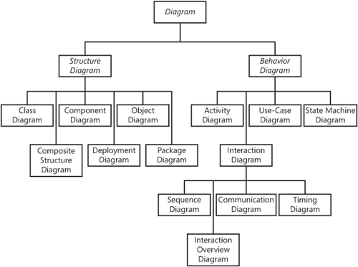
UML for
Software System Documentation

Slide 13
Questions?

Slide 14
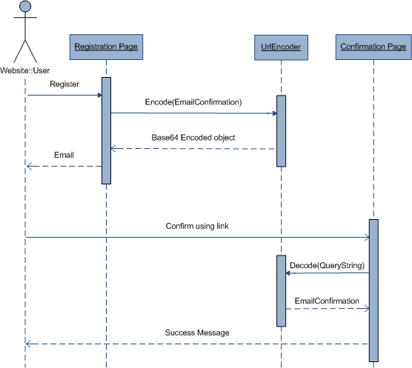
UML – Sequence Diagram
UML sequence diagram represents the dynamics of the system.
UML sequence diagram depicts:
  interactions between objects.
  how the business currently works by showing how various business objects interact.

Slide 15
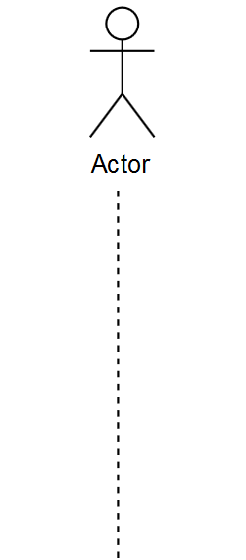
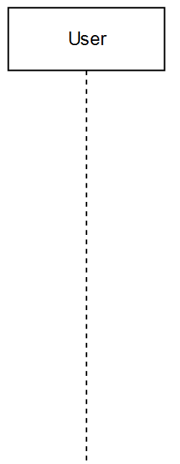
Sequence Diagram Elements
Lifeline : Class Name (instance name)

Slide 16
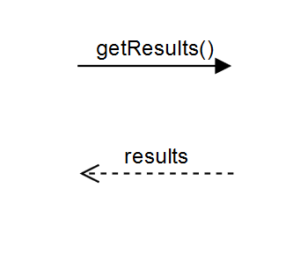
Sequence Diagram Elements
Messages:
  Request
  Response

Slide 17
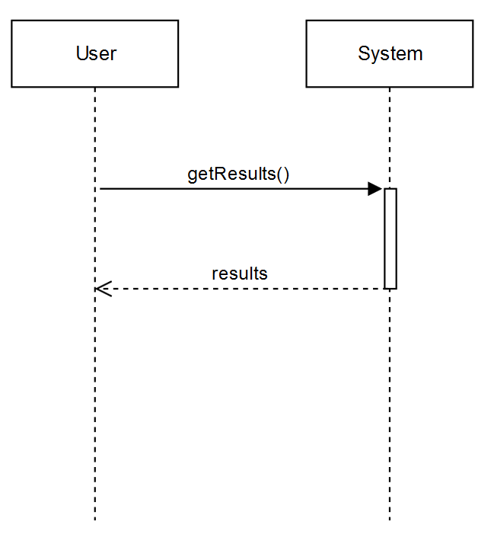
Sequence Diagram Elements
Activation line (Execution Occurrence)

Slide 18
Sequence Diagram Elements
  Combined fragments
  alternatives (alt) denote a mutually exclusive choice between two or more message sequences
  options (opt),
  loops (loop)

Slide 19
Sequence Diagram Elements
  Combined fragments
  alternatives (alt),
  options (opt) denote a sequence that occurs only under a certain condition. Otherwise, the sequence does not occur.
  loops (loop)

Slide 20
Sequence Diagram Elements
  Combined fragments
  alternatives (alt),
  options (opt),
  loops (loop) capture repetitive sequences.

Slide 21
Sequence Diagram Elements

Slide 22
Sequence Diagram: Beyond the basics

Slide 23
Questions?

Slide 24
Assignment 3 :
An online flight reservation system must allow customers to search flights, make a reservation, purchase a ticket, and select a seat. Purchasing a ticket operation is verified by a bank.
To do: draw a Sequence Diagram of the system.
Time : 5 minutes.

Slide 25
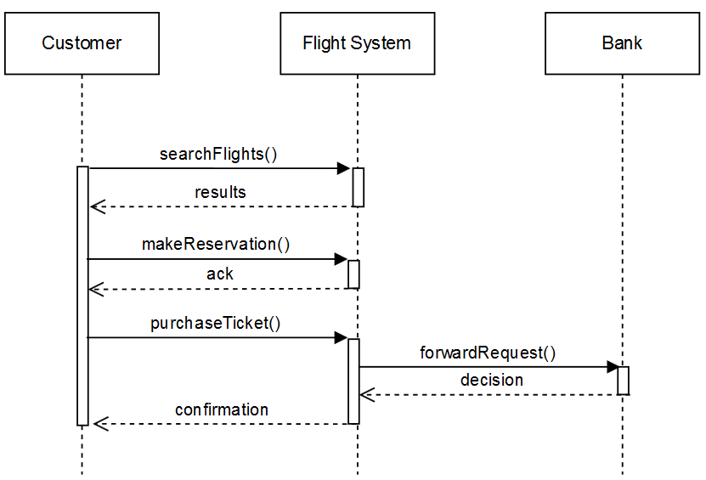
Assignment 3 : solution

Slide 26
UML – Activity Diagram
Activity diagrams represent the dynamics of the system.
They show the flow of actions in system
They show:
  The flow of control from activity to activity in the system
  Alternate paths through the flow
  Which activities can be done in parallel

Slide 27
Notation of Activity Diagrams
Activity
  is the core symbol
  rectangle with rounded ends
  meaningful name
Transition
  shows the flow
  (sequence) between
  activities
  arrow with open
  arrowheads
Add a New
Client
Assign Staff
Contact
Notes:
Activity is the core symbol of an activity diagram. An activity represents a task which needs to be done. Exxample: Add a New Client; Assign Staff Contact.

Slide 28
Notation of Activity Diagrams
Start state
  black circle
Decision points
  diamond
Guard conditions
  in square brackets
Final state
  black circle in white circle
Add a New
Client
Assign Staff
Contact
[no campaign to add]
[campaign to add]
Add New
Campaign

Slide 29
Notation of Activity Diagrams
Alternative notation for
branching:
  alternative transitions
  are shown leaving the
  activity with guard
  conditions
Note that guard conditions do not have to be mutually exclusive, but it is advisable that they should be
Add a New
Client
Assign Staff
Contact
[no campaign to add]
[campaign to add]
Add New
Campaign
Notes:
Alternative notation for branching: alternative transitions are shown leaving the activity with guard conditions
Note that guard conditions do not have to be mutually exclusive, but it is advisable that they should be

Slide 30
Add a New
Client
=
Add a New
Client
Assign Staff
Contact
[no campaign to add]
Assign Staff
Contact
[no campaign to add]
[campaign to add]
Add New
Campaign
[campaign to add]
Add New
Campaign
Notes:
They are the same - It’s depend on your style of drawing
Conditions can be stated in informal language and in formal language such as predicate logic.

Slide 31
Notation of Activity Diagrams
Object flows
  dashed arrow
Objects
  rectangle
  with name of object underlined
  optionally shows the state of the object in square brackets
:Campaign
[Active]
Record completion
of a campaign
:Campaign
[Completed]

Slide 32
Notation of Activity Diagrams
Campaign
Manager
Accountant
Client
Swimlanes
  vertical columns
  labelled with the
  person, organisation
  or department
  responsible for the
  activities in that
  column
Record Completion
of a campaign
Issue invoice
Pay invoice
Record client
payment

Slide 33
More Notations
Read more:
Chapter 5 of Bennett, McRobb and Farmer’s book (2nd Ed.)

Slide 34
Assignment 1:
An online flight reservation system must allow customers to search flights, make a reservation, purchase a ticket, and select a seat. Purchasing a ticket operation is verified by a bank.
To do: draw a Activity Diagram of the system.
Time : 5 minutes.
Note: These actions in red happen in a sequential order.
This is not a solution, don’t copy!

Slide 35
Assignment 1 : solution
Customer
Bank
Search for flights
Make a reservaton
Purchase a ticket
Verify a purchase
[purchase is confirmed]
Select a seat
[purchase is NOT confirmed]

Slide 36
UML – Class Diagram
A class diagram provides an overview of the structure of the system by showing its:
  Classes,
  attributes (properties),
  methods (operations) and,
  relationships between the classes.

Slide 37
Main Elements of a Class Diagram
Classes
Relationships

Slide 38
Classes

Slide 39
Class Representation
Classes are represented by rectangular boxes
Each box contains three elements:
  Class name
  Attributes
  Methods (Operations)
MyCar
- brand: String
- registrationPlate: String
+ drive(): void
+ fillWithFuel(): void
Notes:
Classes are represented by a box with three sections as you see here:
The first section contains the Name of the class, the second section contains the attributes or properties… and the last section contains a list of the operation or methods ..
Here we have..

Slide 40
Naming Convention
  Class names: first letter is capital, camel-case.
  Attributes: first letter is small, camel-case.
  Methods: first letter is small, camel-case.
MyCar
- brand: String
- registrationPlate: String
+ drive(): void
+ fillWithFuel(): void
Notes:
- Name should be singular, and in the middle of the box, first letter is capital and if it contains two words, it should be represented with a camel-case structure.

Slide 41
Visibility of Attributes & Methods
Visibility:
  “-” private visibility
  “+” public visibility
By default, attributes are hidden and methods are visible.
MyCar
- brand: String
- registrationPlate: String
+ drive(): void
+ fillWithFuel(): void

Slide 42
Interfaces
Interfaces are very important. By using an interface you can separate implementation from specification.
An interface specifies a service of a class.
Notes:
By using the interfaces, you separate the specification form the implementation.
The interface provides a general specification of the structure and behavior of a class without providing any details on implementation.

Slide 43
Interfaces: example
<<interface>>
Audio Player
play()
stop()
pause()
skipForward()
skipBackwards()
DiscPlayer
Notes:
Can we put inheritance to go from top to bottom/vertically?

Slide 44
Enumerations
A user defined data type that consists of a name and a list of enumeration literals.
Car
- fuel : FuelType
<<enumeration>>
FuelType
Gasoline
Diesel

Slide 45
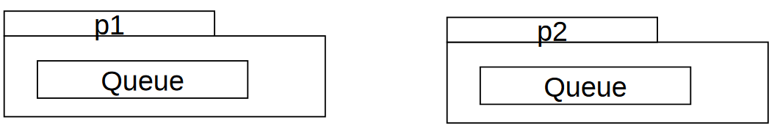
Packages
In UML, one can use packages to group classes.
One can resolve name conflicts with packages, for example:
p1::Queue and p2::Queue are two different classes with the same name.

Slide 46
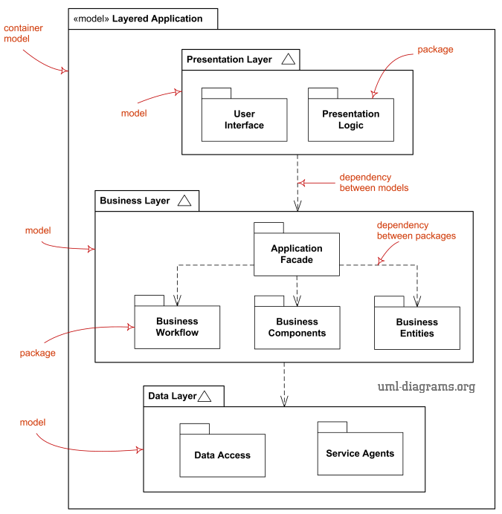

Slide 47

Relationships

Slide 48
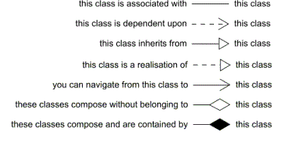
Relationships Types
Association (bidirectional)
Dependency
Generalization
Realization
Association (unidirectional)
Aggregation
Composition

Slide 49
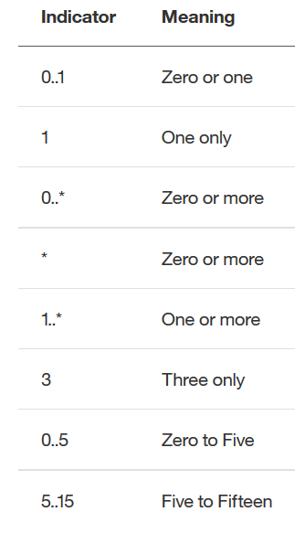
Multiplicity

Slide 50
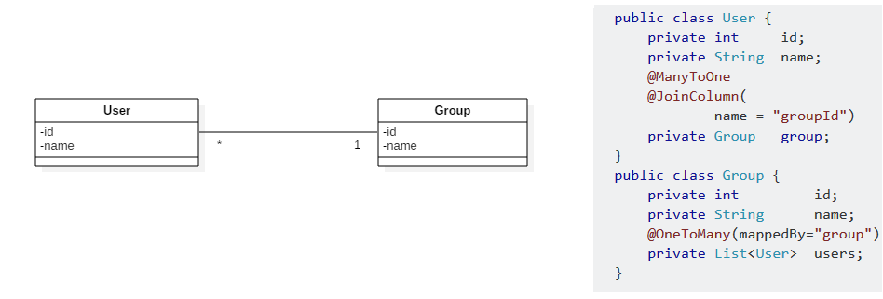
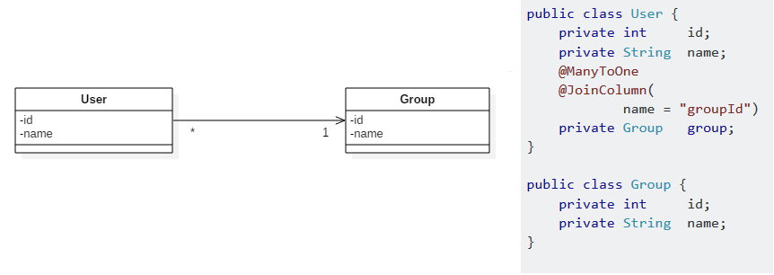
Association: Bidirectional vs. Unidirectional
Notes:
User knows Group, but Group dose not know user: there is no reference to User in Group class

Slide 51
Association: naming
  Verb phrase.
  Can be read only one way.
Belongs to

Slide 52
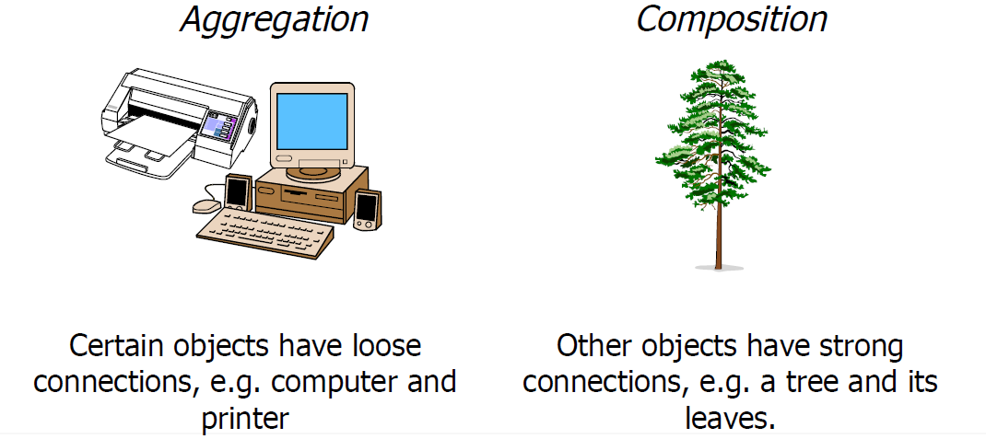
Aggregation vs. Composition

Slide 53


Aggregation vs. Composition
  If we destroy the computer, we still have the printer
  If we destroy the mouse, the buttons will be destroyed

Slide 54
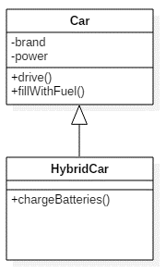
Generalization
HybridCar extends Car
HybridCar inherits all the properties and the methods of Car
HybridCar can do more things!

Slide 55
Good or Bad?
FRUIT
GARAGE
APPLE
PEAR
CAR
BICYCLE

Slide 56
Good or Bad?
FRUIT
GARAGE
APPLE
PEAR
CAR
BICYCLE

Slide 57
Realization
It is a specialized type of implementation relationship between a class and interface.
The interface realization relationship specifies that the realizing class must conform to the contract that the provided interface specifies.
Notes:
If you have done everything correctly you only have to change the implementation of the methods in the interface, the rest of the program remains the same.
a Dependency is a relationship that shows that an element requires other model element for its specification or implementation. The element is dependent upon the independent element, called the supplier.
- The class MultiMedia infact uses the methods in the interface, which is implemented by TapePlayer.

Slide 58
Dependency
It is a directed relationship that shows that an element requires other model element for its specification or implementation.
The element is dependent upon the independent element, called the supplier.

Slide 59
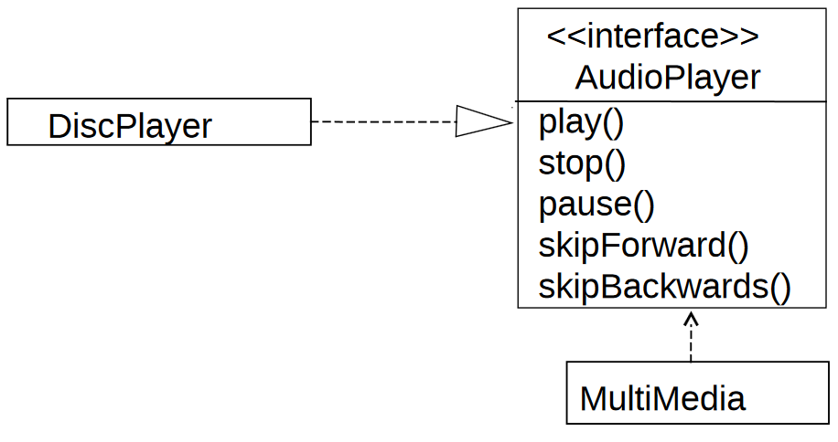
Realization & Dependency
Realization
Dependency
Notes:
If you have done everything correctly you only have to change the implementation of the methods in the interface, the rest of the program remains the same.
a Dependency is a relationship that shows that an element requires other model element for its specification or implementation. The element is dependent upon the independent element, called the supplier.
The class MultiMedia uses the methods in the interface, which is implemented by TapePlayer.
a change to the DiscPlayer class might require a change to the MultiMedia class.
DIFFERECE between Association, Dependency??

Slide 60
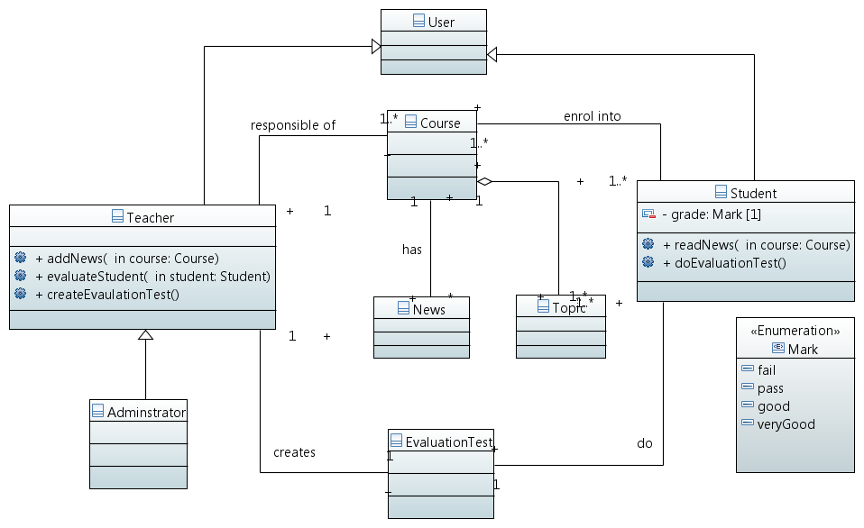
Class Diagram: Example

Slide 61
Questions?

Slide 62
Assignment 2 :
An online flight reservation system must allow customers to search flights, make a reservation, purchase a ticket, and select a seat. Purchasing a ticket operation is verified by a bank.
To do: draw a Class Diagram of the system.
Time : 5 minutes.

Slide 63
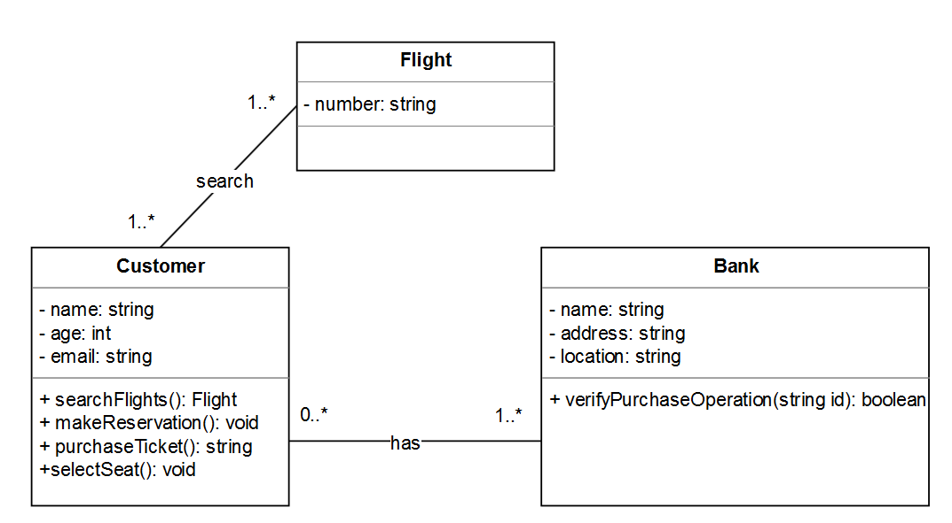
Assignment 2 : solution

Slide 64
Summary
Use Class Diagrams to model structure
Use Activity diagrams and Sequence Diagrams to model dynamics/behaviour of systems

