Slide 1
Sequence Diagrams
Activity Diagrams
Gothenburg, April 2019

Slide 2
Student representatives
Nafen Haj Ahmad gushajana@student.gu.se
Marcus Aronsson gusaromad@student.gu.se
Moritz Denke gusdenmo@student.gu.se

Slide 3
Learning Goals Lecture 6
Object interaction with sequence diagrams
  Sequence diagram notation (UML)
Interaction
  Black Box
  White Box
Example case: from domain model and use cases to sequence diagram

Slide 4
Lectures Outline – Part 1
Lecture | Topic
L1 | Introduction (course logistics, scoping, …) Design Process (Analysis & Design) Modeling in general
L2 | Systems/Responsibilities/Roles,Components, Objects & Object Orientation
L3 | The Problem Domain (Analysis): Context diagram, Stakeholders, Use Cases
L4 | Domain Modelling with Class Diagrams (Analysis / Finding Objects)
L5 | CRC cards
L6 | Sequence diagrams / Activity Diagrams / Black/White-Box

Slide 5
Lectures Outline – Part 2
Lecture | Topic
L7 | State machines & Activity Diagrams
L8 | Going from Domain to Technical Design (more depth/detail on UML notation), layering Component Diagram (part 1)
L9 | Going from Domain to Technical Design (more depth/detail on UML notation), layering Component Diagram (part 2)
L10 | Agile development with UML Agile Software Development Workshop (part 1)
L11 | Recap Design Principles and Design Patterns

Slide 6
4 + 1 Views Model
Logical view: classes, packages, components, interfaces.
Development view:
file ownership
Config. Mngnt view
versioning policies
…
A
B
Stakeholders &
Use Cases view
C
D
Process view:
State-diagrams
Deployment view:
physical model + mapping
A
B
C
D
A
C
D
B
TCP/IP over Ethernet
bandwidth, availability
Notes:
- The views are used to describe the system from different viewpoints.
- The scenarios describe sequences of interactions between objects and between processes.

Slide 7
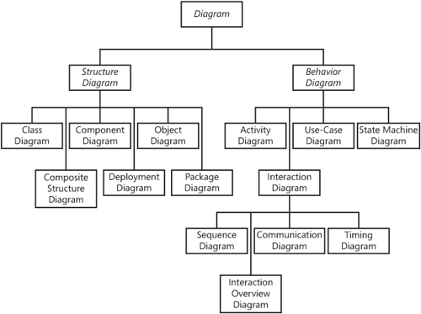
UML for
Software System Documentation

Slide 8

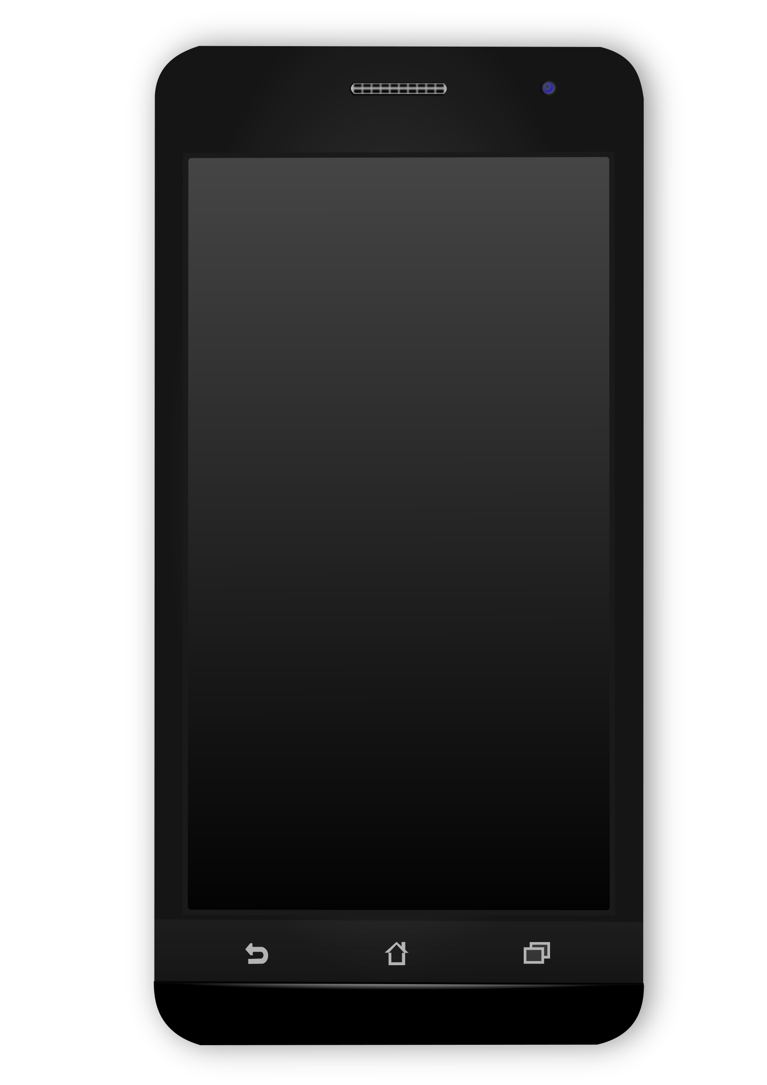

Example
Blood
Pressure
Running
Tracker
send

Slide 9
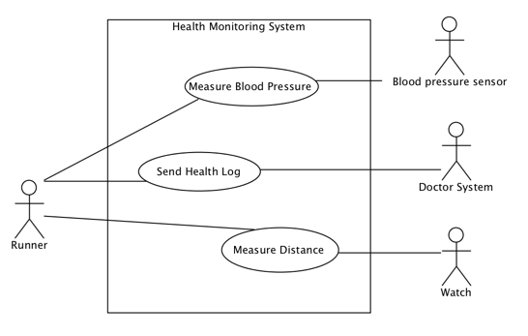
Use Case Diagram
d

Slide 10
Use Case Specification
Measure Distance
Runner wants to measure distance from A to B
Basic Flow
Use case begins when runner starts measuring and starts running. Phone shows progress.
2. Runner runs on. Display shows distance 0km.
3. Runner reaches B and stops the measuring. Display shows final distance. The use case ends
Alternative Flows
At 1, the app is on from previous run. The runner resets trip value and the use case resumes from 2.
At 3, the runner stops for so long that the app turns off the measuring. Use case aborts.
Scenario’s
S1. Basic Flow
S2. Basic Flow, A1
S2. Basic Flow, A2

Slide 11
Use Case Diagram
d
?

Slide 12
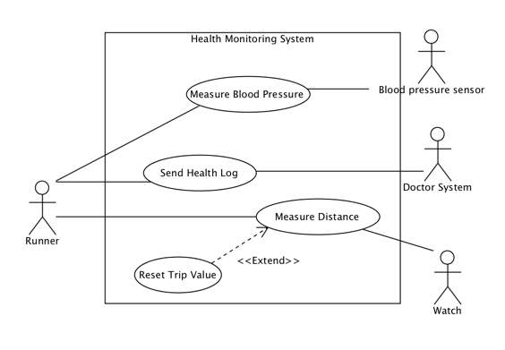

Slide 13
Reset trip value
Runner wants to reset the trip value in the computer
Basic Flow
1. Use case begins when the runner decides to reset the computer’s trip value.
2. The runner selects the reset function. The system asks for confirmation to reset all trip values.
3. The runner confirms. The system notifies the runner that all trip values have been reset.
4. After 3 seconds, the system returns to its main display. The use case ends.
Alternate flow
A1. At 3, the user rejects resetting all trip values. The system immediately returns to the main display. The use case ends.
Scenarios
S1. BF
S2. BF, A1

Slide 14
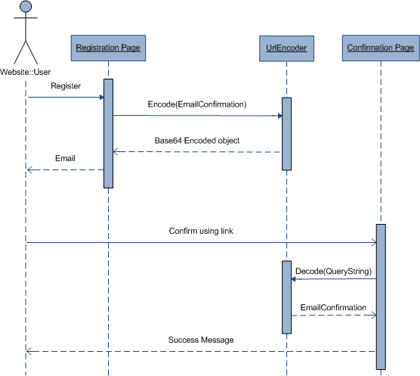
UML – Sequence Diagram
UML sequence diagram represents the dynamics of the system – i.e. temporal .
UML sequence diagram depicts:
  interactions between objects.
  how the business currently works by showing how various business objects interact.

Slide 15
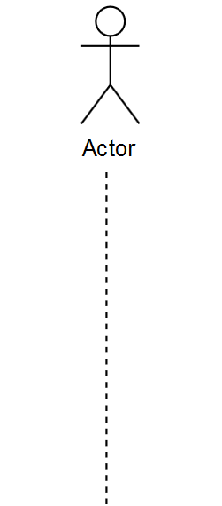
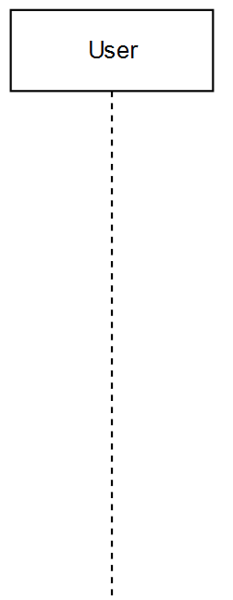
Sequence Diagram Elements
Lifeline : Class Name (instance name)

Slide 16
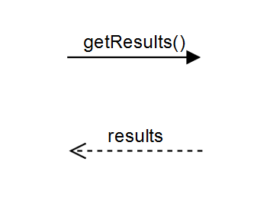
Sequence Diagram Elements
Messages:
Can be:
      Request
      Response

Slide 17
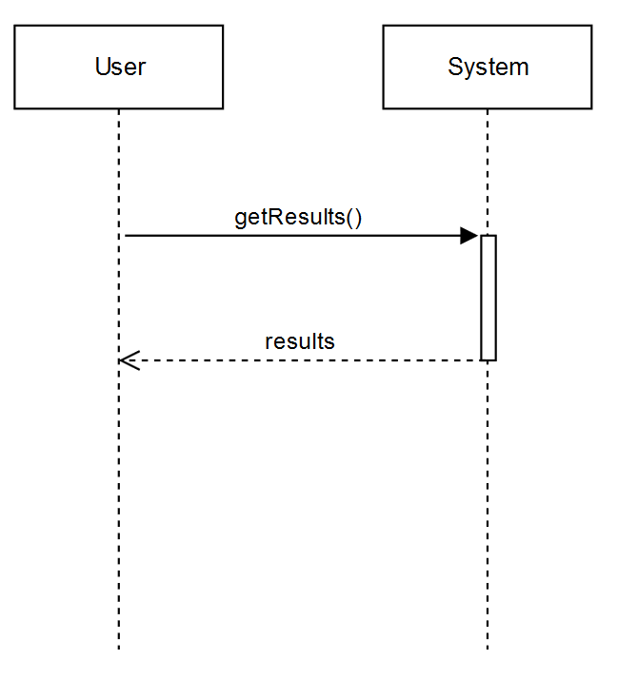
Sequence Diagram Elements
Activation line (Execution Occurrence)

Slide 18
Relationship to Class Diagrams
: Store
Store
: A
add (1)
- s : int [*]
add(4)
add(6)
+ add (n:int)
+ get() : String
get()
x
x = get()
Class diagram notation:
- stands for Private
+ stands for Public
[*] is attribute Multiplicity

Slide 19
Linking Use Cases and Sequence Diagrams
Use Cases view
Behaviour view: Sequence Diagrams
Eat
Eat
A
G
P
Eve
Sleep
Adam
Eve
Play
Sleep
E
F
G
Adam
A Software Design should include a sequence diagram for every use case
to illustrate how a use case is implemented.
in Analysis Seq Diagrams illustrate collaborations in the domain
Play
H
I
Adam
Eve
Notes:
- The views are used to describe the system from different viewpoints.
- The scenarios describe sequences of interactions between objects and between processes.

Slide 20


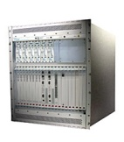


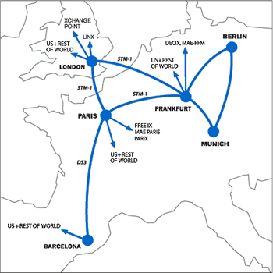
Interaction
”Black Box Model”
HIGH LEVEL
INTERACTION
SYSTEM
BOUNDARY
Mobile
Telephony
”White Box Model”
Radio
Network
Controller
Radio
Network
Controller
Mobile Phone
Radio
Base Station
Public Switch
Telephony
Network
Radio
Base Station
Mobile Phone
INTERNAL INTERACTION
Notes:
s

Slide 21
Black Box vs White Box
Black Box: looks at the system as a whole.
No knowledge of the internal workings.
Only its input and output.
White Box: internal workings are known

Slide 22
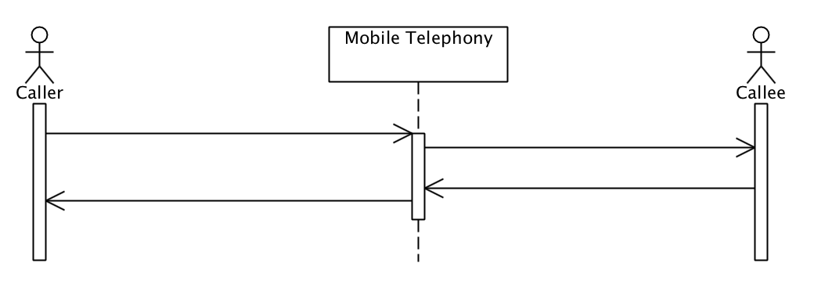
Black Box or White Box?
Black Box

Slide 23
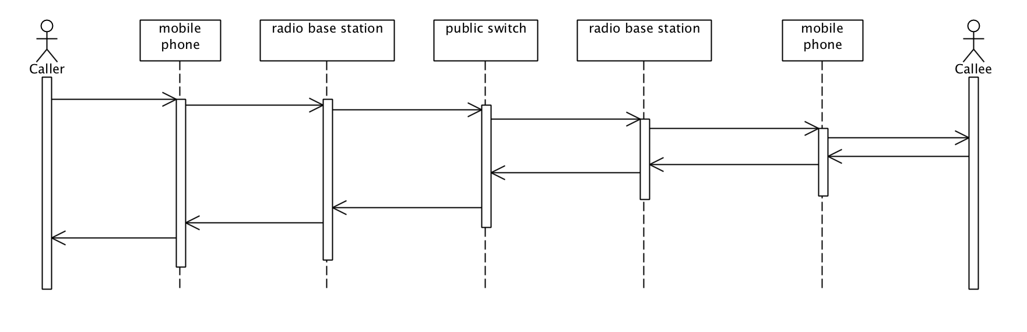
Black Box or White Box?
White Box

Slide 24
Black Box or White Box?
Black Box

Slide 25
Loop Frames (a.k.a. Loop Fragments)
: A
: B
loop
[expression]
message()
The loop expression is informal, e.g.,
  1..10
  for each item in the shopping basket
  until the sun goes down.

Slide 26
Parallellism Frames
: A
: B
par
m
[expression]
n
o
p
The frame here stands for all of the following scenarios (traces):
: A
: B
: A
: B
: A
: B
: A
: B
o
m
m
m
p
o
o
n
m
n
p
o
p
n
n
p
Q: Do you see any more?

Slide 27
Object Creation
: GU1
Create()
b1 : Button
Create()
b2 : Button
Object-rectangle ‘starts’ later in time (‘create’-label).
Not essential requirement for many diagrams.

Slide 28
Sequence Diagram Elements
  Combined fragments
  alternatives (alt) denote a mutually exclusive choice between two or more message sequences
  options (opt),
  loops (loop)

Slide 29
Sequence Diagram Elements
  Combined fragments
  alternatives (alt),
  options (opt) denote a sequence that occurs only under a certain condition. Otherwise, the sequence does not occur.
  loops (loop)

Slide 30
Sequence Diagram Elements
  Combined fragments
  alternatives (alt),
  options (opt),
  loops (loop) capture repetitive sequences.

Slide 31
Reference Frames
: A
: B
ref
External Sequence Diagram Name (Parameters)

Slide 32
Illustration Loop, Alt, Opt

Slide 33
Illustration: Opt(ional) & Ref(erence)
Correct?

Slide 34

Questions?
Der Wanderer über dem Nebelmeer
(Wanderer above the Sea of Fog)
1818 by Caspar David Friedrich
(Kunsthalle Hamburg)

Slide 35
Assignment 3 :
An online flight reservation system must allow customers to search flights, make a reservation, purchase a ticket, and select a seat. Purchasing a ticket operation is verified by a bank.
To do: draw a Sequence Diagram of the system.
Time : 5 minutes.

Slide 36
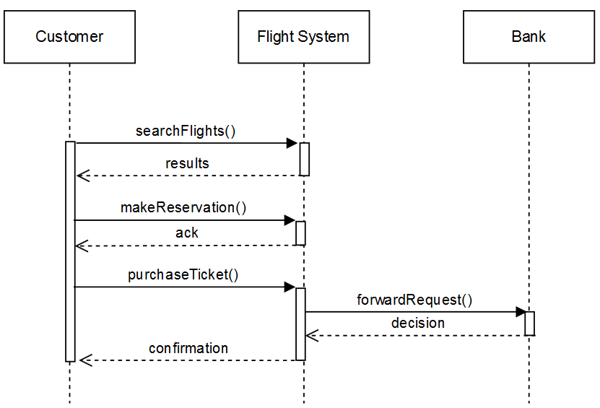
Assignment 3 : solution
Notes:
[MC: we think ‘verification’ of the payment is missing in this diagram compared to the text]

Slide 37
UML – Activity Diagram
Activity diagrams represent:
a process of actions and decision
the flow of actions in system
  The flow of control from activity to activity in the system
  Alternate paths through the flow
  Which activities can be done in parallel

Slide 38
Notation of Activity Diagrams
Activity
  is the core symbol
  rectangle with rounded ends
  meaningful name
Transition
  shows the flow (sequencing)
  between activities
  arrow with open
  arrowheads
Add
Client
Assign Staff
Contact
Notes:
Activity is the core symbol of an activity diagram. An activity represents a task which needs to be done.
Example: Add a Client; Assign Staff Contact.

Slide 39
Notation of Activity Diagrams
Start state
  black circle
Decision points
  diamond
Guard conditions
  in square brackets
Final state
  black circle in white circle
Add a New
Client
Assign Staff
Contact
[no campaign to add]
[campaign to add]
Add New
Campaign

Slide 40
Notation of Activity Diagrams
Alternative notation for
branching:
  alternative transitions
  are shown leaving the
  activity with guard
  conditions
Note that guard conditions do not have to be mutually exclusive, but it is advisable that they are
Add a New
Client
Assign Staff
Contact
[no campaign to add]
[campaign to add]
Add New
Campaign
Notes:
Alternative notation for branching: alternative transitions are shown leaving the activity with guard conditions
Note that guard conditions do not have to be mutually exclusive, but it is advisable that they should be

Slide 41
Add a New
Client
=
Add a New
Client
Assign Staff
Contact
[no campaign to add]
Assign Staff
Contact
[no campaign to add]
[campaign to add]
Add New
Campaign
[campaign to add]
Add New
Campaign
Notes:
They are the same - It depends on your style of drawing
Conditions can be stated in informal language and in formal language such as predicate logic.

Slide 42
Notation of Activity Diagrams
Object flows
  dashed arrow
Objects
  rectangle
  with name of object underlined
  optionally shows the state of the object in square brackets
:Campaign
[Active]
Record completion
of a campaign
:Campaign
[Completed]

Slide 43
Activity Diagrams: Swimlanes
Swimlanes
  vertical columns
  labelled with the
  person, organisation
  or department
  responsible for the
  activities in that
  column
Campaign
Manager
Accountant
Client
Record Completion
of a campaign
Issue invoice
Pay invoice
Record client
payment

Slide 44
More Notations
Read more:
Chapter 5 of Bennett, McRobb and Farmer’s book (2nd Ed.)

Slide 45
Assignment 1:
An online flight reservation system must allow customers to search flights, make a reservation, purchase a ticket, and select a seat. Purchasing a ticket operation is verified by a bank.
To do: draw a Activity Diagram of the system.
Time : 5 minutes.
Note: These actions in red happen in a sequential order.
This is not a solution, don’t copy!

Slide 46
Assignment 1 : solution
Customer
Bank
Search for flights
Make a reservaton
Purchase a ticket
Verify a purchase
[purchase is confirmed]
Select a seat
[purchase is NOT confirmed]

Slide 47
UML – Class Diagram
A class diagram provides an overview of the structure of the system by showing its:
  classes,
  attributes (properties),
  methods (operations) and,
  relationships between the classes.

Slide 48
Main Elements of a Class Diagram
Classes
Relationships

Slide 49
Classes

Slide 50
Class Representation
Classes are represented by rectangular boxes
Each box contains three elements:
  Class name
  Attributes
  Methods (Operations)
MyCar
- brand: String
- registrationPlate: String
+ drive(): void
+ fillWithFuel(): void
Notes:
Classes are represented by a box with three sections as you see here:
The first section contains the Name of the class, the second section contains the attributes or properties… and the last section contains a list of the operation or methods ..
Here we have..

Slide 51
Naming Convention
  Class names: first letter is capital, camel-case.
  Attributes: first letter is small, camel-case.
  Methods: first letter is small, camel-case.
MyCar
- brand: String
- registrationPlate: String
+ drive(): void
+ fillWithFuel(): void
Notes:
- Name should be singular, and in the middle of the box, first letter is capital and if it contains two words, it should be represented with a camel-case structure.

Slide 52
Visibility of Attributes & Methods
Visibility:
  “-” private visibility
  “+” public visibility
By default, attributes are hidden and methods are visible.
MyCar
- brand: String
- registrationPlate: String
+ drive(): void
+ fillWithFuel(): void

Slide 53
Interfaces
Interfaces are very important. By using an interface you can separate implementation from specification.
An interface specifies a service of a class.
Notes:
By using the interfaces, you separate the specification form the implementation.
The interface provides a general specification of the structure and behavior of a class without providing any details on implementation.

Slide 54
Interfaces: example
<<interface>>
Audio Player
play()
stop()
pause()
skipForward()
skipBackwards()
DiscPlayer
Notes:
Can we put inheritance to go from top to bottom/vertically?

Slide 55
Enumerations
A user defined data type that consists of a name and a list of enumeration literals.
Car
- fuel : FuelType
<<enumeration>>
FuelType
Gasoline
Diesel

Slide 56
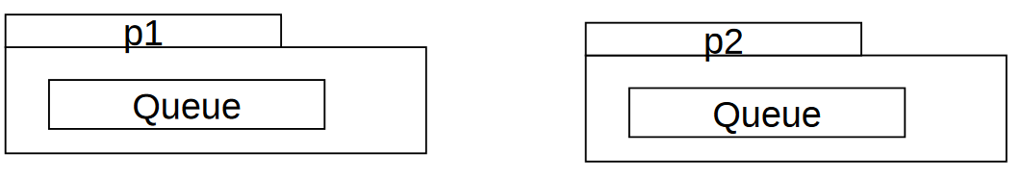
Packages
In UML, one can use packages to group classes.
One can resolve name conflicts with packages, for example:
p1::Queue and p2::Queue are two different classes with the same name.

Slide 57
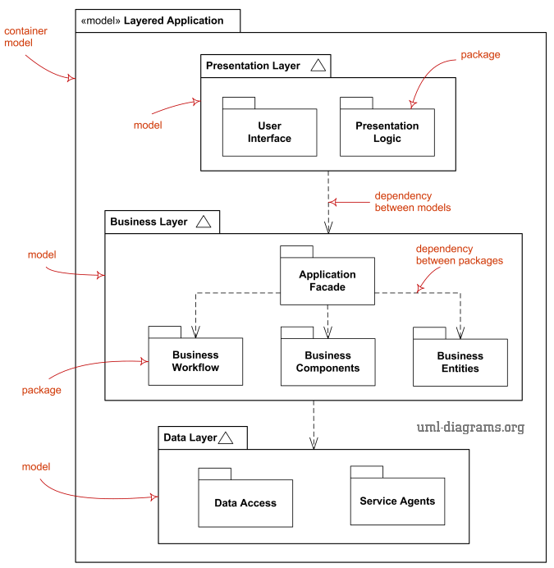

Slide 58

Relationships

Slide 59
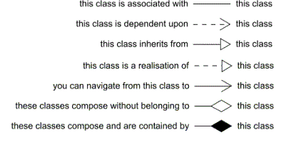
Relationships Types
Association (bidirectional)
Dependency
Generalization
Realization
Association (unidirectional)
Aggregation
Composition

Slide 60
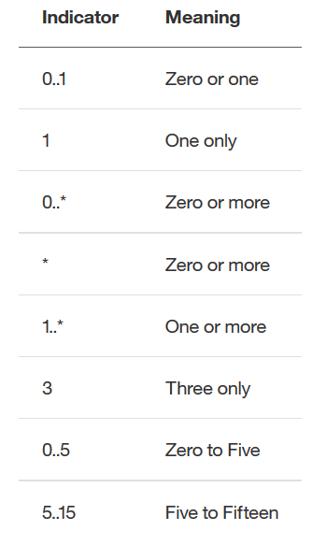
Multiplicity

Slide 61
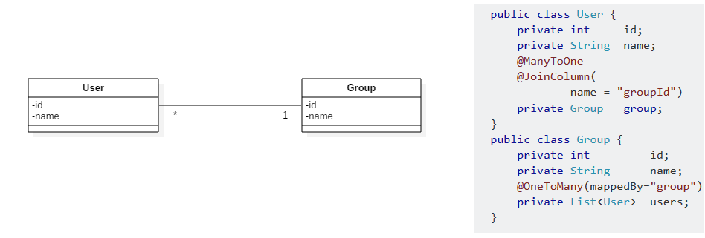
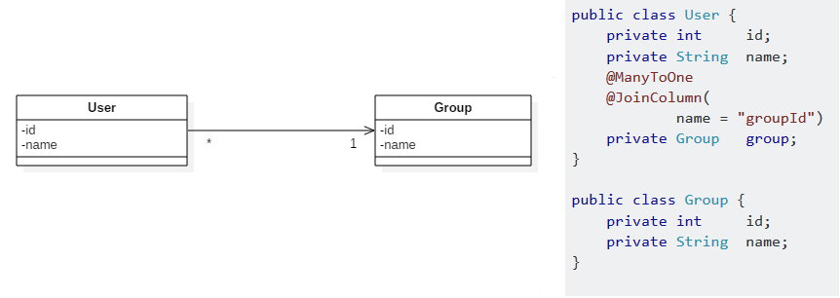
Association: Bidirectional vs. Unidirectional
Notes:
User knows Group, but Group dose not know user: there is no reference to User in Group class

Slide 62
Association: naming
  Verb phrase.
  Can be read only one way.
Belongs to

Slide 63
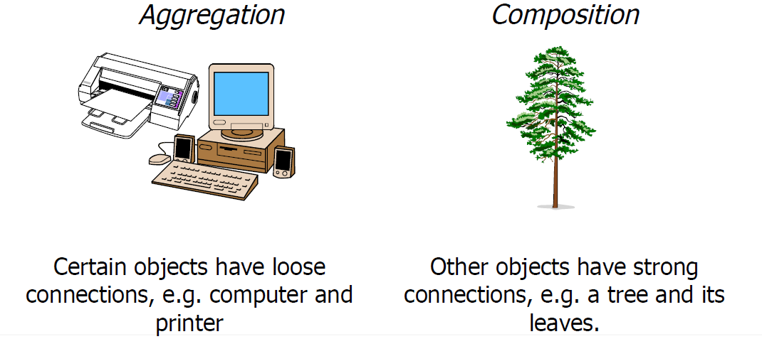
Aggregation vs. Composition

Slide 64


Aggregation vs. Composition
  If we destroy the computer, we still have the printer
  If we destroy the mouse, the buttons will be destroyed

Slide 65
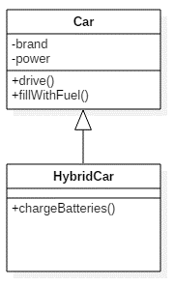
Generalization
HybridCar extends Car
HybridCar inherits all the properties and the methods of Car
HybridCar can do more things!

Slide 66
Good or Bad?
FRUIT
GARAGE
APPLE
PEAR
CAR
BICYCLE

Slide 67
Good or Bad?
FRUIT
GARAGE
APPLE
PEAR
CAR
BICYCLE

Slide 68
Realization
It is a specialized type of implementation relationship between a class and interface.
The interface realization relationship specifies that the realizing class must conform to the contract that the provided interface specifies.
Notes:
If you have done everything correctly you only have to change the implementation of the methods in the interface, the rest of the program remains the same.
a Dependency is a relationship that shows that an element requires other model element for its specification or implementation. The element is dependent upon the independent element, called the supplier.
- The class MultiMedia infact uses the methods in the interface, which is implemented by TapePlayer.

Slide 69
Dependency
It is a directed relationship that shows that an element requires other model element for its specification or implementation.
The element is dependent upon the independent element, called the supplier.

Slide 70
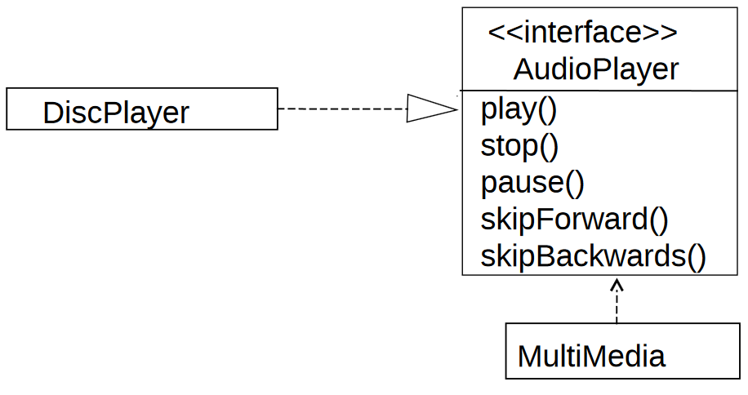
Realization & Dependency
Realization
Dependency
Notes:
If you have done everything correctly you only have to change the implementation of the methods in the interface, the rest of the program remains the same.
a Dependency is a relationship that shows that an element requires other model element for its specification or implementation. The element is dependent upon the independent element, called the supplier.
The class MultiMedia uses the methods in the interface, which is implemented by TapePlayer.
a change to the DiscPlayer class might require a change to the MultiMedia class.
DIFFERECE between Association, Dependency??

Slide 71
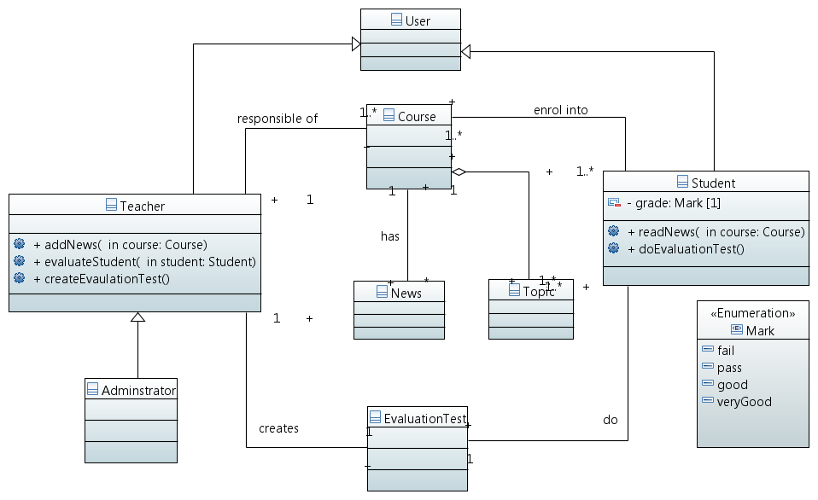
Class Diagram: Example

Slide 72
Summary
Sequence Diagrams describe the temporal sequencing of interactions in a system.
  Sequence diagrams can be used in the analysis-stage (from a black-box perspective). They can also be used in the design stage (from a white-box perspective).
  Sequence diagrams are typically used to ‘illustrate’ particular scenario’s of all possible behaviour, and rarely completely specify a system.
Activity Diagrams describe a system from the perspective of ‘processes’ (which can be based on actions taken by different actors).
  Activity diagrams typically describe a complete process.

Slide 73

Questions?

Slide 74
Assignment 2 :
An online flight reservation system must allow customers to search flights, make a reservation, purchase a ticket, and select a seat. Purchasing a ticket operation is verified by a bank.
To do: draw a Class Diagram of the system.
Time : 5 minutes.

Slide 75
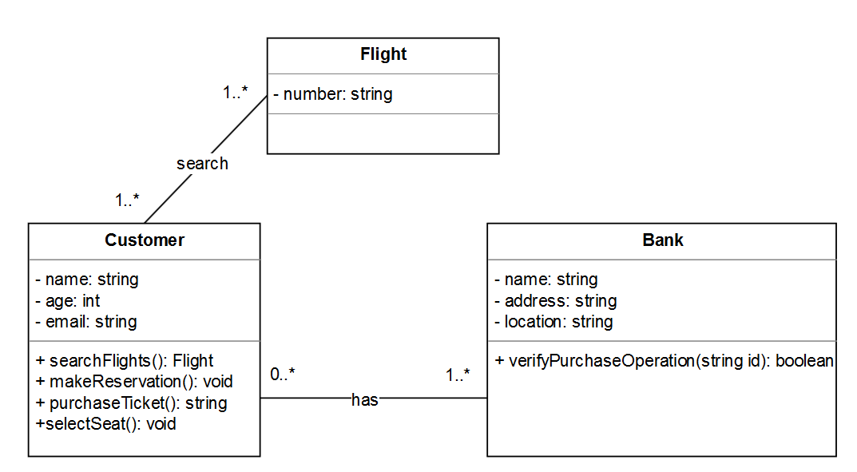
Assignment 2 : solution

