Slide 1
Stroopwafels, Recap, CRC exercise
SAD 2019 - Lecture 6
Dave Stikkolorum
Michel Chaudron

Slide 2
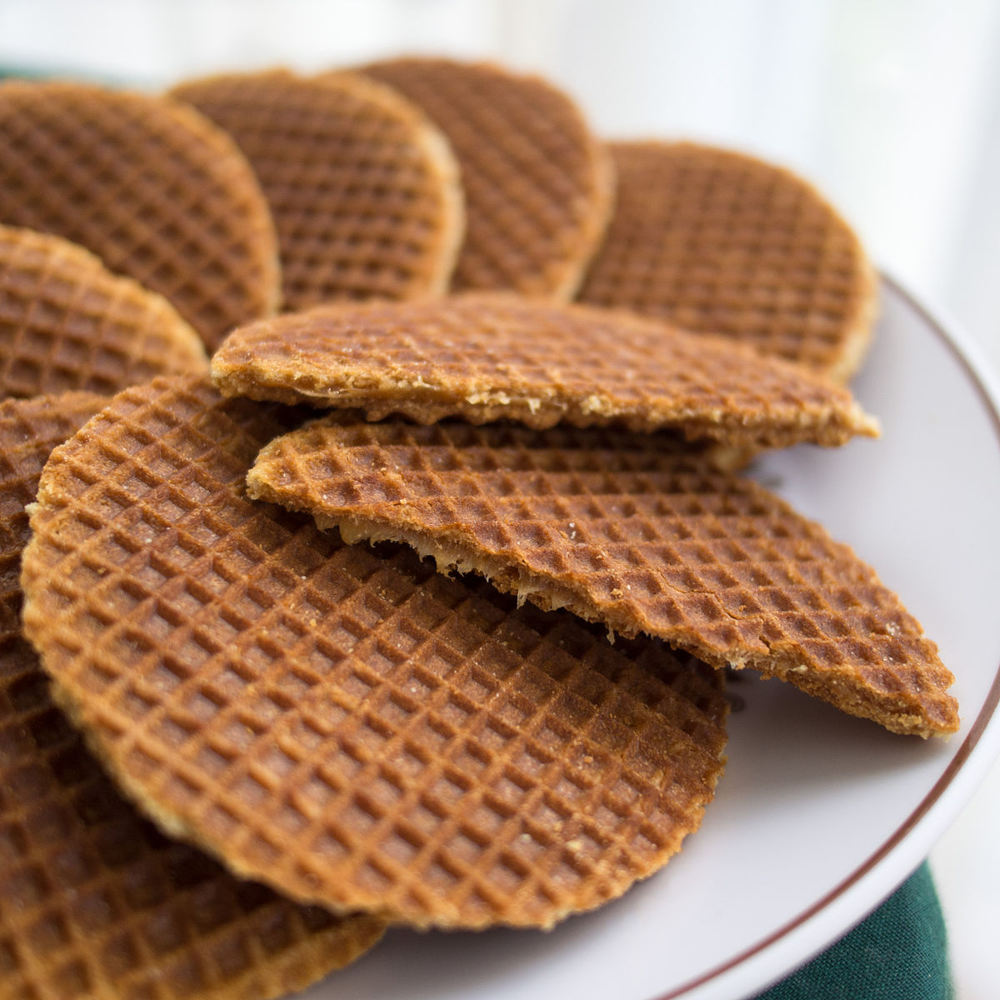
Stroopwafel Contest
Takeaway (https://commons.wikimedia.org/wiki/File:Stroopwafels_01.jpg), „Stroopwafels 01“, https://creativecommons.org/licenses/by-sa/3.0/legalcode

Slide 3
Global Learning Goals Lecture 6
Recap:
Relationships in Class Diagrams
Sequence Diagrams
Activity Diagram (tokens)
Example case: from case description to domain model, use case diagram and use cases.
CRC card exercise

Slide 4
We are still in the Analysis Phase!!

Slide 5
Recap: class relationships - association

Slide 6
Recap: class relationships - association
A “knows” relationship

Slide 7
Recap: class relationships - composition

Slide 8
Recap: class relationships - composition
A “part of” and “owns” relationship

Slide 9
Recap: class relationships - aggregation

Slide 10
Recap: class relationships - aggregation
A “part of” and “has” relationship

Slide 11
Recap: class relationships - directed association
Mouse does not know Cat

Slide 12
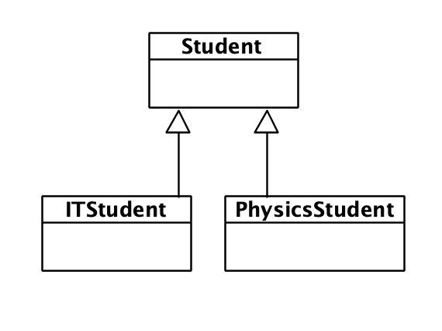
Recap: class relationships - inheritance
“Is a” relationship

Slide 13
Recap: class relationships - more?
Yes, there is more, but … better fits the Design Phase (dependency, realizes, ...)

Slide 14
Sequence Diagram: Traces
: A
: B
: C
: D
m
n
p
o
Q
What is the trace? (order of messages?)
This slide is originally from Lars Pareto

Slide 15
Sequence Diagram: Traces
: A
: B
: C
: D
m
n
p
o
Q
What is the trace? (order of messages?):
n, m, p, o, q
But also: m, n, p, q, o
This slide is originally from Lars Pareto

Slide 16
Parrallellism Frames
: A
: B
par
m
[expression]
n
o
p
The frame here stands for all of the following scenarios (traces):
: A
: B
: A
: B
o
m
p
o
Q: Do you see any more?
m
n
p
n
This slide is originally from Lars Pareto

Slide 17
Parrallellism Frames
: A
: B
par
m
[expression]
n
o
p
The frame here stands for all of the following scenarios (traces):
: A
: B
: A
: B
: A
: B
: A
: B
o
m
m
m
p
o
o
n
m
n
p
o
p
n
n
p
This slide is originally from Lars Pareto
Q: Do you see any more?

Slide 18
Sequence Diagram: Numbering
: A
: B
: C
: D
1.m
2.n
3.p
5.o
4.Q
What is the trace? (order of messages?): 1,2,3,4,5
This slide is originally from Lars Pareto

Slide 19
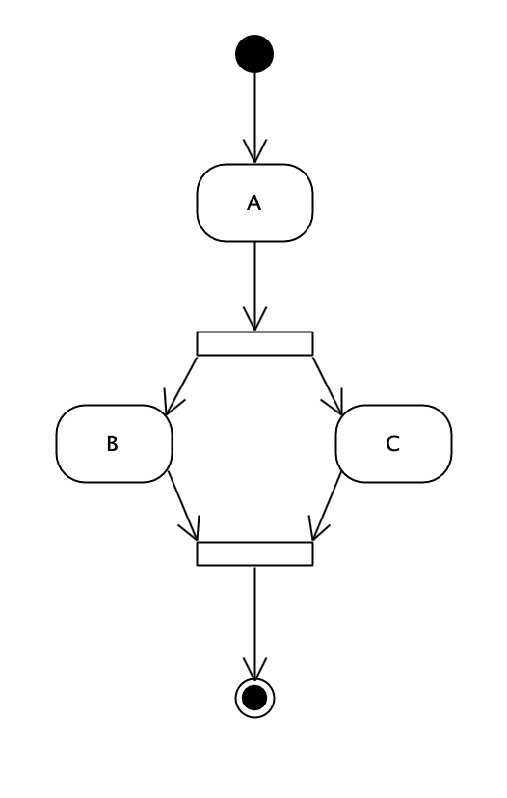
Activity Diagram

Slide 20
Activity Diagram

Slide 21
Activity Diagram

Slide 22
Activity Diagram
What’s next?

Slide 23
Activity Diagram
What’s next?

Slide 24
Activity Diagram
What’s next?

Slide 25
We are still in the Analysis Phase!!

Slide 26
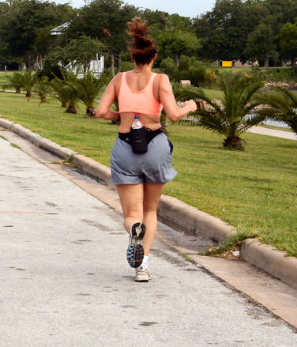
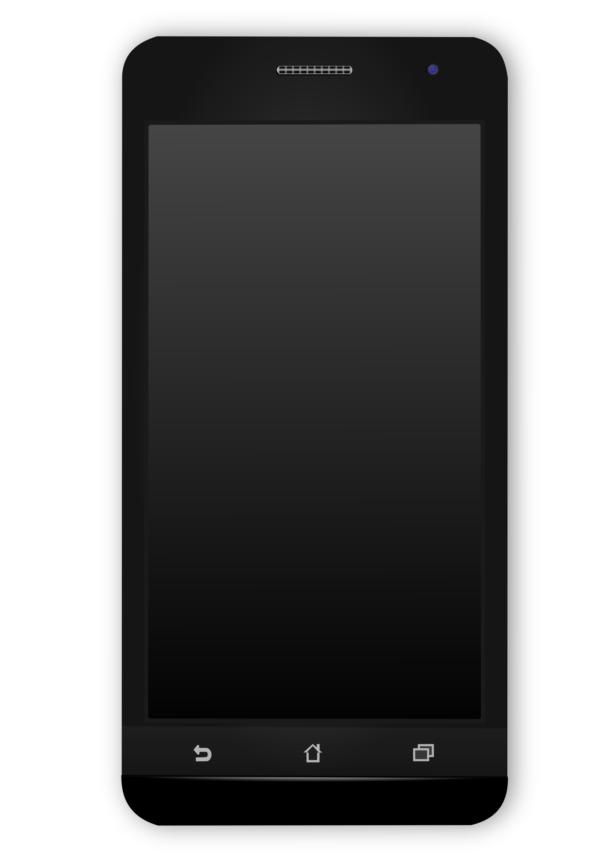
Example Case
Blood
Pressure
Running
Tracker
send
Monitoring Runners’ Health

Slide 27
Case Description
Monitoring Health
A group of runners wants to monitor several personal statistics for analysing their health during exercising. There are four main matters they want to measure: heart rate, blood pressure, distance and time. Every runner owns a watch that can do the heart rate measurement and a pressure belt for the measurement of the blood pressure.
The group wants a system that combines the input from the watch and the belt. The system should be able to show distance, speed, heart rate, blood pressure during running or when having a pause. The system should be able to send health logs to a doctor (for support during professional advice).

Slide 28
Noun + Verb Identification
Monitoring Health
A group of runners wants to monitor several personal statistics for analysing their health during exercising. There are four main matters they want to measure: heart rate, blood pressure, distance and time. Every runner owns a watch that can do the heart rate measurement and a pressure belt for the measurement of the blood pressure.
The group wants a system that combines the input from the watch and the belt. The system should be able to show distance, speed, heart rate, blood pressure during running or when having a pause. The system should be able to send health logs to a doctor (for support during professional advice).

Slide 29
Verb Identification - selecting use cases
Wants - vague, help verb Monitor - Measure? Exercising - not an activity of the system Are - vague, help verb to measure -> Use Case?: Measure ….. / Perform Measurement? owns -> could say something about relation can - vague, help verb combines - related to analyse should be able to show -> Use Case: Show Status should be able to send -> Use Case: Send Health Log Having - vague, help verb Send - already covered

Slide 30
1st version use case diagram
Health Monitoring System
Start Activity
Blood Pressure Belt
<<include>>
Runner
Perform Measurement
Watch
Send Health Log
Doctor

Slide 31
2nd version use case diagram
Health Monitoring System
Measure Blood Pressure
Blood Preasure Belt
<<include>>
Measure Hearth Rate
Start Activity
<<include>>
Runner
<<include>>
Measure Distance
Watch
Send Health Log
In this case the Runner can initiate the separate measurements. Also it can start an Activity that starts the measurements
Downside: a bit more complex
Doctor

Slide 32
3rd version use case diagram
Health Monitoring System
Start Activity
<<include>>
Blood Preasure Belt
Perform Measurement
Runner
Measure Blood Pressure
Measure Distance
Measure Hearth Rate
Watch
Also possible
Send Health Log
Doctor

Slide 33
Noun identification - candidate classes and selection
Group - collection of runners Runners -> class : Runner statistics - vague, related to measurements Health - vague, related to measurements matters - just vague ;-) heart rate - attribute of Measurement blood pressure - attribute of Measurement distance - attribute of Measurement Time - class Time? We assume time is available, so implicit Watch - class: Watch Measurement: class Measurement
pressure belt - class PressureBelt blood pressure - attribute of Measurement System - very abstract term, end situation, not applicable now
Input - vague related measurement Speed - attribute of Measurement (calculated) Running - activity -> class Activity Pause - action of runner, not relevant health logs -> class HealthLog Doctor -> class: Doctor Support - outside of scope case
Advice - outside of scope case

Slide 34
1st version Domain Model
Runner
does an
Activity
Is measured by
HealthLog
Measurement
contains
Receives from
Is send to a
Watch
Receives from
Docter
PressureBelt

Slide 35
In the meantime, a discussion with the client
What should be known about a runner?
Length, Weight, Age and the Name
Which device knows the location?
The watch

Slide 36
2nd version Domain Model
1
does an
*
Runner
Activity
1
Is measured through
name
length
weight
age
date
duration
currentSpeed
distance
1..*
contains
Measurement
Receives from
run()
1..*
HealthLog
Watch
0..*
If it helps to explain better. Only clear domain specific.
date
heartRate
location
Receives from
Is send to a
BloodPressureBelt
Doctor
pressure
emailAddress

Slide 37
2nd version Domain Model
1
does an
*
Runner
Activity
1
Is measured through
name
length
weight
age
date
duration
currentSpeed
distance
1..*
contains
Measurement
Receives from
run()
1..*
HealthLog
Watch
0..*
date
heartRate
location
Receives from
Is send to a
BloodPressureBelt
Doctor
pressure
emailAddress

Slide 38
Health Monitoring System
Measure Blood Pressure
d
Blood Pressure Belt
<<include>>
Phone is obvious, but could also be another ‘device’. Actually not decided on yet in this phase.
Measure Hearth Rate
Start Activity
<<include>>
Runner
<<include>>
Measure Distance
Watch
Send Health Log
Doctor

Slide 39
Use Case Specification
Use case: Measure Distance
Brief description: Runner wants to measure distance from A to B
Actors: Runner
Basic Flow
1.Use case begins when runner starts measuring and starts running. 2. System shows progress. 3.Runner runs on. 4. System shows distance 0 km. 5. Runner reaches B and stops the measuring. 6. System shows final distance. The use case ends.
Alternative Flows
At 1, the system is still on from a previous run. The runner resets trip value and the use case resumes from 2.
Exceptions
1. At 3, the runner stops for so long that the system turns off the measuring. Use case aborts.
Scenario’s
S1. Basic Flow
S2. Basic Flow, A1
S2. Basic Flow, A2

Slide 40
Use Case Specification (alternative notation)
Use case: Measure Distance
Brief description: Runner wants to measure distance from A to B
Actors: Runner
Basic Flow
Alternative Flows
At 1, the system is still on from a previous run. The runner resets trip value and the use case resumes from 2.
Exceptions
1. At 3, the runner stops for so long that the system turns off the measuring. Use case aborts.
User | System
1.Use case begins when runner starts measuring and starts running. 3.Runner runs on. 5. Runner reaches B and stops the measuring. | 2. System shows progress. 4. System shows distance 0 km. 6. System shows final distance.The use case ends.

Slide 41
Health Monitoring System
Measure Blood Pressure
Blood Pressure Belt
<<include>>
Measure Hearth Rate
Start Activity
<<include>>
Runner
<<include>>
Measure Distance
Watch
Send Health Log
?
Doctor

Slide 42
Health Monitoring System
Measure Blood Pressure
Blood Pressure Belt
<<include>>
Measure Hearth Rate
Start Activity
<<include>>
Runner
<<include>>
Measure Distance
Watch
<<extends>>
Send Health Log
Reset Trip Value
Doctor

Slide 43
Reset trip value
Runner wants to reset the trip value in the computer
Basic Flow
1. Use case begins when the runner decides to reset the computer’s trip value.
2. The runner selects the reset function. The system asks for confirmation to reset all trip values.
3. The runner confirms. The system notifies the runner that all trip values have been reset.
4. After 3 seconds, the system returns to its main display. The use case ends.
Alternate flow
A1. At 3, the user rejects resetting all trip values. The system immediately returns to the main display. The use case ends.
Scenarios
S1. BF
S2. BF, A1

Slide 44
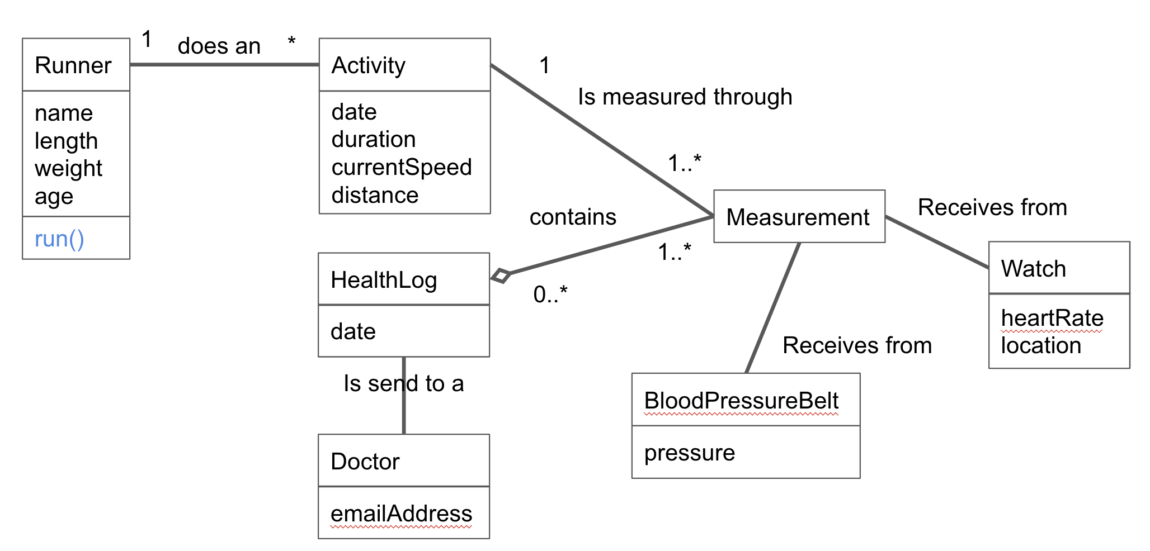
Running App Domain
already satisfied with this one?
Does it reflect the problem?
Exercise: USE CRC Cards to complete
Complete the diagram

Slide 45
Modelling Exercise 1/2
Exercise: USE CRC Cards to complete Complete the diagram
Complete the use case descriptions (which one is missing?)
Search for candidate classes
Text analysis
Discussion
Make CRC cards
Validate by simulating the use cases
Complete the analysis class diagram

Slide 46
Modelling Exercise 2/2
Exercise: Use a sequence diagram to show the interaction between domain objects
1. Have a look at the domain model (analysis class diagram)
2. For every use case, make a sequence diagram

