Slide 1
SAD 2019
Lecture 7 - Behaviour (state machines)
Dave Stikkolorum

Slide 2
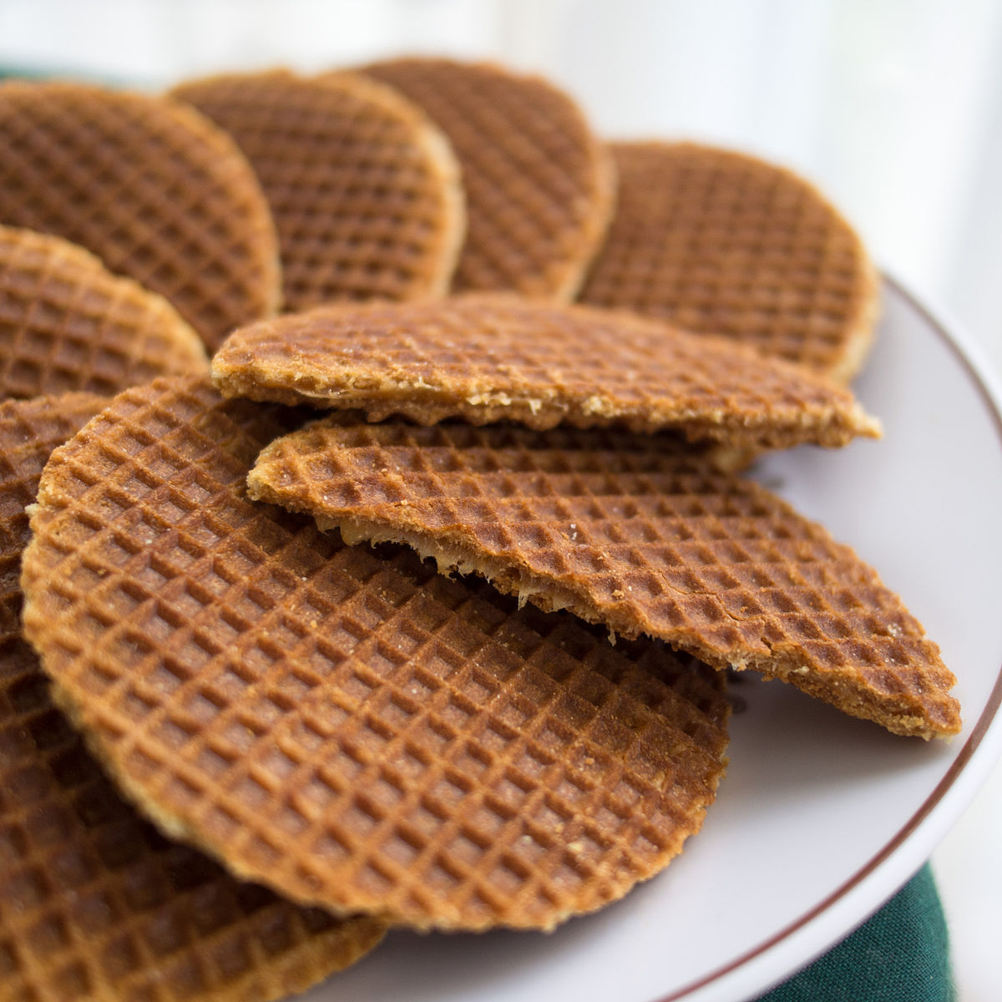
Stroopwafel Contest
Takeaway (https://commons.wikimedia.org/wiki/File:Stroopwafels_01.jpg), „Stroopwafels 01“, https://creativecommons.org/licenses/by-sa/3.0/legalcode

Slide 3
Global Learning Goals Lecture 7
Recap:
Example case: from domain model and use cases to sequence diagram / CRC card exercise
Modelling behavior
State Machine Diagrams
Behavioral
Protocol

Slide 4
Behaviour
behavior can be modelled on different levels:
system as a whole
internals of a system
object level
sequence diagram - actor <-> system interaction
activity diagram - internal control flow
sequence diagram - object interaction
activity diagram - internal algorithms (maybe actually: operation/method level)
state machine diagram - internal object behaviour
Q : how to model the different types of behavior?

Slide 5
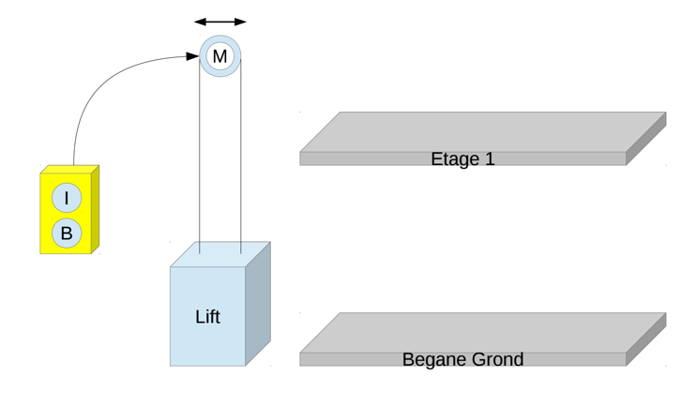
Object Behavior - state machine diagrams
Book
CH 9,10,11
consider an elevator on a construction site
Level 1
1
0
Level 0

Slide 6
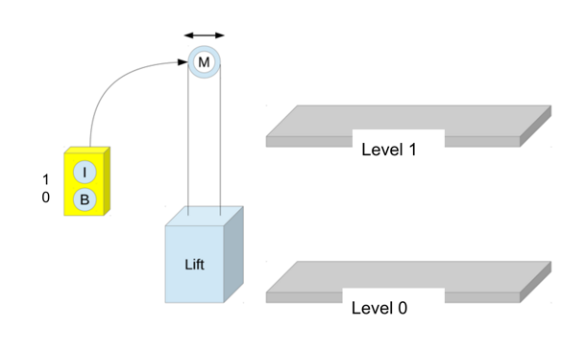
YOUR TURN
Model the behavior of this elevator using arrows and rounded rectangles
?
Use Visual Paradigm - State Machine Diagram
doing something

Slide 7
YOUR TURN
Model the behavior of this elevator using arrows and rounded rectangles
trigger
hit by hamer
state
next state
good
broken
transition
Example: fragment of state machine diagram

Slide 8
trigger / effect
hit by hamer / noise
state
next state
good
broken
transition
Example: fragment of state machine diagram

Slide 9
State machine diagram V0
button 1 pressed / motor right
GOING UP
reached level 0/ motor off
IDLE
reached level 1 / motor off
What can be criticized here?
GOING DOWN
button 0 pressed / motor left

Slide 10
State machine diagram V0
button pressed / motor right
GOING DOWN
CAN THIS EVEN BEEN WRITTEN SHORTER?
reached level / motor off
IDLE
reached level / motor off
GOING DOWN
button pressed / motor left

Slide 11
State machine diagram V1
so it knows which direction
button n pressed / motor on (button n)
MOVE
IDLE
reached level n / motor off

Slide 12
A secured elevator
How to model this?
Lift should not move when door is open
Door

Slide 13
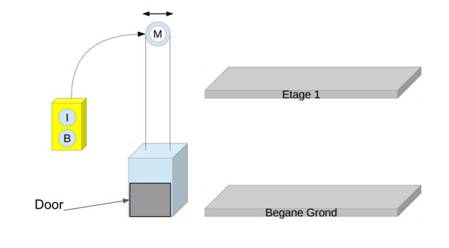
State machine diagram V2
button n pressed [door closed] / motor on (button n)
MOVE
IDLE
reached level n / motor off

Slide 14
guard
trigger or event
MOVE
entry / beep()
do / sign.showUp()
exit / buzz()
button n pressed [door closed] / motor on (button n)
Internal state activity: do activity
effect or action
IDLE
reached level / motor off
transition
state

Slide 15
State Machine
Originally, a state machine or finite state machine is an abstraction of a machine / machine’s behavior. (e.g. vending machine)
Also applicable for describing object behaviour (rember our ‘what’s a system?’ discussion?)

Slide 16
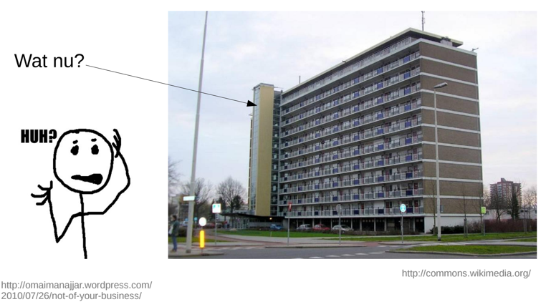
And now what?
Practical assignment 4 Part 1

Slide 17
Assignment 4
Model the state behaviour for the elevator case for a flat building
The model is independent of the amount of floors
It should be possible to ‘remember’ what floors are requested
The elevator can be requested with an up - and down button on the outside of the elevator
Inside the elevator the floor can be chosen
The doors have to be closed before the elevator can move

Slide 18
State Machine Diagram - more notation
pseudo states
Initial state (always present)
History state
Shallow
Deep
Final state

Slide 19
State Machine - History states
H
Shallow History remembers state
Deep History re remembers also substates
H*

Slide 20
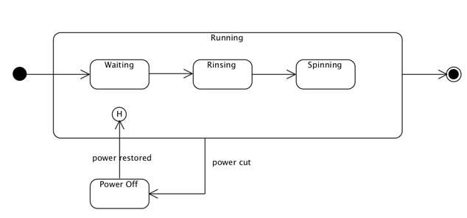
State Machine - Shallow History
Shallow history state

Slide 21
Power cut

Slide 22
State Machine - Shallow History
1
3
Power on
Power cut
4
2

Slide 23
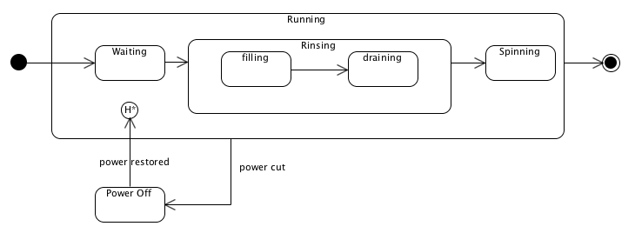
State Machine - Deep History state

Slide 24
Power cut

Slide 25
State Machine - Deep History
1
3
Power on
Power cut
4
2

Slide 26
State Machine Diagram - Deferred State
Defer keyword preservers the event (memorizes)

Slide 27
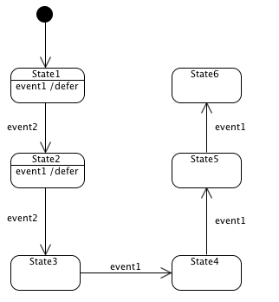
State Machine - Deferred State
Event1 is queued.
Event1 is invoked when not deferred anymore and possibly consumed.
Zie voor deferred event bron: http://redboltz.wikidot.com/deferred-events

Slide 28
State Machine - Deferred State
event 1
Suppose no external triggered events occur after the 2nd event 2.
Which state does the state machine reach?
event 1
Zie voor deferred event bron: http://redboltz.wikidot.com/deferred-events

Slide 29
State Machine - Deferred State
event 1
Queue
event1
Zie voor deferred event bron: http://redboltz.wikidot.com/deferred-events

Slide 30
State Machine - Deferred State
event 1
Queue
event1
event1
event 1
Zie voor deferred event bron: http://redboltz.wikidot.com/deferred-events

Slide 31
State Machine - Deferred State
Queue
event1
event1
Zie voor deferred event bron: http://redboltz.wikidot.com/deferred-events

Slide 32
State Machine - Deferred State
Queue
event1
...
Zie voor deferred event bron: http://redboltz.wikidot.com/deferred-events

Slide 33
State Machine - Deferred State
Queue
...
...
Zie voor deferred event bron: http://redboltz.wikidot.com/deferred-events

Slide 34
State Machine Diagram
Composite state:
Contains states
Final state
Initial state
Initial state

Slide 35
There is even more
terminate pseudostate
entry point
exit point
choice
join
fork
Junction
Have a look in the book or one of the references

Slide 36
Exercise
Suppose the Blood Pressure Belt can be in different states:
Idle, when there is no activity
Charging, when an usb cable is plugged in
Measuring, when it receives a signal to ‘start measuring’ and the belt is strapped around the arm
Model the behavior of this Blood Pressure Belt with a state machine diagram.

Slide 37
Reading suggestions
https://www.uml-diagrams.org/
https://www.uml-diagrams.org/state-machine-diagrams.html

