Slide 1
SAD 2018
Lecture 8 - Going from Analysis to Design
Michel Chaudron

Slide 2
Logistics
May 9th: no lecture
How/if use Tue 14th of May ?
  need your input on which topics to discuss
  we can do theory / supervision or both

Slide 3
Outline
Recap on purpose of modeling
What is software design?
Moving from Analysis to Design
Design Principles

Slide 4
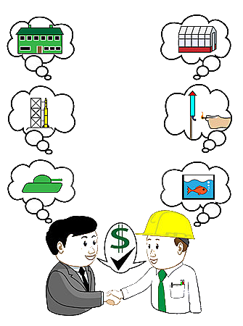
Purposes of Models in Software Development
Increase own understanding
  Manage complexity
Communication / Coordination
  Explain
  Discuss with the team & stakeholders
  Coded representation of shared understanding
Analyze & Verify
  Will the system meet requirements (performance, maintainability, …)
  Verify that the constructed system follows the design
Guide
  The construction work
  Generate the implementation
UML Models are the language of Software Engineering.
Like algebra is the language of Mathematics

Slide 5
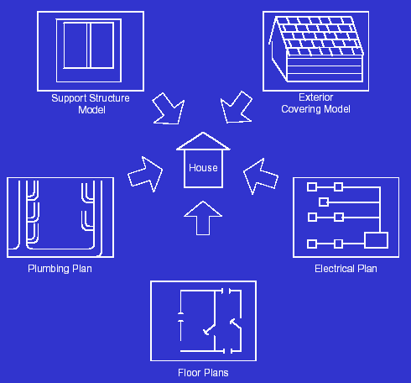
Systems have multiple aspects
How is the system structured?
How does the system behave?
A single language does not fit to capture all aspects of software systems

Slide 6
4+1 Views Representation of Software
What can/does the system do ?
How is the system structured?
How to build / configure ?
Logical View
Development View
System Architect
End-user
Programmers
Configuration management
Functionality (Decomposition)
Use Case View
How does the system behave?
Where to install ?
What hw\nw is used?
Process View
Deployment View
System Architect
System engineering
System topology
Delivery, installation, maintenance
Performance, Scalability, Throughput
Concurrency, Communication,
Synchronization
How does the system perform ?

Slide 7
Example 4+1 model
Structure view: components, packages, interfaces
Development view
versioning policies
file ownership
…
A
B
Stakeholders &
Use cases view
C
D
Behaviour view:
MSC, state-diagrams
Deployment view:
physical model + mapping
A
B
C
D
A
C
D
B
TCP/IP over Ethernet
BC/WC e2e-response times, freq.
bandwidth, availability

Slide 8
What is software design?
Notes:
Activate discussion of software design and its views / abstraction levels

Slide 9
Analysis & Design
In this course
Analysis is for: understanding & describing the domain
describes what : main concept & their relations
Design is for: synthesis of executable solution
describes how a construction of a solution should work

Slide 10
From Analysis to Design
Problem Space/Domain
Use Case
Diagram
Actors
Actions
Sequence / Activity
Diagram
Processes
Responsibilities
Class Diagram
Data
These are elements of analysis:
What is there?
Notes:
Michel maakt nieuw plaatje over hoe diagrammen gebruikt worden en overgaan van analyse naar design

Slide 11
From Analysis to Design
Problem Space/Domain
Solution Space/Domain
Actors
- User Interface Design
- Features
- Test cases
Use Case
Diagram
Actions
Sequence / Activity
Diagram
Business Processes /
Workflows
Processes
Responsibilities
Class Diagram
Classes (Components)
Data
& their behaviour
State Machine
Diagram
Data Collections
Behaviour
Following our terminology, these are MODELS!
These are elements of construction!
Notes:
Michel maakt nieuw plaatje over hoe diagrammen gebruikt worden en overgaan van analyse naar design

Slide 12
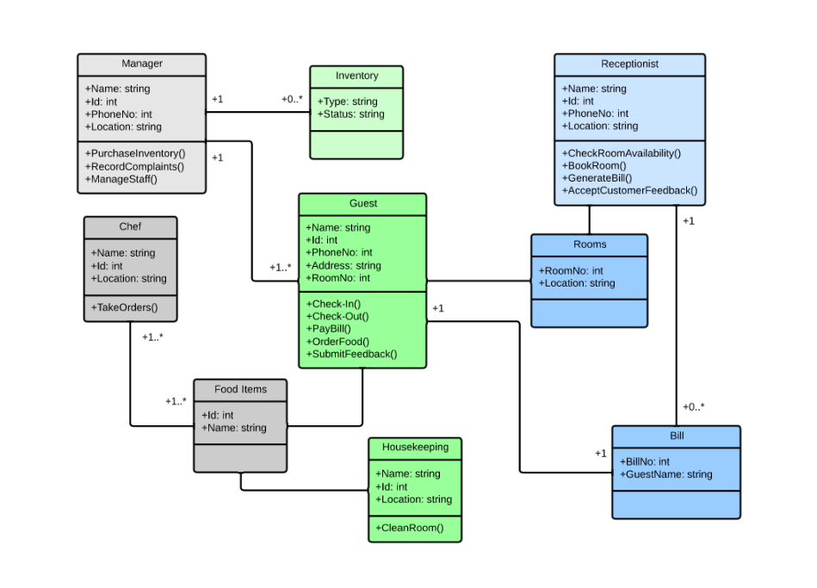
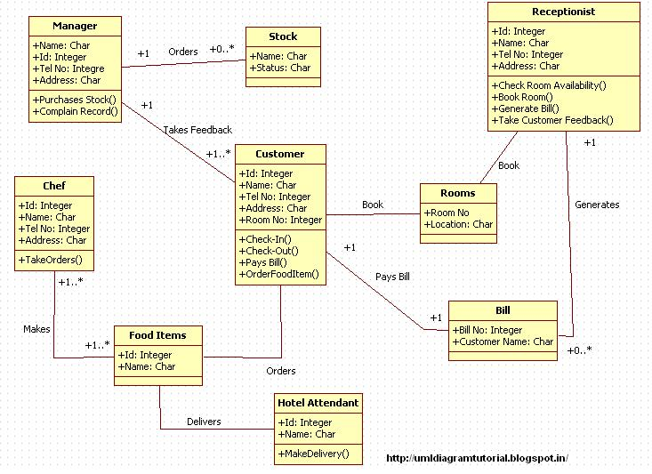
From Analysis to Initial Design
The OO paradigm has been designed such that Analysis and Design models look ‘alike’:
Classes that appear in a domain model, can also appear in a design model
Descriptive Models
Prescriptive Models
Problem Space/Domain
Solution Space/Domain
Component/Class
Diagram
Components/Classes
& their behaviour
These are elements of analysis:
What is there?
These are elements of construction:
How will it work?

Slide 13
From Analysis to Design
Descriptive Models
Prescriptive Models
S
S
Sensor
Class handles input
(e.g. UI-layer)
P
P
Process
(e.g. ordering)
Class handles process
(e.g. business layer)
D
D
Data-collection
Table in data-base
These are elements of analysis:
What is there?
These are elements of construction:
How will it work?

Slide 14
The step: software design
A quick scan through literature / internet
Denis et al: “Whereas analysis modeling concentrated on the functional requirements of the evolving system, design modeling incorporates the nonfunctional requirements. That is, design modeling focuses on how the system will operate.”
Larman: “Design emphasizes a conceptual solution that fulfills the requirements, rather than its implementation. Ultimately, designs can be implemented. During object-oriented design, there is an emphasis on defining software objects and how they collaborate to fulfill the requirements.”
Booch et al: “Design involves balancing a set of competing requirements. The products of design are models that enable us to reason about our structures, make trade-offs when requirements conflict, and in general, provide a blueprint for implementation.”
Wikipedia: “Software design usually involves problem solving and planning a software solution. This includes both low-level component and algorithm design and high-level, architecture design.”

Slide 15
Modular Design
Units are
Easy to replace
Easy to configure/tailor
Containers of defects
Easy to combine into overall design
As a result of:
- standardization

Slide 16
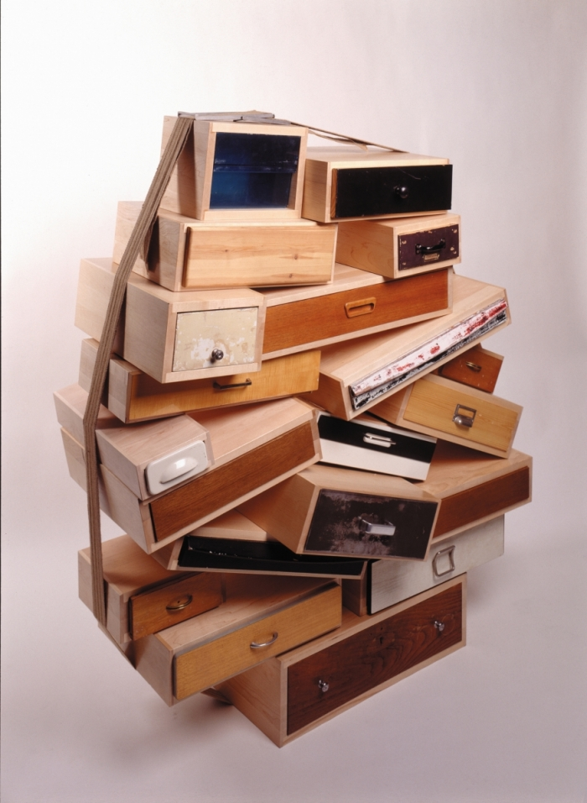
Chest of drawers by Droog Design
Units are
Easy to replace?
Easy to configure/tailor?
Containers of defects?
Easy to combine into overall
design?
Result of:
- standardization?

Slide 17

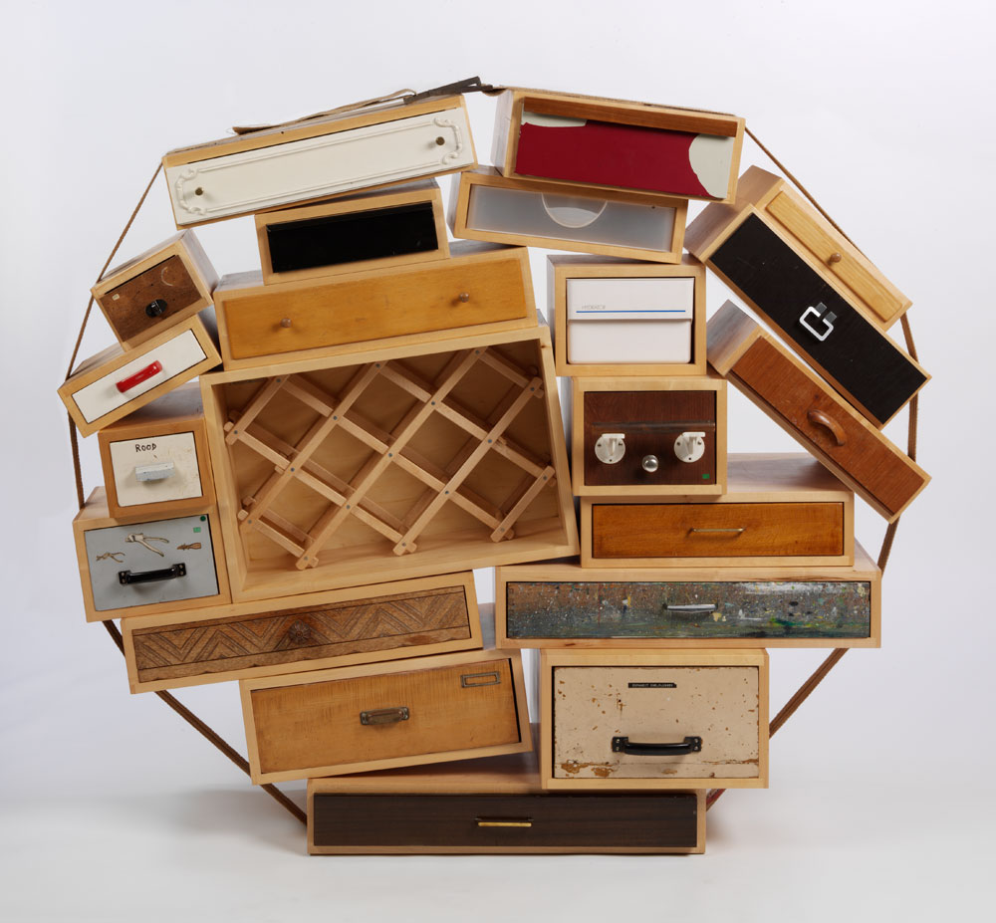
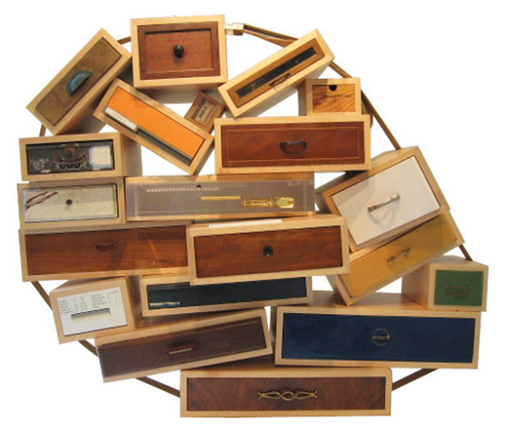
Tejo Remy’s design ‘You Can’t Lay Down Your Memory’ chest of drawers from 1991, an accumulation of reused drawers held together with a strap.

Slide 18
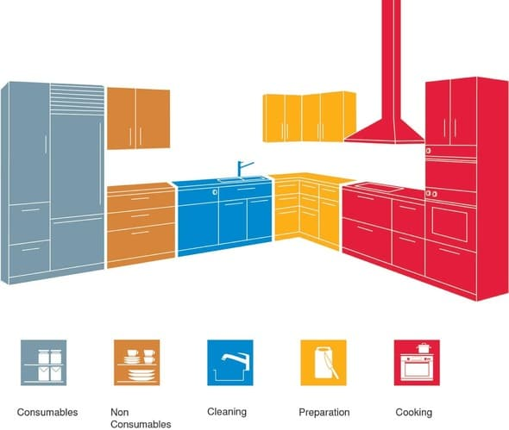
Modular Design
Units are
Easy to replace
Easy to configure/tailor
Containers of defects
Easy to combine into overall
design
As a result of:
- standardization

Slide 19

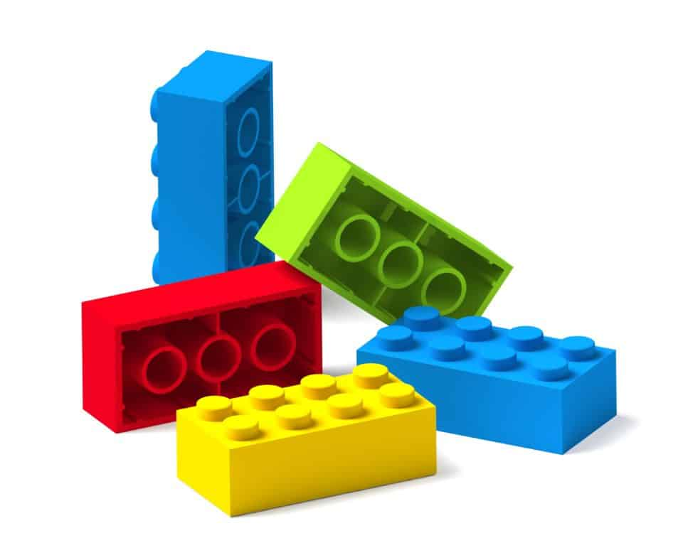
Modularity?
How does this work for software?

Slide 20
Good Modularity
Conceptually: good identification, decomposition and
allocation of responsibilities
examples : knowing something , doing something
Technically: Coupling & Cohesion
Modularity
Extensibility
Portability
Reusability
Mainainability

Slide 21
Software Architecture
Definition
The fundamental organization of a system embodied by its components, their relationships to each other and to the environment and the principles guiding its design and evolution
IEEE Standard P1471 Recommended Practice for
Architectural Description of Software-Intensive Systems

Slide 22


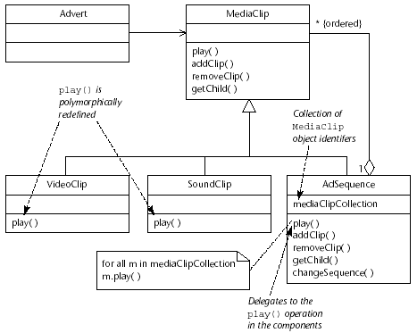
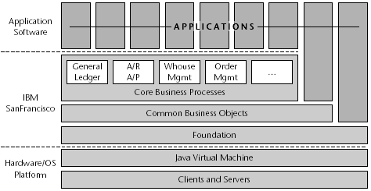


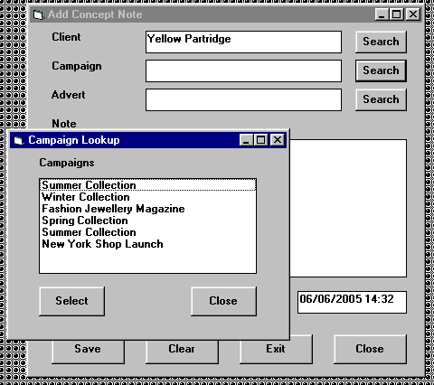
Enterprise Architecture
Alignment of IT architecture to business strategy and structure, and existing IT
System Architecture
Agate Boundary
sd Broker-based client–server communication
Agate Control Client
:Client
:ClientSide
Proxy
:Broker
:ServerSide
Proxy
:Server
callServer
sendRequest
packData
Agate Control Server
sendRequest
findServer
requestService
unpackData
Agate Domain
service
response
packData
Agate Business
Objects
Agate Value
Objects
sendResponse
sendResponse
Agate Database
response
unpackData
Meeting users’ requirements and determining the high-level structure of the system
System Design
Global
Catalogue
Data
Local Data
Catalogues
Data
Choosing technologies and frameworks, setting standards, and applying patterns
Detailed Design
Agate Boundary
Agate Control Client
CheckCampaignBudgetUI
CheckCampaignBudgetClient
ListCampaigns
«interface»
java::awt::event::ItemListener
+ listAllCampaigns(CampaignLister)
+ listCampaigns(CampaignLister, Client)
+ itemStateChanged(ItemEvent)
Agate Entity
Agate Control Server
«use»
Agate Domain
ListClients
ListCampaigns
sd Check campaign budget
«interface»
CampaignLister
CheckCampaignBudgetUI
+ addCampaignName(String)
+ clearAllCampaignNames( )
+ removeCampaignName(String)
- clientLabel : JLabel
Client
Campaign
CheckCampaignBudgetServer
:CheckCampaign
Budget
- campaignLabel : JLabel
CheckCampaignBudget
- budgetLabel : JLabel
- checkButton : JButton
ControllerFactory
:CheckCampaign
BudgetUI
- closeButton : JButton
Advert
CheckCampaign
BudgetUI( this )
- budgetTextField : JTextField
:ListClients
- clientComboBox : JComboBox
ccbUI :=
CheckCampaignBudgetUI
ListClients
«interface»
ClientLister
- campaignComboBox : JComboBox
loop
lc := ListClients
+ enable( )
+ enableCheckButton( )
+ getSelectedClient( )
+ getSelectedCampaign( )
+ setBudget(Currency)
+ addCampaignName(String)
+ clearAllCampaignNames( )
+ removeCampaignName(String)
+ addClientName(String)
+ clearAllClientNames( )
+ removeClientName(String)
+ itemStateChanged(ItemEvent)
[For all clients]
listAllClients( ccbUI )
+ addClientName(String)
+ clearAllClientNames( )
+ removeClientName(String)
Agate Data Management
enable
addClientName( name )
«use»
RelationalBroker
disableCampaignList
ListClients
ClientBroker
CampaignBroker
disableCheckButton
+ listAllClients(ClientLister)
AdvertBroker
Designing user interfaces, interactions, classes, data storage

Slide 23
Common 4-layer architecture
Presentation / I/O
Handle User Input/Output
Application logic
Manage Processes that belong within
a single application
Business Logic
Manage Processes that go across
multiple applications
Data / Persistence
Handle the (persistent) storage/retrieval of data

Slide 24
Partitioned Subsystems
Loosely coupled subsystems, each delivering a single service or coherent group of services
Presentation
layer
Advert
HCI Subsystem
Campaign Costs
HCI Subsystem
Four layer architecture applied to part of the Agate campaign management system
Application
layer
Advert
Subsystem
Campaign Costs
Subsystem
Campaign Domain
A single business
layer supports
two application
subsystems
Campaign Database

Slide 25
Example
«layer»
«layer»
Presentation and Dialogue Layer
Common Elements
«subsystem»
«subsystem»
Client / Browser
Client Authentication
«subsystem»
«subsystem»
«subsystem»
«subsystem»
S
M
P
M
C
«subsystem»
«subsystem»
«subsystem»
D
F
«subsystem»
E
«layer»
Business Layer
«subsystem»
«subsystem»
«subsystem»
«subsystem»
JR
M
P
M
C
«subsystem»
«subsystem»
«subsystem»
«subsystem»
D
F
Apache
«layer»
«subsystem»
«subsystem»
Persistence Layer
RC
Data Security
«subsystem»
«subsystem»
«subsystem»
P
M
M
PL
«subsystem»
«subsystem»
«subsystem»
«subsystem»
C
D
F

Slide 26


Software Design Principles

Slide 27

Generic Design Principle: Separation of Concerns
Decomposition / Divide and Conquer
Issues that are not related should be handled in separate parts
Single responsibility:
  Assign a single responsibility to a single component/class
  Typical responsibilities: to know something, to do something
  E.g. to know an algorithm (worker)
  to coordinate workers (coordination)
  to manage student-records (information holder)
Edsger W.
Dijkstra

Slide 28

Simplicity
Simplicity is a great virtue but it requires hard work to achieve it and education to appreciate it.
And to make matters worse:
Complexity sells better.
Source: Edsger W. Dijkstra
EWD896 - On the nature of Computing Science
Turing Award (1972)

Slide 29

Edsger Wybe Dijkstra
1930-2002
Ph.D. in Physics
Leiden University, Netherlands
Contributions to:
Algorithms, Concurrency, Distributed Systems,
Program Correctness, Discipline of Design:
Structured Programming (Go To considered Harmful)
Separation of Concerns
Turing Award (1972)
O.-J. Dahl, E. W. Dijkstra, C. A. R. Hoare, Structured Programming, Academic Press, London, 1972
Notes:
O.-J. Dahl, E. W. Dijkstra, C. A. R. Hoare Structured Programming, Academic Press, London, 1972 ISBN 0-12-200550-3

Slide 30
Example Separation of Concern Principle
Telecom Domain:
  Telecom protocol:
    decode1 ; handle1 ; decode2 ; handle2 ; decode3
handle &
encode/
decode
Separate the encoding/decoding of a message from the handling of a message:
    decode1 ; decode2 ; decode3 ; handle1 ; handle2
handle
encode/
decode

Slide 31

Separation of Concerns in Interface Design
Separate What from How
The interface of a component exposes what it do, but not how it does this.
The ‘how’ is the information-hiding ‘secret’
Details of the data representation
Details of the algorithm

Slide 32
What is a dependency?
A
A depends on B
B
Component A requires B for it to work
  Functional coupling
A change in module B requires a change in module A
  Implementation coupling
  Typically requires: re-testing A & B
Run-time
Development-time

Slide 33
Dependency/Coupling
There is coupling between two classes A and B if:
  A calls a service of an object B
  A has a method which references B
  (via return type or parameter)
  A has an attribute that refers to B
  A is of type (inherits from) B
    A is a subclass of (or implements) class B
A
A depends on B
B
A may depend on
some assumption on
another component B
This is not an exhaustive definition

Slide 34
Cohesion
Cohesion is concerned with the relatedness
within a module
high cohesion
low cohesion
Heuristic:
Keep things together that belong together
High cohesion within a module is good

Slide 35
Cohesion
Cohesion is concerned with the relatedness
within a module
FILTER
SORT
COUNT
REVIEW
PLAY
PRINT
STORE
GAME
high cohesion
low cohesion
Heuristic:
Keep things together that belong together
High cohesion within a module is good

Slide 36
Domino-Effect of Changes
UI
Application
Domain
Infrastructure

Slide 37
Software Design Principles
Aims:
Minimize the impact of variation and change:
Limit the ‘domino effect’ of changes
Design Guidelines:
Limit dependencies
Hide internals/specifics of construction/implementation details
                E.g. by using generic interfaces;
                i.e. chose right abstractions for interface

Slide 38


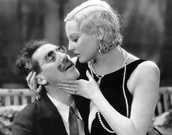

Dependency: Coupling
Coupling is the degree of dependency between modules
high coupling
low coupling

Slide 39
Benefits of Low Coupling/Dependencies
Modules are easier to replace
fewer dependencies between modules reduce time needed for understanding the modules and interactions
fewer dependencies between modules reduce the chance that changes in one module cause problems in other modules, which enhances reusability
fewer dependencies between modules reduce the chance that a fault in one module will cause a failure in other modules, which enhances robustness
Page-Jones, M. 1980. The Practical Guide to Structured Systems Design. New York, Yourdon Press, 1980.

Slide 40
Example Design Case:
Web Shop

Slide 41
Example Design Case: Web Shop
register
login
search
add item to
catalogue
add item to cart
remove item
from catalogue
customer
shop owner
remove item from cart
add to stock
pay items in cart
package & ship

Slide 42
Structure/Group Functionality
Define subsystems of functionality
Purpose
  Define decomposition into subsystems
  Provide support for use-cases
Think in terms of responsibilities
Use Component diagram
  May use Class, but this suggests OO implementation

Slide 43
Web Shop: Functional Areas (V0.1)
Customer
Registration
Shop Owner
Registration
Product Catalogue
Management
Payment
Stock Control

Slide 44
Check Use Cases Against Functional Areas
login
Customer
Registration
Shop Owner
Registration
login
register
add item to
catalogue
search
Product Catalogue
Management
remove item
from catalogue
Payment
Stock Control
pay items in cart
add to stock
?
package & ship
add item to cart
remove item from cart

Slide 45
Web Shop: Functional Areas (V0.2)
login
Customer
Registration
Shop Owner
Registration
login
register
add item to
catalogue
Product Catalogue
Management
search
remove item
from catalogue
Payment
Stock Control
pay items in cart
add to stock
Excluded from example
Payment adm
Shop staff salary adm
...
add item to cart
package & ship
Customer Selection
Management
remove item from cart
Notes:
I consider as alternative name for Customer Selection Management to be Customer Session Management

Slide 46
Web Shop: Responsabilities
Customer Registration
Entry, storage & retrieval of customers
Shop Owner Registration
Entry, storage & retrieval of shop staff
Product Catalog Mngmt
Entry, storage & retrieval of product data
Cust. Selection Mngmt
Register customer product selection
Payment
Handle transaction between customer & shop
Stock Control
Register available products in stock
Shop UI
Interact with user (I/O)

Slide 47
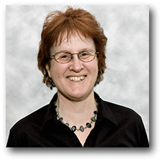
Characterizing Classes according to Rebecca J. Wirfs-Brock, IEEE Software, March/April 2006
■ Information holder: an object designed to know certain information and provide that information to other objects.
■ Structurer: an object that maintains relationships between objects and information about those relationships.
Complex structurers might pool, collect, and maintain groups of many objects; simpler structurers maintain relationships between a few objects. An example of a generic structurer is a Java HashMap, which relates keys to values.
■ Service provider: an object that performs specific work and offers services to others on demand.
■ Controller: an object designed to make decisions and control a complex task.
■ Coordinator: an object that doesn’t make many decisions but, in a rote or mechanical way, delegates work to other objects. The Mediator pattern is one example.
■ Interfacer: an object that transforms information or requests between distinct parts of a
system. The edges of an application contain user-interfacer objects that interact with the user and external interfacer objects, which communicate with external systems. Interfacers also exist between subsystems. The Facade pattern is an example of a class designed to simplify interactions and limit clients’ visibility of objects within a subsystem.
Notes:
These are subsystem ‘archetypes’

Slide 50
Identification of Dependencies
Shop UI
Staff Shop UI
Customer
Registration
Cust. Sel.
Mngmt.
Cart-
data
Payment
Prod. Catal.
Maint.
Stock
Control
Shop Staff
Registration
Customer
data
Product
Catalogue
Stock
data
Shop
Staff
data
key
uses
Subsystem
<< subsystem>>
package
Notes:
Drawing the picture this way, makes it clear that a separate Staff Shop UI is needed

Slide 51
Introduce layer for business logic
Shop UI
Staff Shop UI
Business Process Coordinator
Customer
Registration
Cust. Sel.
Mngmt.
Cart-
data
Payment
Prod. Catal.
Maint.
Stock
Control
Shop Staff
Registration
Customer
data
Product
Catalogue
Stock
data
Shop
Staff
data
key
uses
Subsystem
<< subsystem>>
package
Notes:
Drawing the picture this way, makes it clear that a separate Staff Shop UI is needed

Slide 52
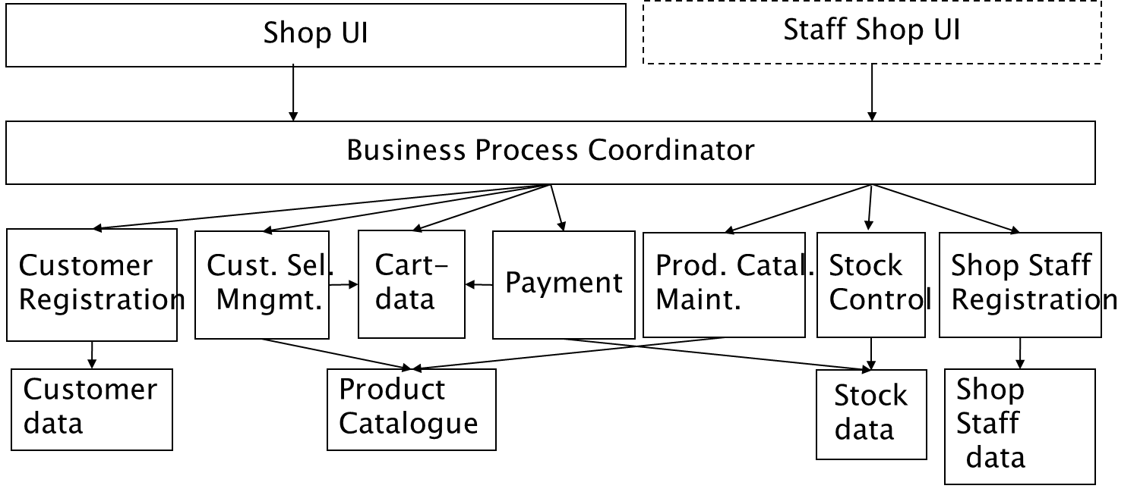
Typical Roles across different layers
Interfacers
Coordinator
Service Providers
Information holders

Slide 53

Elaboration of Data Domains
Customer
name+address
authentication
Customer Registration
Shop staff
name
authentication
Shop Staff Registration
Prod. Cat. Mngmnt
Product
product-id
price
Cust. Selection Mngmt
Cart
product-id
quantity
Payment
volatile
Stock Control
Stock data
product-id
quantity

Slide 54
Identify support for Use Cases at different layers in the architecture
login
presentation
layer
login
screen
search
screen
…
register
select
item
check
-out
search
…
manage
cart
business
logic layer
pay items in cart
add item to cart
user
table
product
table
…
data mngmt
layer
remove item from cart

Slide 55
Web Shop Deployment Diagram
Internet Client
Backend System
Shop UI
Staff Shop UI
Staff Shop
Registration
Cust. Selection
Management
Customer
Registration
Stock Control
Product
Cat. Maint.
Cart Data
Payment
Internet
Local Area Network
Gateway
Firewall
Shop Staff
Stock
Customer
DB
Product
Catalogue

Slide 56
Design System Dynamics: Scenario’s
Shop UI
Product
Catalogue
Customer Selection
Management
Cart-data
customer
query
Enter search
Matches of search
e2e deadline
1,0 sec.
Select item
Update selection
Store selection
Scenario’s describe the interaction between components

Slide 57
Identification of Active Processes
Shop UI
Staff Shop UI
Customer
Registration
Cust. Sel.
Mngmt.
Cart-
data
Payment
Prod. Catal.
Mmgmt
Stock
Control
Shop Staff
Registration
Customer
data
Product
Catalogue
Stock
data
Shop
Staff data
key
uses
Active
Component
Passive
Component
Notes:
Drawing the picture this way, makes it clear that a separate Staff Shop UI is needed

Slide 58
Solution Decisions
Designing a solution typically requires decisions on:
Which components to construct vs buy / reuse
Which type of technologies to use
  Pigeons or internet? Monkeys or computers?
  datastorage: database (sql, no-sql?) or cards
    where to store? Cloud or server or … GDPR
  Run in browser or on desktop or on mobile (or both)
  User-interface technology?
    text or graphical or … voice or touch or gesture ….

Slide 59
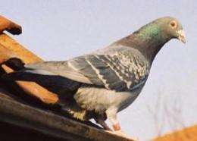
Carrier Pigeon Winston Faster Than Broadband Internet
by Lisa Zyga , Phys.org
---In South Africa, a carrier pigeon carrying a 4GB memory stick proved to be faster than the ADSL service from the country's biggest web firm, Telkom. Winston the pigeon took one hour and eight minutes to carry the data across the 60-mile course, and it took another hour to upload the data. During the same time, the ADSL had sent just 4% of the data.
The race was held by an IT company in Durban, South Africa, called Unlimited IT. One of Unlimited IT's employees complained about the slow speed of data transmission on ADSL, saying that data would get transferred faster by carrier pigeon. To highlight just how slow the broadband internet is, the company decided to test that claim.
The 11-month-old Winston flew 60 miles from Unlimited IT's call center in Howick to another office in Durban. To make sure that the bird didn't have an unfair advantage, Unlimited IT imposed some rules on its website, including "no cats allowed" and "birdseed must not have any performance-enhancing seeds within." Hundreds of South Africans followed the race on social networking sites Facebook and Twitter.
(…) BBC News
https://phys.org/news/2009-09-carrier-pigeon-faster-broadband-internet.html

Slide 60
General Software - Design Principles 1
Information Hiding:
All information about a module should be private to
the module unless required externally
Minimize Coupling
Every module should depend on as few
others as possible
Coherence:
Keep things together that belong together
Keep behaviour together with related data
Keep information about one thing in one place

Slide 61
General Software Design Principles 2
Divide and Conquer
  Break a big problem into smaller ones
Separation of Concerns
  Divide into different parts logic
  that addresses different issues
Keep it Simple

Slide 62
Summary
Models are the language of software engineering
We need multiple complementary languages to describe systems
Analysis describes ‘what is’, Design describes how solution works
Design principles
  Aimed at keeping design simple &
  limiting impact of change/variation
  Separation of concerns
  Information hiding
  Low coupling (between modules) &
  High cohesion (within modules)

Slide 63
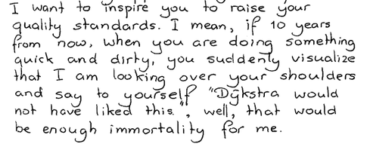
For you: no shortcuts! ! No sloppiness!!

Slide 64
Questions?

Slide 65
References
[1] Grady Booch, Object-oriented analysis and design.
[2] Craig Larman, Applying UML and patterns
[3] James Martin, http://butunclebob.com/ArticleS.UncleBob.PrinciplesOfOod

Slide 67
Reducing Coupling: Information Hiding
Information Hiding:
  Try to localize future change
  Hide system details likely to change independently
  Separate parts that are likely to have a different rate of change
  In interfaces expose only assumptions unlikely to change

Slide 68
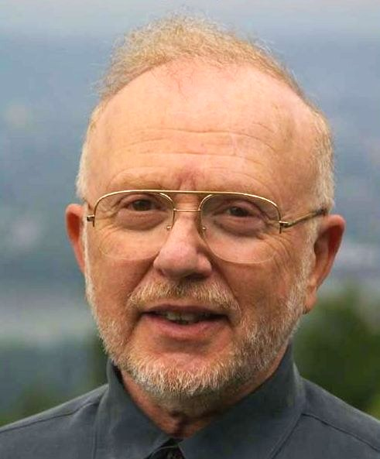
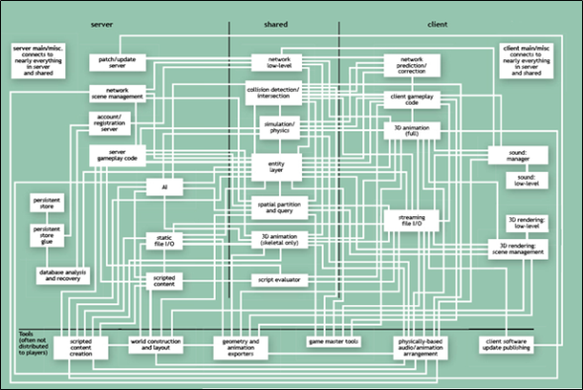
David Parnas
We propose that one begins with a list of:
  difficult design decisions, or
  design decisions which are likely to change
Each module is then designed to hide such a decision from the other modules.
David Parnas
Goal: ISOLATE CHANGE
Means: Information hiding, minimizing dependencies
I advise students to pay more attention to the fundamental ideas rather than the latest technology.
The technology will be out-of-date before they graduate. Fundamental ideas never get out of date.
Classic Paper:
"On the Criteria To Be Used in Decomposing Systems into Modules"
Notes:
"On the Criteria To Be Used in Decomposing Systems into Modules". http://www.cs.umd.edu/class/spring2003/cmsc838p/Design/criteria.pdf.
I would advise students to pay more attention to the fundamental ideas rather than the latest technology.
The technology will be out-of-date before they graduate. Fundamental ideas never get out of date.

Slide 69
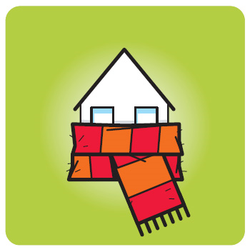
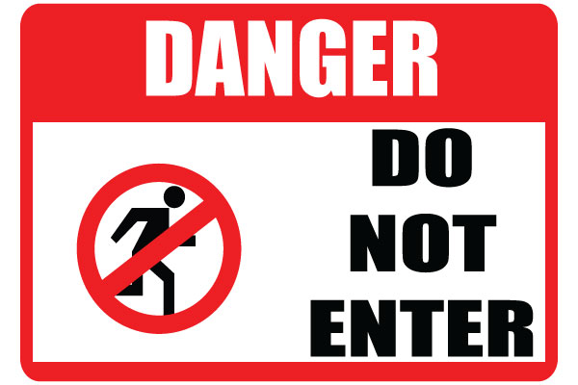
Design Principle: Information Hiding
  what is inside, must stay inside.

Slide 70

WHAT versus HOW
‘WHAT’: think Responsibility, Declarative
Mechanisms are about ‘HOW’
Interface is about
‘WHAT’
Database
DB
Cloud
WHAT: Build a house
HOW: stone, sticks, straw
Implementation is about ‘HOW’

Slide 71


Example: Change implementation
Build_House()
Public
Interface
Sort()
Store()
Sorter
Database
Builder
straw
Bubble
sort
stone
Quick
sort
Server
Cloud
Supports evolution and platform-independence

Slide 72
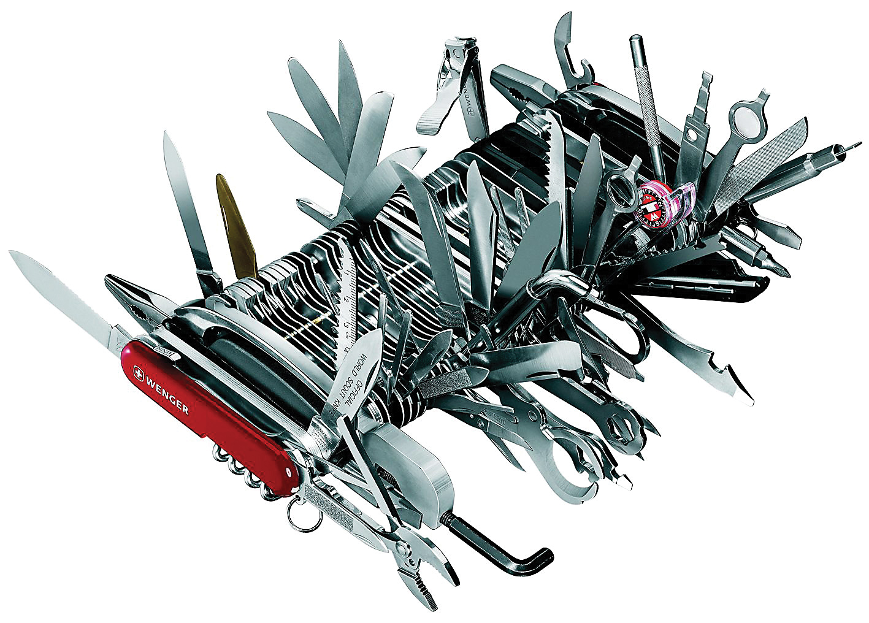
The Single Responsibility Principle (SRP)
Classes should not have more than one responsibility.
Anti pattern: GOD class, or Swiss Army Knife

Slide 73
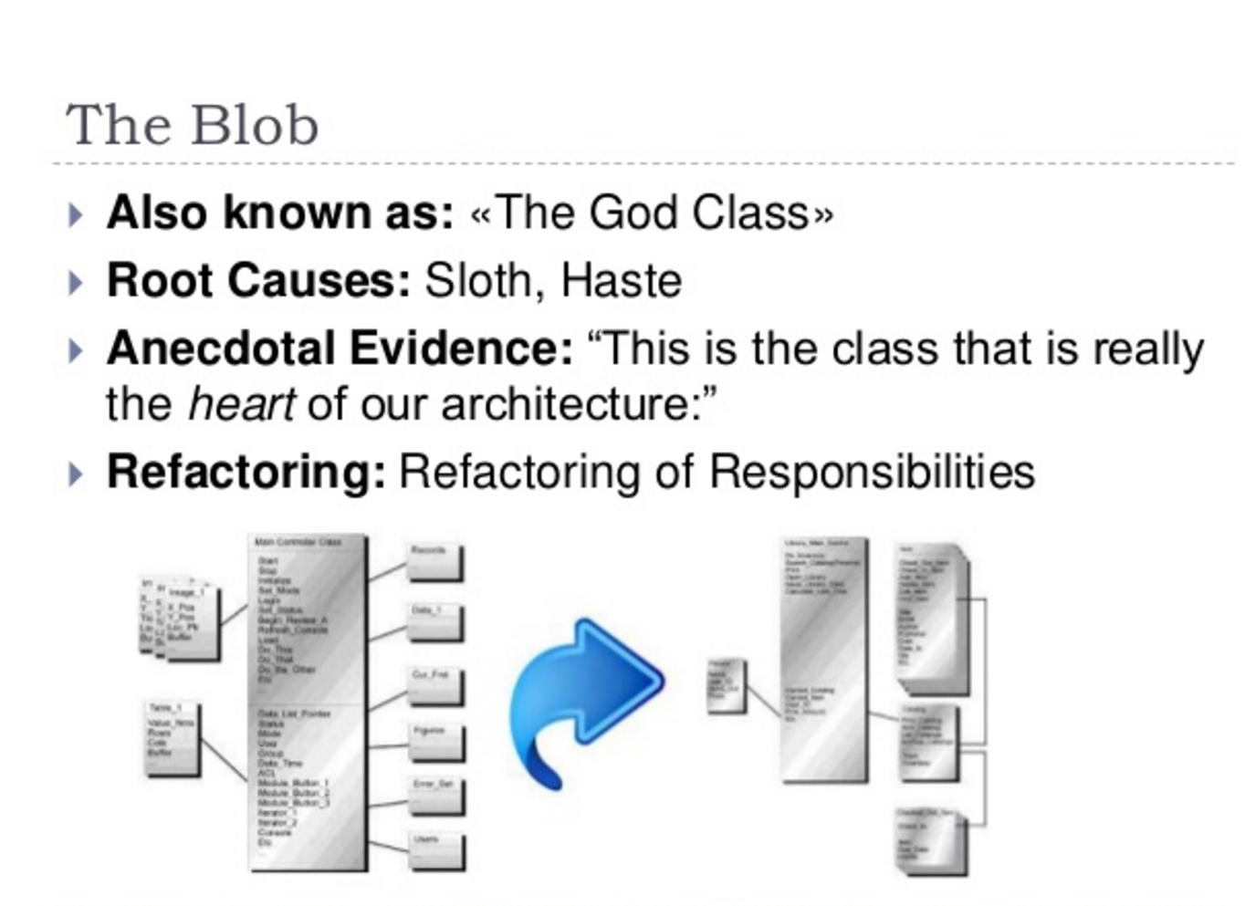
Slide from Claudio Bernasconi (Slideshare)

Slide 74
Extensibility
`
Extend with loading
another type of images: PNG
Optical Character Recognition System
UI
OCR
Filter
JPG loader
Recognizer
Segmentation

Slide 75
Extensibility
`
Extend with loading
another type of images: PNG
Optical Character Recognition System
UI
OCR
Filter
JPG loader
PNG loader
Do we like this?
Why (not) ?
Recognizer
Segmentation

Slide 76
Extensibility
Identify ‘Region’ of system related
to loading of ‘Image format’
`
Optical Character Recognition System
UI
OCR
Filter
ImageLoading
Recognizer
Segmentation
JPG loader
PNG loader
Design Strategies
for Software Extensibility
Principle : Separate Interface from Implementation
Principle : Hide implementation details

Slide 77
Extensibility
Depend on Abstraction (Interface) rather than on implementation
`
Optical Character Recognition System
UI
OCR
Filter
AbstractFeature
Recognizer
Segmentation
Concrete
Feature 1
Concrete
Feature 2
Principle : Separate Interface from Implementation
Principle : Hide implementation details

Slide 78
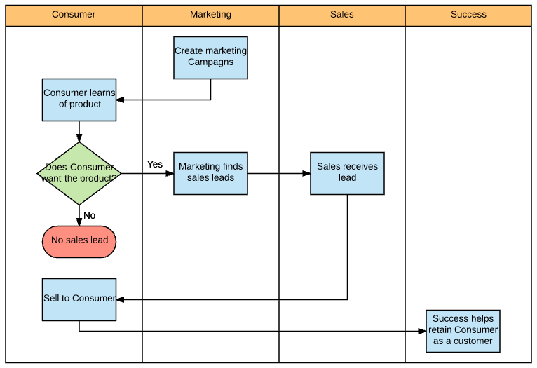
Modeling behaviour of systems
Multiple components
Sequence Diagram
Focus on:
interaction between
components
- Typical scenario’s
A
B
D
A
B
C
D
C
Activity ‘Swimlane’ Diagrams
A
B
C
D
Focus on:
interaction between
components
- Capture complete flow of tasks and (control-) decisions

