Slide 1
Wrap up

Slide 2
Content
Design Principles
Information hiding
Extensibility
Aggregation and Composition
Recap

Slide 3
General Software - Design Principles 1
Information Hiding:
All information about a module should be private to
the module unless required externally
Minimize Coupling
Every module should depend on as few
others as possible
Coherence: Keep things together that belong together
Keep behaviour together with related data
Keep information about one thing in one place

Slide 4
General Software Design Principles 2
Divide and Conquer
Break a big problem into smaller ones
Separation of Concerns
Divide into different parts logic that addresses different issues
Keep it Simple

Slide 5
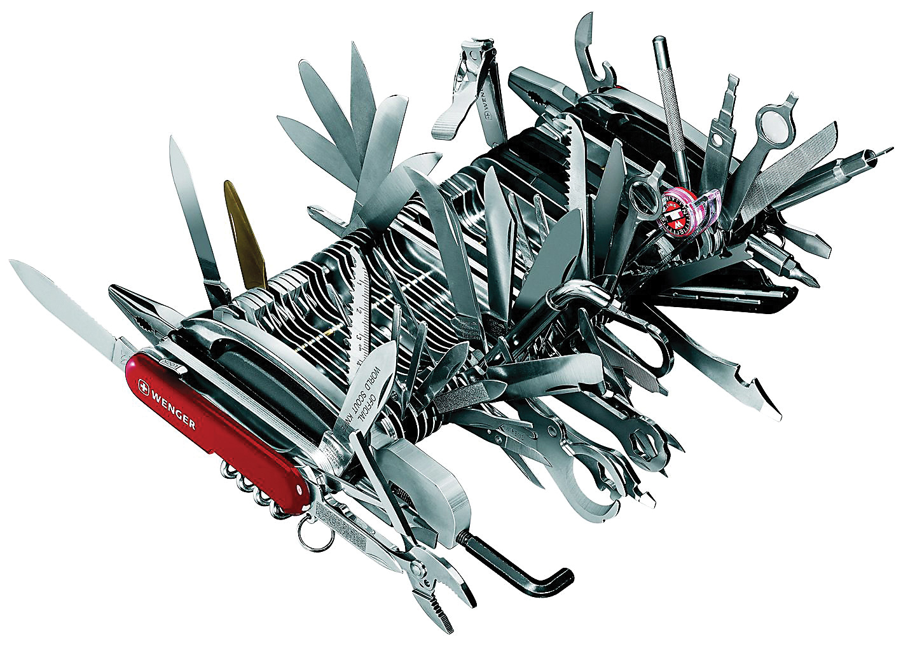
The Single Responsibility Principle (SRP)
Classes should not have more than one responsibility.
Anti pattern: GOD class, or Swiss Army Knife

Slide 6
Reducing Coupling: Information Hiding
Information Hiding:
Try to localize future change
Hide system details likely to change independently
Separate parts that are likely to have a different rate of change
In interfaces expose only assumptions unlikely to change

Slide 7
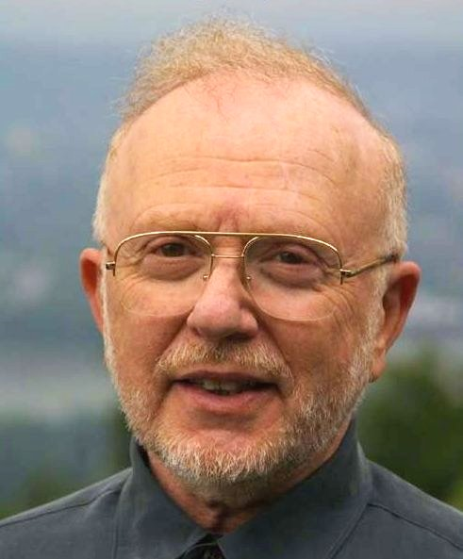
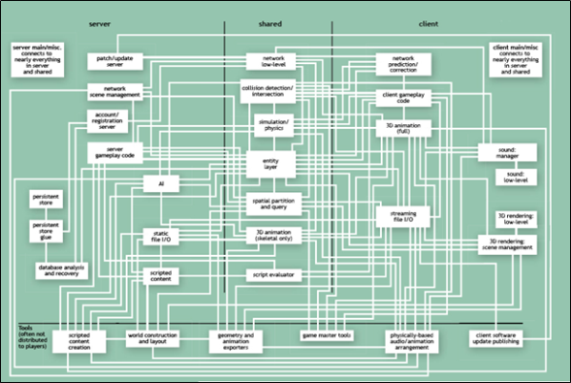
David Parnas
We propose that one begins with a list of:
difficult design decisions, or
design decisions which are likely to change
Each module is then designed to hide such a decision from the other modules.
David Parnas
Goal: ISOLATE CHANGE
Means: Information hiding, minimizing dependencies
I advise students to pay more attention to the fundamental ideas rather than the latest technology.
The technology will be out-of-date before they graduate. Fundamental ideas never get out of date.
Classic Paper:
"On the Criteria To Be Used in Decomposing Systems into Modules"
Notes:
"On the Criteria To Be Used in Decomposing Systems into Modules". http://www.cs.umd.edu/class/spring2003/cmsc838p/Design/criteria.pdf.
I would advise students to pay more attention to the fundamental ideas rather than the latest technology.
The technology will be out-of-date before they graduate. Fundamental ideas never get out of date.

Slide 8
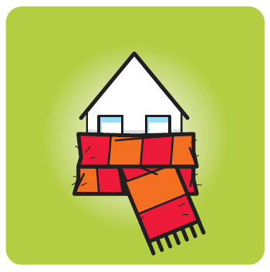
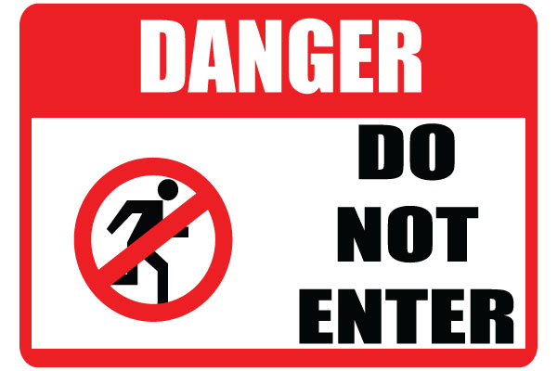
Design Principle: Information Hiding
what is inside, must stay inside.

Slide 9
WHAT versus HOW
‘WHAT’: think Responsibility, Declarative
Mechanisms are about ‘HOW’
Interface is about
‘WHAT’
Database
DB
Cloud
WHAT: Build a house
HOW: stone, sticks, straw
Implementation is about ‘HOW’

Slide 10
Example: Change implementation
Build_House()
Public Interface
Sort()
Store()
Sorter
Database
Builder
straw
Bubble sort
stone
Quick sort
Server
Cloud
Supports evolution and platform-independence

Slide 11
Extensibility
`
Extend with loading another type of images: PNG
Optical Character Recognition System
UI
OCR
Filter
JPG loader
Recognizer
Segmentation

Slide 12
Extensibility
`
Extend with loading another type of images: PNG
Optical Character Recognition System
UI
OCR
Filter
JPG loader
PNG loader
Do we like this?
Why (not) ?
Recognizer
Segmentation

Slide 13
Extensibility
Depend on Abstraction (Interface) rather than on implementation
`
Optical Character Recognition System
UI
OCR
Filter
AbstractFeature
Recognizer
Segmentation
Concrete Feature 1
Concrete
Feature 2
Principle : Separate Interface from Implementation
Principle : Hide implementation details

Slide 14
Aggregation and Composition
Special types of association, both sometimes called whole-part
A campaign is made up of adverts:
Campaign
1
0..*
Advert
Unfilled diamond signifies aggregation

Slide 15
Aggregation and Composition
Aggregation is essentially any whole-part relationship
Semantics can be very imprecise
Composition is ‘stronger’:
Each part may belong to only one whole at a time
When the whole is destroyed, so are all its parts

Slide 16
Aggregation and Composition
An everyday example:
Clearly not composition:
Students could be in several classes
If class is cancelled, students are not destroyed!
Class
1..*
0..*
Student

Slide 17
Aggregation and Composition
Another everyday example:
Meal
1
1..*
Ingredient
Filled diamond signifies composition
This is (probably) composition:
Ingredient is in only one meal at a time
If you drop your dinner on the floor, you lose the ingredients too

Slide 18
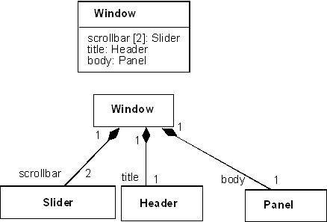
Composition (Strong type)

Slide 19
Composition and Aggregation Guidelines
Not a ‘has a’ relation
But ‘part-whole’
Composition: the parts cannot exist without the whole
human without head? (same lifetime)
Aggregations: parts can reasonably exist without whole
car without wheels? It is an exchangeable part
When in doubt: use ‘regular’ association. Both aggregation and composition are ‘special types’ of this general type of association.

Slide 20
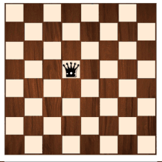
More examples
Path
Board
Segment
Square

Slide 21
Learning Objectives Michel’s Recap of Highlights (Dave will highlight additional topics)
Understand:
What models are, and are not
Why we model
Role of models in Software Development
Relation between model(ing) and design(ing)
Abstraction

Slide 22
Model vs Diagram
Model
Systematic use of well-defined concepts and notation for representation (intent is to define)
Notation has consistent semantics (meaning)
Amenable to (automated) manipulation - such as simulation, analysis – based on meaning of model
Diagram
Choice of notation to support communication of content (intent is to communicate)
Notation may be informal, without consistent meaning
It is not just the appearance that distinguishes models and diagrams; more importantly: systematic use of semantics

Slide 23
Going from Analysis to Design
Context diagram
Use case diagram
extend, includes
Use case story
Class diagram
Sequence diagram
Activity diagram
State-(machine-)diagram
Consistency!
Objects in sequence diagram must correspond to classes in class diagram
Methods in a sequence diagram must correspond to methods in the class diagram

Slide 24
4+1 Views Representation of Software
What can/does the system do ?
How is the system structured?
How to build / configure ?
Logical View
Development View
System Architect
End-user
Programmers
Configuration management
Functionality (Decomposition)
Use Case View
How does the system behave?
Where to install ?
What hw\nw is used?
Process View
Deployment View
System Architect
System engineering
System topology
Delivery, installation, maintenance
Performance, Scalability, Throughput
Concurrency, Communication,
Synchronization
How does the system perform ?

Slide 25
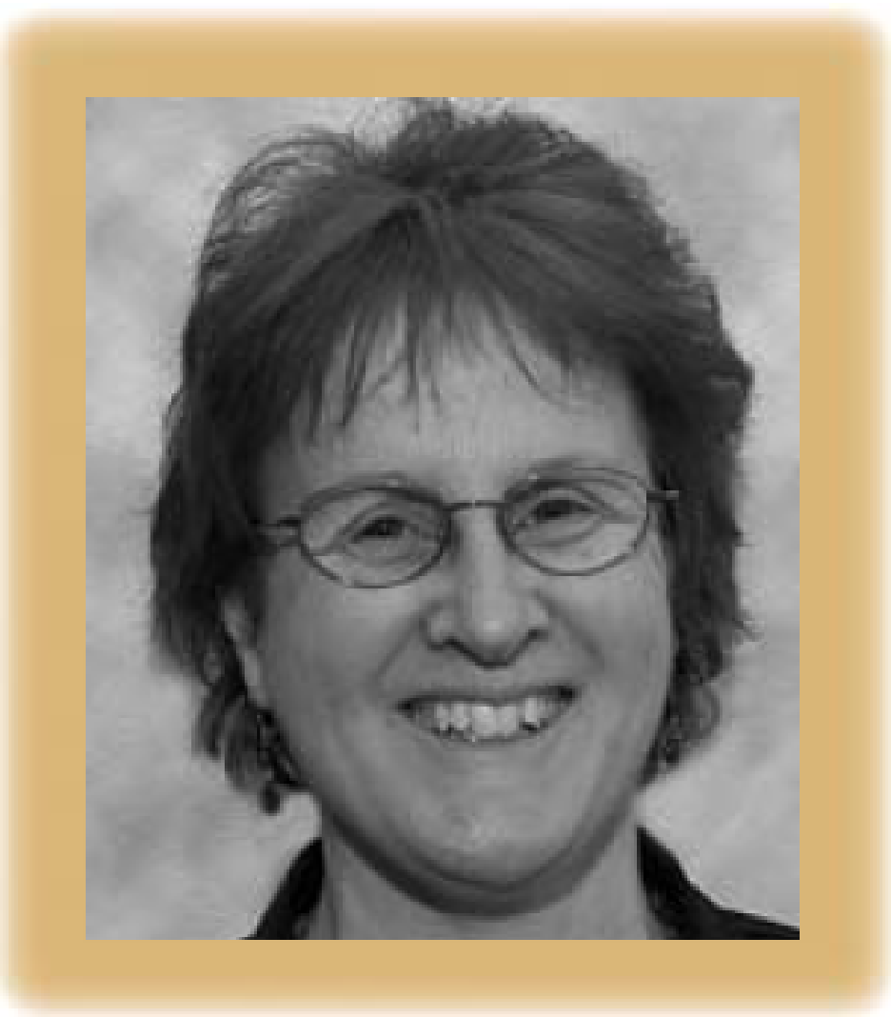
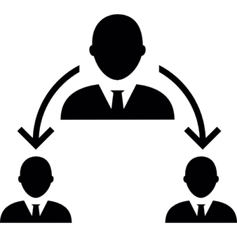
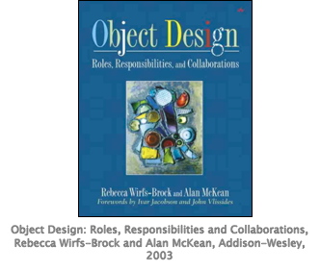
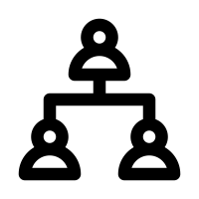
Role Stereotypes of responsibilities
Rebecca Wirfs-Brock: Software designs are built from building blocks that have stereotypical responsibility-roles
Controller
Coordinator
Interfacer
Structurer
Service Provider
Information Holder
Notes:
Michel came to my office and gave me papers and a book by this amazing lady and asked: hey, why don’t we try to identify the six role stereotypes described by Rebecca Wiffs-Brock?

Slide 26
General Software - Design Principles 1
Information Hiding:
All information about a module should be private to
the module unless required externally
Minimize Coupling
Every module should depend on as few
others as possible
Coherence: Keep things together that belong together
Keep behaviour together with related data
Keep information about one thing in one place

Slide 27
General Software Design Principles 2
Divide and Conquer
Break a big problem into smaller ones
Separation of Concerns
Divide into different parts logic that addresses different issues
Keep it Simple

Slide 28
My compliment to you as class
Positive & Constructive attitude
Appreciation

