Slide 1
Wild Life App
Exam(June 1st) protocol and possible solutions

Slide 2
Possible solutions :
The next slides give a possible solution to the ‘Wild Life App’ case based on the exam grading protocol.
Sometimes a student’s solution doesn’t align with the protocol. In these cases the grade is given based on the professional judgment of the lecturers. No rights can be derived from these solution for any SAD exam.
There can be various variations that are still valid solutions.
Images are fetched from openclipart.org or made with Google Drawings Diagrams are made in Visual Paradigm

Slide 3
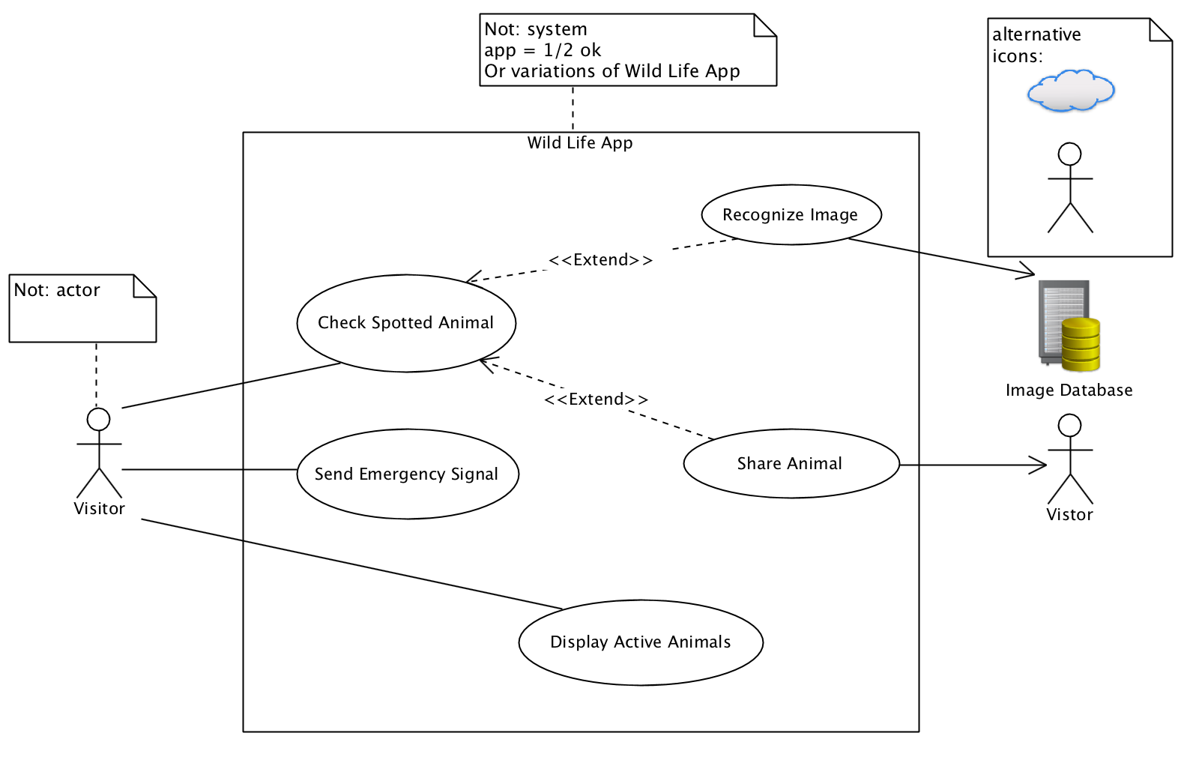
P1 (1/4)
Noun + Verb
External System
System Border!

Slide 4
P1 (2/4)
 | 8 POINTS
!! | There should be only one diagram. If there are two, only the first is considered.
+2 | System border (1) + system name (Wild Life App) (1). ‘System’ is not a good name
+2 | 2 identified Use Cases ( ‘check spotted animal’, ‘share animal) NOT ‘check’ / ‘animal’. 1 identified Use Case gives 1 point.
+2 | Proper use of extend (an optional use case) / include (is always used) See: http://agilemodeling.com/essays/useCaseReuse.htm, figure 1 for an example. Or the example solution
+2 | Actors identified: vistor (required) (1) , alternative: person Image database (external system) (required) (1) , alternative: image server
-1 | -1 for every syntax error like : wrong elements associated; wrong symbols; wrong naming (no noun + verb combination in use case) ;wrong use of extend/include relationships
Max -3 | Wrongly identified actors: actors that are not interacting with the system or not recognized because of unclear naming.
Max -3 | Wrongly identified use cases: such as procedural steps or non existing use cases.

Slide 5
P1 (3/4)
Use Case | Check Spotted Animal
Brief Descr. | The visitor checks an animal that was spotted on a list
Basic Flow | 1. The use case starts when the visitor spots an animal 2. The visitor chooses to open the checklist 3. The system shows a list of animals 3. The visitor marks the animal that was spotted. 4. If the visitor wants to share the animal, the visitor starts <<extends>> Share Spotted Animal. 5. The use case ends.
Alt. Flow | At BF 3 the visitor chooses to upload a picture. A. the system asks for the picture. B. the visitor selects the picture. C. <<extends>> Recognize Image starts .D. the use case resumes at basic flow 4.
Perspective is from Visitor and has Visitor <-> System interaction.

Slide 6
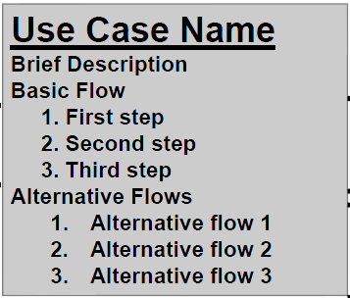
P1 (4/4)
 | 7 POINTS
!! | Should be about the ‘check spotted animal’ use case
+1 | The given format is followed
+1 | The actor is present in the flow
+2 | Description has a clear interaction user ↔ system The system offers lists to choose from Description is not only from user perspective. The text makes sense. Flows do not break before end of use case.
+1 | The use case description has a specific goal
+2 | The alternative flow is used as an alternative to come to same goal (flow is not an exception) Alternative flows do not break before end of use case / have `continue’ or ‘resume’
-1 | Missing name of the target use case / wrong, incomplete naming
Max -2 | Poor use case description
Max -2 | No alternative flow Wrong alternative flow (not leading to goal) / Exception instead of flow.

Slide 7
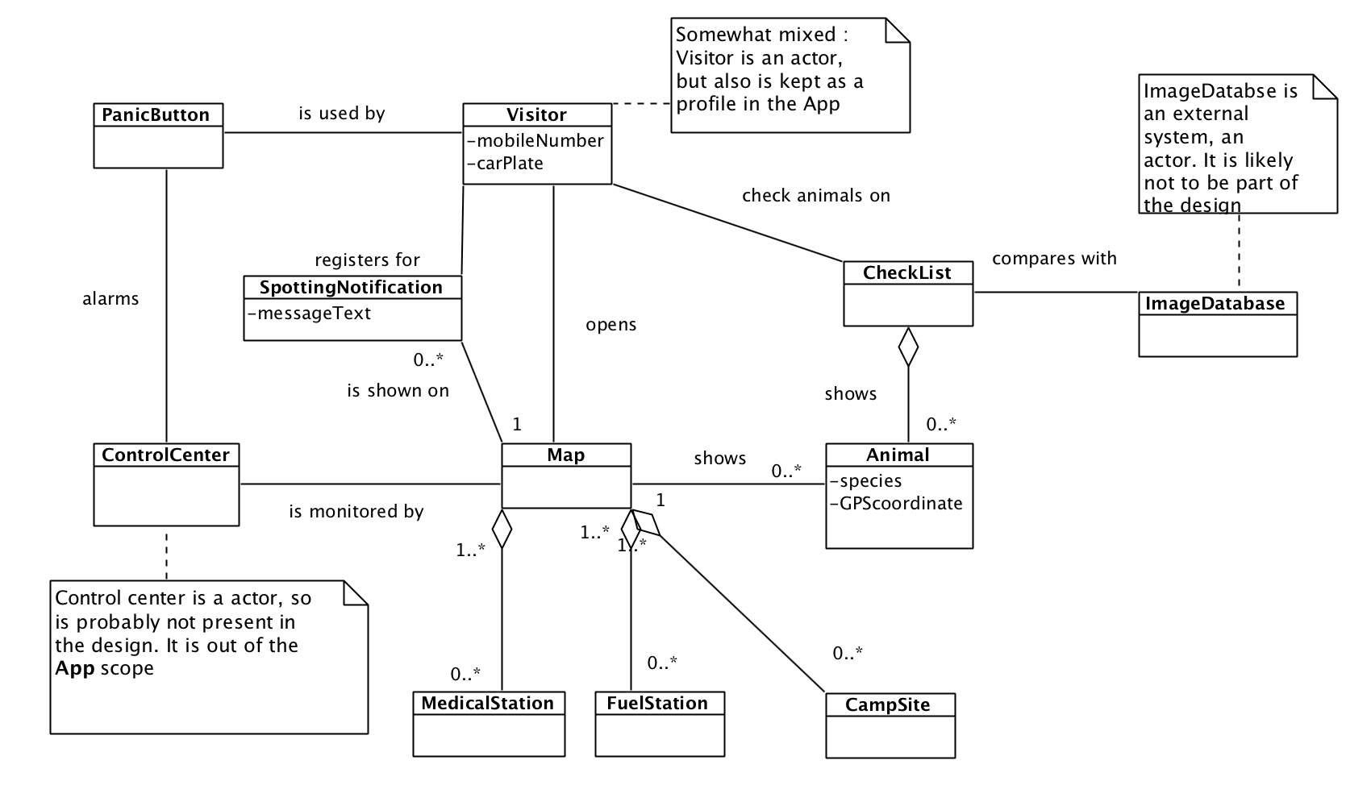
P2 (1/2)
Probably students come up with this approach
Should have labels
Maybe inheritance is used to group points of interest -> good solution

Slide 8
P2 (2/2)
 | 15 points
!! | Diagram reflects the problem domain (not a software solution)
+8 | Diagram is expressed in more than 5 classes (2 points) 4 of the required classes (or alternative names): Visitor, Map, Animal, SpottingNotification, PanicButton, Medial Station, FuelStation, CampSite, CheckList (4 points) Possible classes, that are probably somewhat out of scope but allowed when they make sense: ControlCenter, ImageDatabase,(Smart)Phone, User, (Touch)Screen, Speaker, PC, Network/Internet, (other hardware could also be present) NOT: App, System, JavaSwing(or other sw libraries) Using compositions / aggregation (2 points) 1/2 POINTS if more than 50% = SW class NO POINT if there are no Wild Life App concepts related classes at all
+2 | All relationships contain labels (not needed for inheritance) (+1 for some)
+2 | Proper use of multiplicity
+3 | Required a representation of list of Animals (2) Should be expressed with multiplicity (1)
Max -2 | Use of inheritance in stead of composition and vice versa Use of inheritance in stead of aggregation and vice versa Use of composition stead of aggregation and vice versa
Max -3 | Wrong use / no use of composition / aggregation / inheritance (Max -2 for exactly the same situation)
Max -3 | Syntax errors
Max -2 | Use of SW class

Slide 9
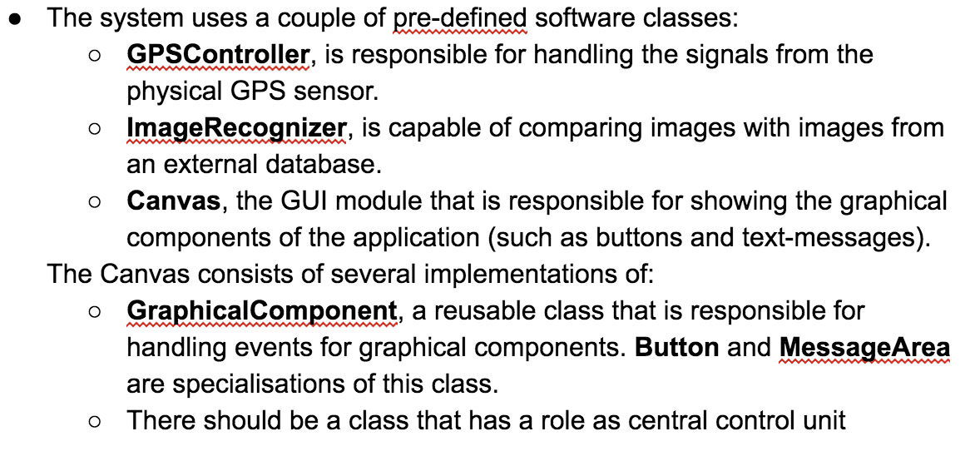
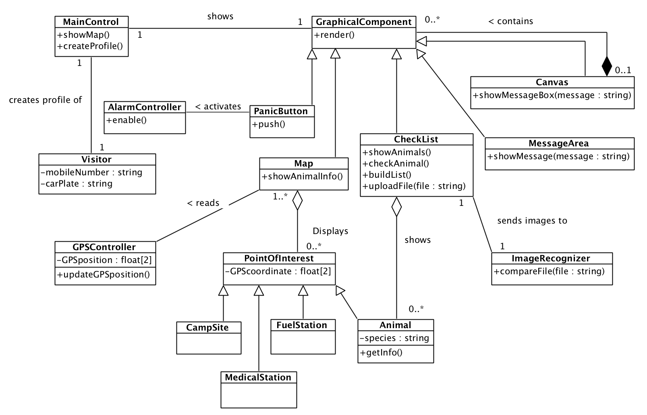
Was meant as top level control, but tex position could lead to place this ‘under’ canvas
P3 (1/5)
Initial design class diagram
Probably better to have upload in MainControl or other class, case text forces this

Slide 10
+3 | 5 of similar classes : GPSController, ImageRecognizer, Canvas, GraphicalComponent, Button, MessageArea , MainController
+1 (was: +2) | Inheritance is used for GUI components and PointsOfInterest
+2 | Responsibilities are properly assigned.
+2 | Appropriate methods at least 4 of (or similar): MainController.showMap() / MaintController.createProfile() CheckList.showAnimals() Button.handlePush() Canvas.render() AlarmController.enable() MessageArea.showMessage()
+2 | Reasonable attributes are used. At least 2 of: mobileNumber, carPlate, species, coordinate, type
+1 (was:+2) | Association names (labels) are given to the associations.
+1 | Types are used (int, float etc.) private/public notation is used.
Max -4 | Wrong use of composition/aggr/inher. (Max -2 per similar case)
Max -2 | Syntax errors, missing association names, (missing multiplicities)
Max -4 | Wrong classes appear in diagram (functions instead of classes or concepts that are not there) Empty classes
Max -2 | Missing important methods / attributes
P3 (2/5)
12 points

Slide 11
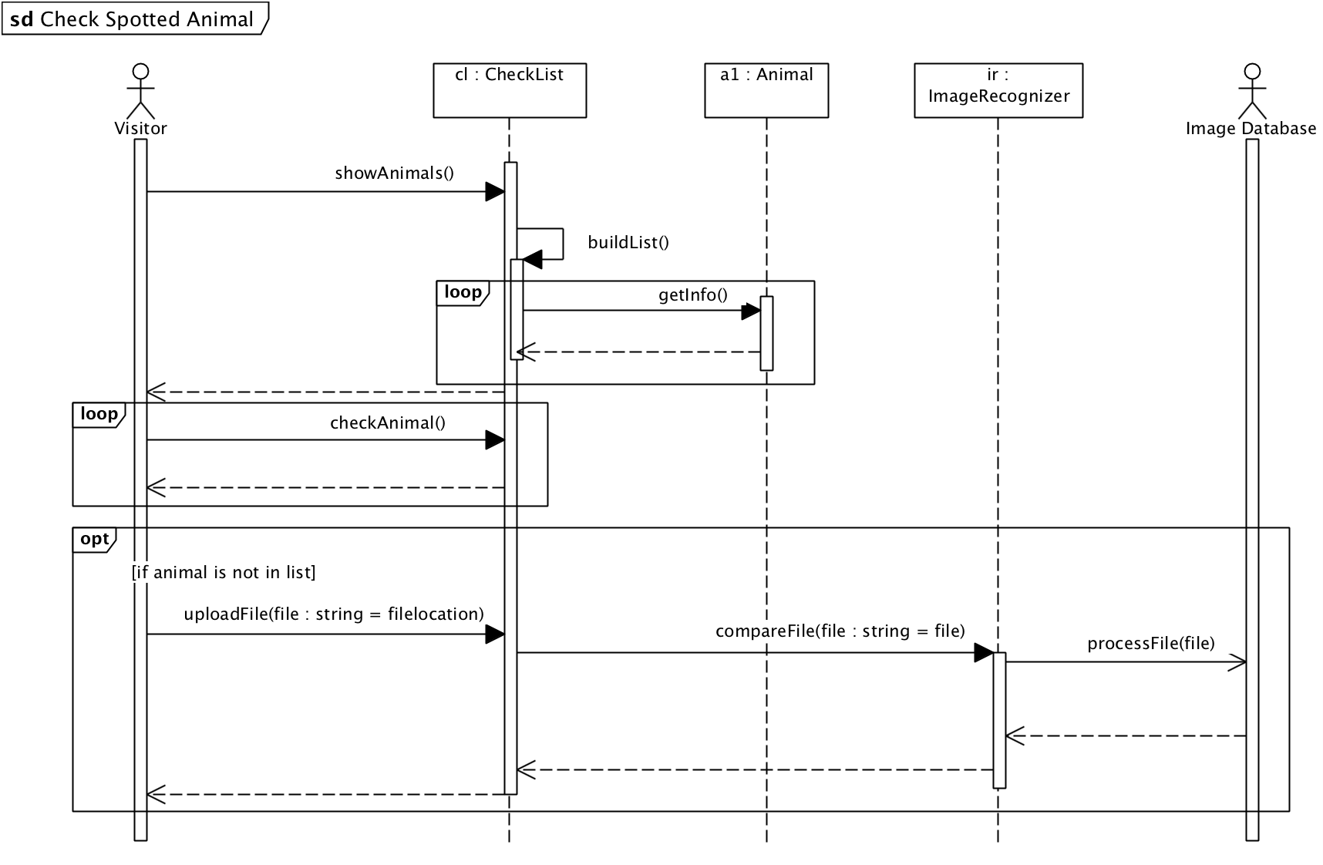
P3 (3/5)

Slide 12
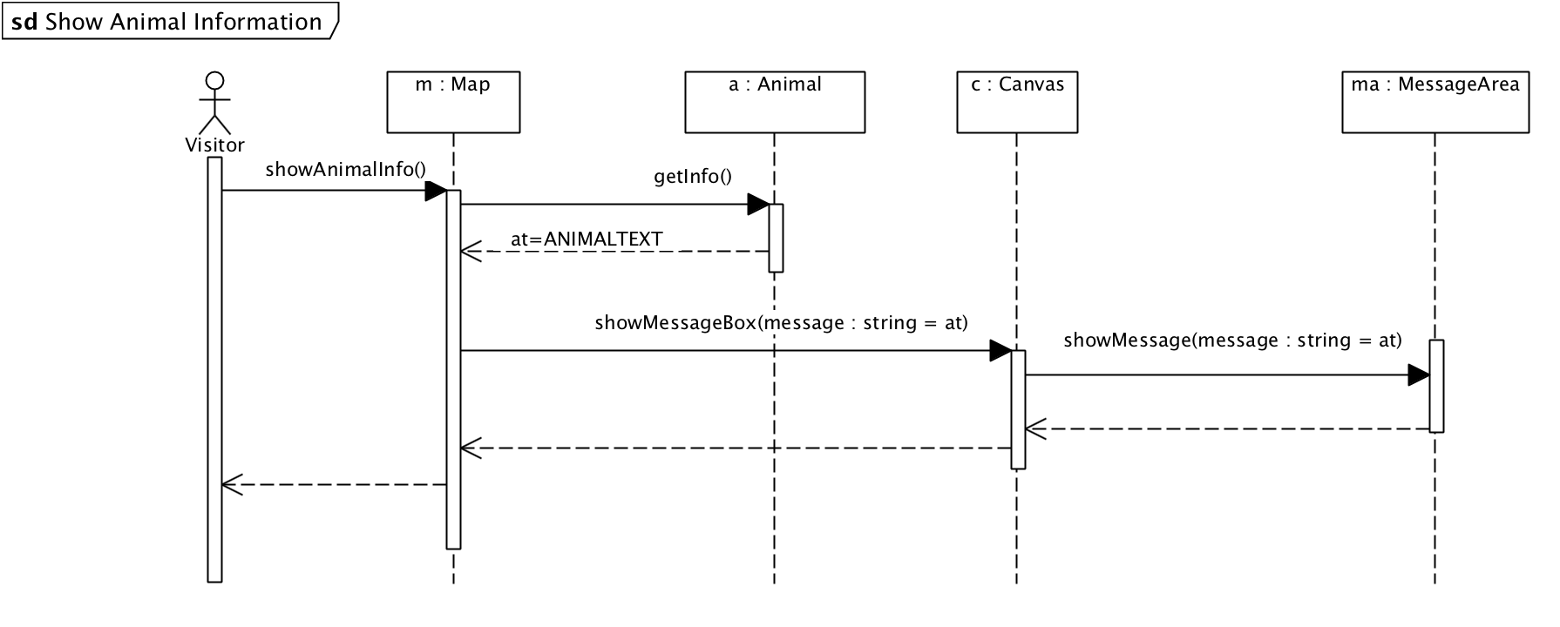
P3 (4/5)

Slide 13
P3 (5/5)
+4 | The Sequence Diagrams are a realization of the 2 use cases (Check Spotted Animal, Show Animal Information) Most objects are instances of the classes in problem 3 and the actors are actors in problem 1a. Most Methods and parameters are consistent with the methods in class diagram 3
(+2) | (Objects are used but the purpose/interaction of the use case is not clear or not consistent with other diagrams) [alternative for the row above]
+4 | Messages are sent and received by the proper sender/receiver and contain methods
-2 | Non logic message / receiver combination.
-2 | Wrong returns (to wrong sender).
Max -3 | Syntax errors (e.g. no ':' for object, no actor name, no actor symbol or <<actor>> stereotype)
Max -4 | Inconsistent parameter / or non existing methods
Max -2 | Objects are not instances of classes from 3a or missing an important object that should participate (Animal or Map for example).
8 points

Slide 14
P4
Architecture (6)
4 | The solution shows a clear architecture and uses dependencies / relationships. The solution consists of the Layers: UI - APP - DOMAIN - TECHNICAL (alternative names are allowed, but they should be clear) The answer consists of arguments for the choices that were made.
2 | The design principles are explained.
0 | No proper/clear diagram is used to explain the architecture. Only some loose concepts are written down with an unclear / inconsistent notation.
-2 | No classical layers are used for answering with a layered architecture.
-2 | No package symbols are used.
-1 (Max -2) | -1 for each wrongly placed class.
Max -2 | Syntax errors.
Pattern (4)
4 | The argument in the answer is related to performance and is valid

Slide 15
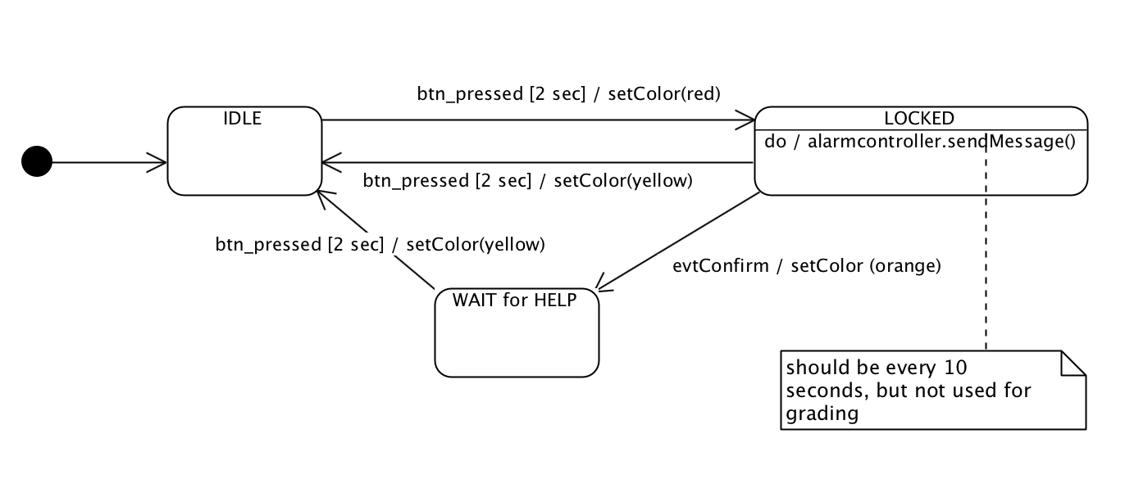
P5
no event / condition
Event or trigger / effect
guard
action code
Simple solution example. More states could be present in solution
transition
state
Do activity

Slide 16
P5
5 | Gives the following states, or alternative /similar names, for the perspective of a PanicButton object: IDLE - LOCKED - WAIT FOR HELP States are connected by a transition arrow
3 | The state diagram includes triggers and action code for all transitions necessary.
2 | It is clear how messages are sent and attributes of the PanicButton object or other objects are changed.
Max -3 | syntax errors
-2 | Messages are not consistent with solution to 3a.
-1 | -1 For every non existing state/vague state name.
10

