Slide 1
Check Me In App
Exam (August 29th) protocol and possible solutions

Slide 2
These slide contain some possible solutions :
The next slides give a possible solution to the ‘Check Me In’ case based on the exam grading protocol. No rights can be derived for this or other exams.
Sometimes a student’s solution doesn’t align with the protocol. In these cases the grade is given based on the professional judgment of the lecturers.
There can be various variations that are still valid solutions.
Images are fetched from openclipart.org or made with Google Drawings Diagrams are made in Visual Paradigm

Slide 3
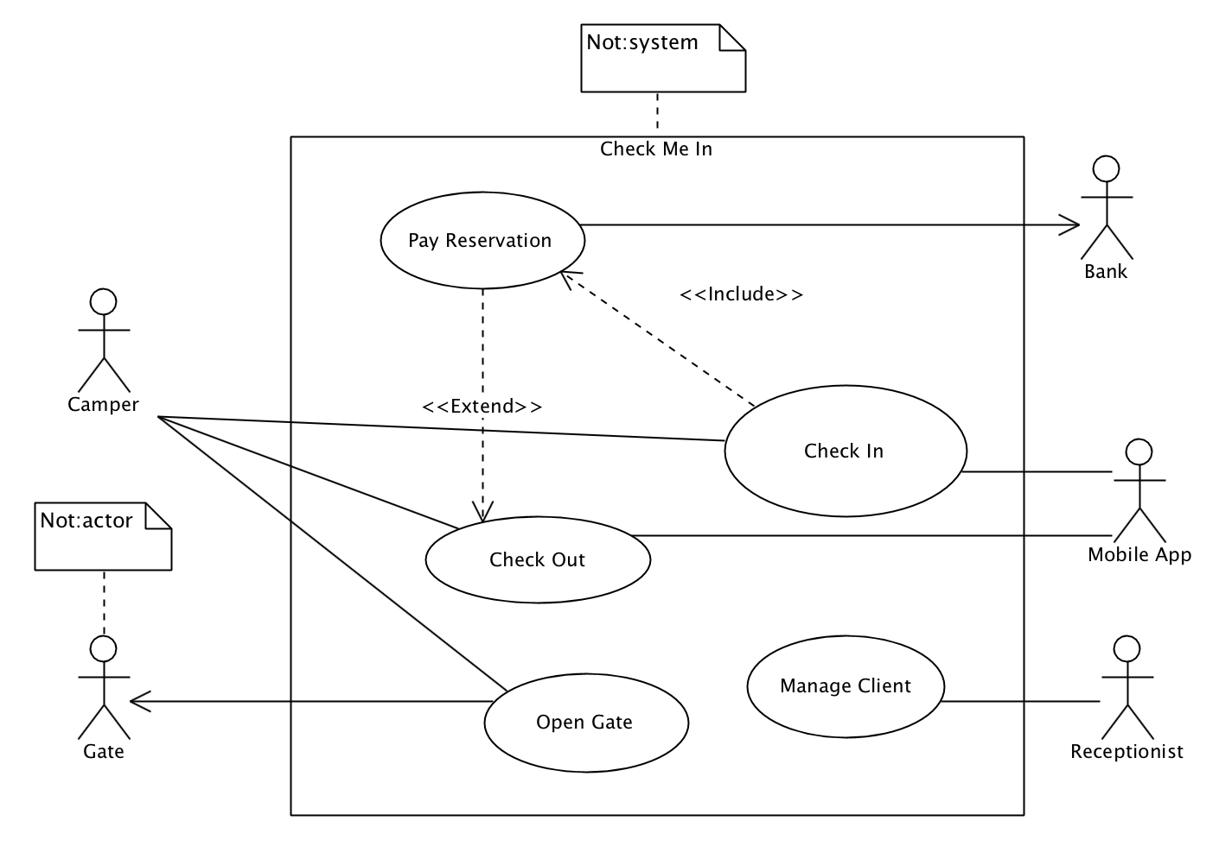
P1 (1/4)
Noun + Verb
(‘check in’ and ‘check out’ = ok)
External System
System Border!

Slide 4
P1 (2/4)
 | 8 POINTS
!! | There should be only one diagram. If there are two, only the first is considered.
+2 | System border (1) + system name (Check Me In) (1). ‘System’ is not a good name
+2 | 2 identified Use Cases ( ‘check in’, ‘check out’ , ‘pay reservation’ , ‘open gate’) NOT ‘check’ / ‘gate’. 1 identified Use Case gives 1 point.
+2 | Proper use of extend (an optional use case) / include (is always used) See: http://agilemodeling.com/essays/useCaseReuse.htm, figure 1 for an example. Or the example solution
+2 | Actors identified: Camper (required) (1) , alternatives: client,person, user Bank (external system) (1) , Gate or Mobile App (external system) - (required)
-1 | -1 for every syntax error like : wrong elements associated; wrong symbols; wrong naming (no noun + verb combination in use case) ;wrong use of extend/include relationships
Max -3 | Wrongly identified actors: actors that are not interacting with the system or not recognized because of unclear naming.
Max -3 | Wrongly identified use cases: such as procedural steps or non existing use cases.

Slide 5
P1 (3/4)
Use Case | Check In
Brief Descr. | The camper (client) checks in on the campsite
Basic Flow | 1. The use case starts when the camper approaches the terminal 2. The system offers a language 3. The camper selects a language 4. The system shows the map with free spots 5. The visitor chooses a free spot. 6. The system asks for personal information. 7. The camper enters the information. 8. The system starts <<include>> Pay Reservation. 5. The use case ends.
Alt. Flow | At BF 6 the camper goes back to BF4 to change the spot.
Perspective is from Visitor and has Visitor <-> System interaction.

Slide 6
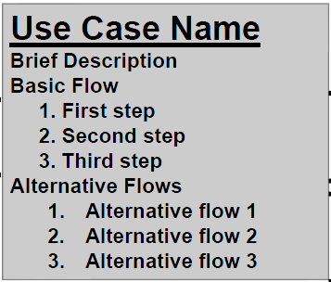
P1 (4/4)
 | 7 POINTS
!! | Should be about the ‘check in’ use case
+1 | The given format is followed
+1 | The actor is present in the flow
+2 | Description has a clear interaction user ↔ system The system offers lists to choose from Description is not only from user perspective. The text makes sense. Flows do not break before end of use case.
+1 | The use case description has a specific goal
+2 | The alternative flow is used as an alternative to come to same goal (flow is not an exception) Alternative flows do not break before end of use case / have `continue’ or ‘resume’
-1 | Missing name of the target use case / wrong, incomplete naming
Max -2 | Poor use case description
Max -2 | No alternative flow Wrong alternative flow (not leading to goal) / Exception instead of flow.

Slide 7
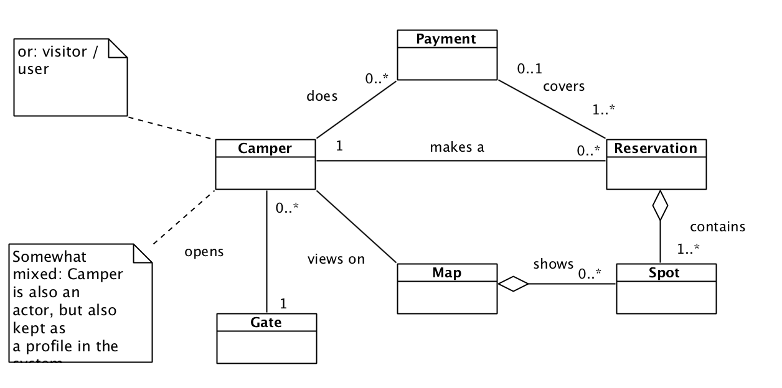
P2 (1/2)
Should have labels
Maybe inheritance is used to group points of interest -> good solution

Slide 8
P2 (2/2)
 | 15 points
!! | Diagram reflects the problem domain (not a software solution)
+8 | Diagram is expressed in more than 5 classes (2 points) 4 of the required classes (or alternative names): Camper/Visitor, Map, Spot, Reservation, Payment, Gate (4 points) Possible classes, that are probably somewhat out of scope but allowed when they make sense: Reception, (Smart)Phone, User, (Touch)Screen, Speaker, PC, Network/Internet, (other hardware could also be present) NOT: App, System, JavaSwing(or other sw libraries) Using compositions / aggregation (2 points) 1/2 POINTS if 5 or more software classes (or more than 50%) NO POINT if there are no Check In App concepts related classes at all
+2 | All relationships contain labels (not needed for inheritance) (+1 for some)
+2 | Application and proper use of multiplicity
+3 | Required a representation of list of Reservations or Spots (2) Should be expressed with multiplicity (1)
Max -2 | Use of inheritance instead of composition and vice versa Use of inheritance instead of aggregation and vice versa Use of composition stead of aggregation and vice versa
Max -3 | Wrong use / no use of composition / aggregation / inheritance (Max -2 for exactly the same situation)
Max -3 | Syntax errors
Max -2 | Use of SW class

Slide 9
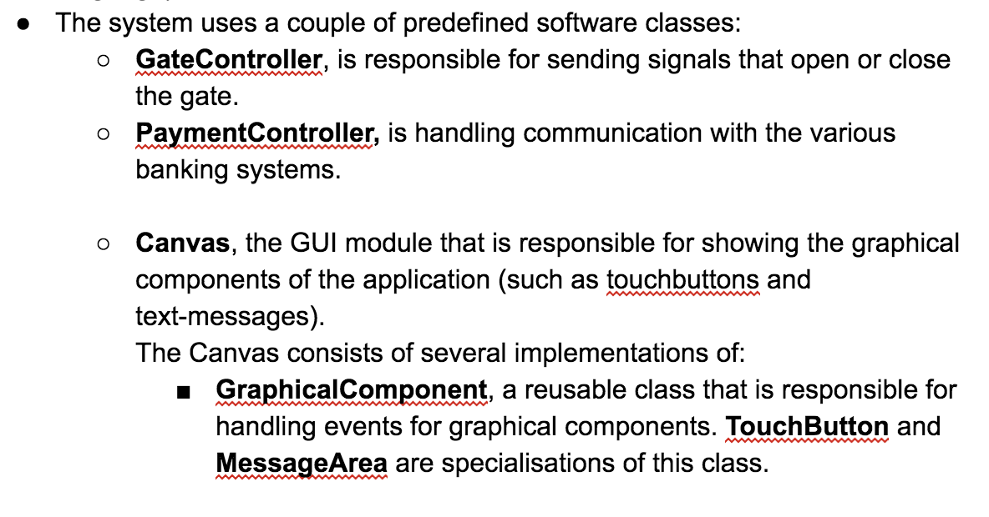
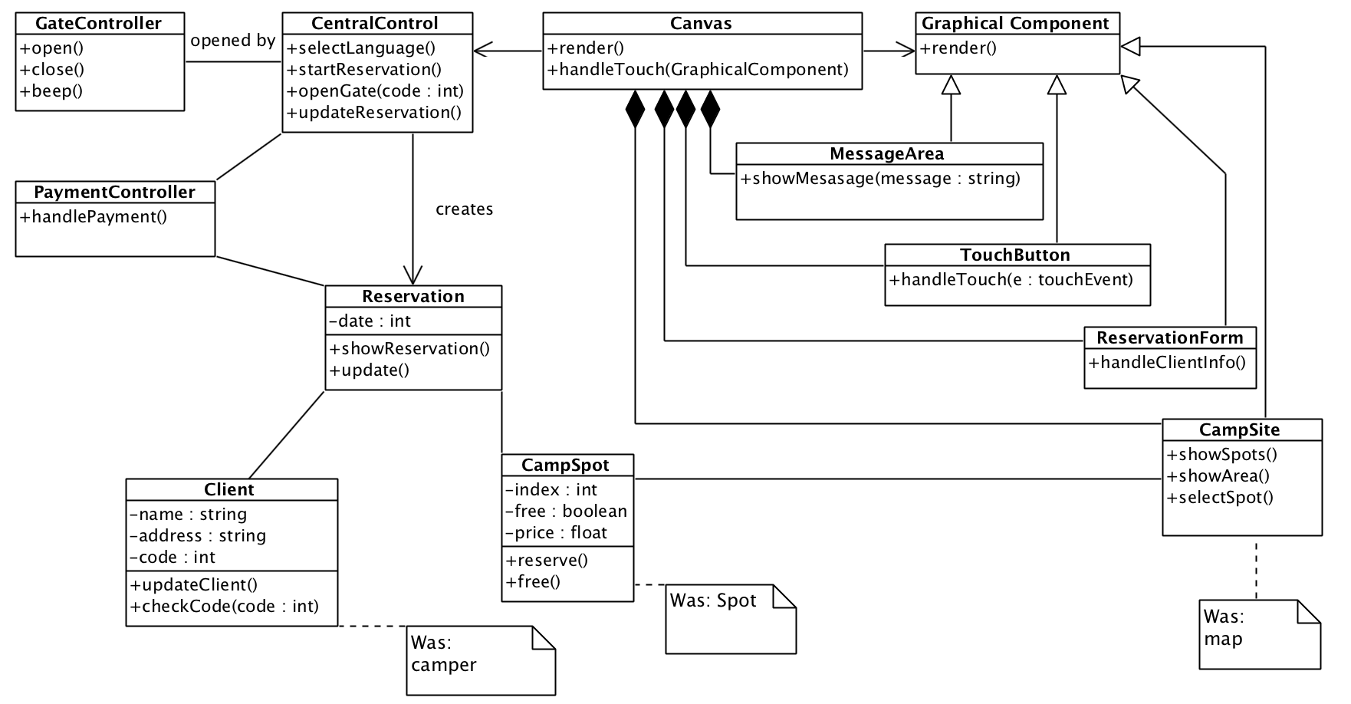
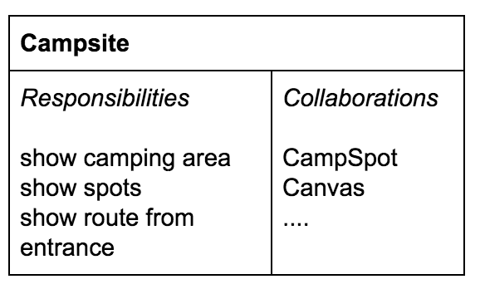
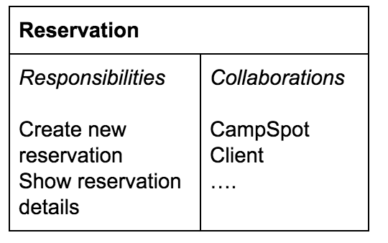
P3 (1/5)
Initial design class diagram

Slide 10
+3 | 5 of similar classes : CentralController, GateController, PaymentController, Client, Reservation, Canvas, GraphicalComponent, TouchButton, MessageArea
+1 | Inheritance is used for GUI components
+2 | Responsibilities are properly assigned.
+2 | Appropriate methods at least 4 of (or similar/extra): CentralController.selectlanguage() CenrralController.startReservation() TouchButton.handleTouch() Canvas.render() Canvas.handleTouch MessageArea.showMessage()
+2 | Reasonable attributes are used. At least 2 of: name, address, (pin)code, price, date
+1 | Association names (labels) are given to the associations.
+1 | Types are used (int, float etc.) private/public notation is used.
Max -4 | Wrong use of composition/aggr/inher. (Max -2 per similar case)
Max -2 | Syntax errors, missing association names, (missing multiplicities)
Max -4 | Wrong classes appear in diagram (functions instead of classes or concepts that are not there) Empty classes
Max -2 | Missing important methods / attributes
P3 (2/5)
12 points

Slide 11
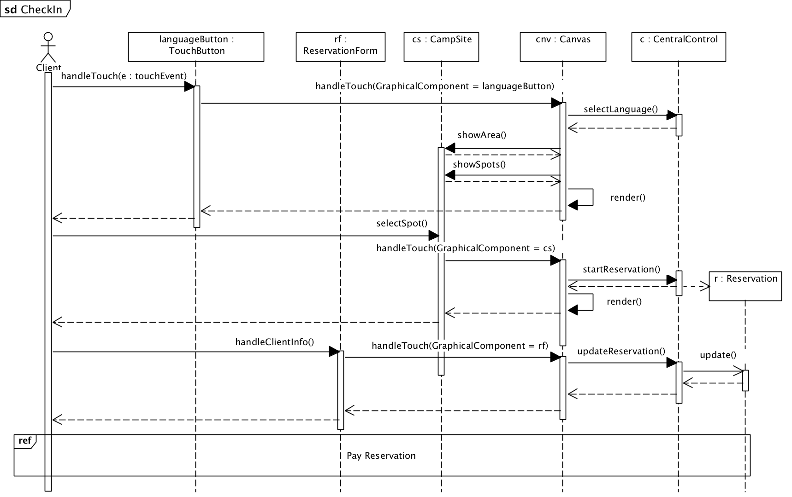
P3 (3/5)

Slide 12
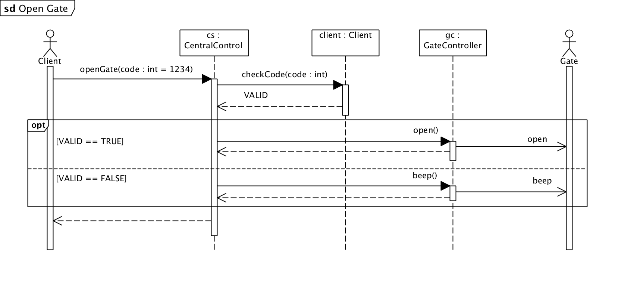
P3 (4/5)

Slide 13
P3 (5/5)
+4 | The Sequence Diagrams are a realization of the 2 use cases (Check In, Open Gate) Most objects are instances of the classes in problem 3 and the actors are actors in problem 1a. Most Methods and parameters are consistent with the methods in class diagram 3
(+2) | (Objects are used but the purpose/interaction of the use case is not clear or not consistent with other diagrams) [alternative for the row above]
+4 | Messages are sent and received by the proper sender/receiver and contain methods
-2 | Non logic message / receiver combination.
-2 | Wrong returns (to wrong sender).
Max -3 | Syntax errors (e.g. no ':' for object, no actor name, no actor symbol or <<actor>> stereotype)
Max -4 | Inconsistent parameter / or non existing methods
Max -2 | Objects are not instances of classes from 3a or missing an important object that should participate (Reservation or GateController for example).
8 points

Slide 14
P4
Architecture (6)
4 | The solution shows a clear architecture and uses dependencies / relationships. The solution consists of the Layers: UI - APP - DOMAIN - TECHNICAL (alternative names are allowed, but they should be clear) The answer consists of arguments for the choices that were made.
2 | The design principles are explained.
0 | No proper/clear diagram is used to explain the architecture. Only some loose concepts are written down with an unclear / inconsistent notation.
-2 | No classical layers are used for answering with a layered architecture.
-2 | No package symbols are used.
-1 (Max -2) | -1 for each wrongly placed class.
Max -2 | Syntax errors.
Pattern (4)
4 | The argument in the answer is related to performance and is valid

Slide 15
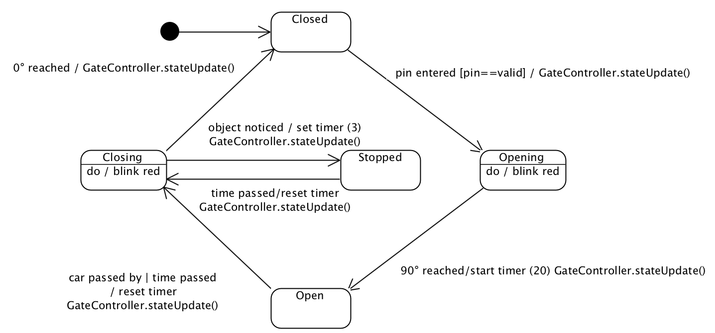
P5
no event / condition
action code
guard
Simple solution example. More states could be present in a student’s solution
Event or trigger / effect
state
Do activity
transition

Slide 16
P5
5 | Gives the following states, or alternative /similar names, for the perspective of a Gate object: STOPPED - CLOSED - OPENING - OPEN - CLOSING States are connected by a transition arrow Initial node used (pseudo state)
3 | The state diagram includes triggers, activities and effects/action code for all transitions necessary.
2 | It is clear how messages are sent (GateController.stateUpdate()) and attributes of the Gate object or other objects are changed.
Max -3 | syntax errors
-2 | Messages are not consistent with solution to 3a.
-1 | -1 For every non existing state/vague state name.
10

Slide 17
T1 Problem Domain and Solution Domain
Problem Domain:
The realm of the real world that consists of concepts and relations between them. The problem domain scopes a problem area. A domain model is used to describe ‘what the problem area is’.
Solution Domain
The realm of technical means to construct a solution for a problem.
Differences between PD and SD:
PD is declarative, describing ‘what’, SD is ‘constructive’ describing ‘how’

Slide 18
T1 Problem Domain and Solution Domain
Any answer that only uses terms from the question such as ‘the domain where the problem exists’, gets 3 points if it suggest some understanding of the concept of PD and DS otherwise 0 points.

Slide 19
T2 what is wrong with this taxomony?
The answer needs to include 3 argument of the following (types).
Each argument is worth 5 points
Not systematic
Because: overlapping, subjective
Some based on what they _are_, what they _do_, what they have _done_, what other people find of them (fabulous, look like flies)
Not hierarchical
Not verifiable properties
Mix of abstraction levels
Not abstract,
Not based on general properties
But on specific properties

